Slide 1
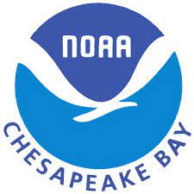
The Economic Impacts of Living Habitat Change in Virginia’s Middle Peninsula
Matt Woodstock, Amanda Bevans, Muhammad Sulyman, Scott Knoche, Tom Ihde
matthew.woodstock@morgan.edu
thomas.ihde@morgan.edu
Notes:
Hi everyone, my name is Matt Woodstock and I am a postdoc at Morgan State University. Today I’m going to present the results of our ongoing project focused on estimating the economic impact of oyster restoration and seagrass population changes in the Virginia Middle Peninsula

Slide 2
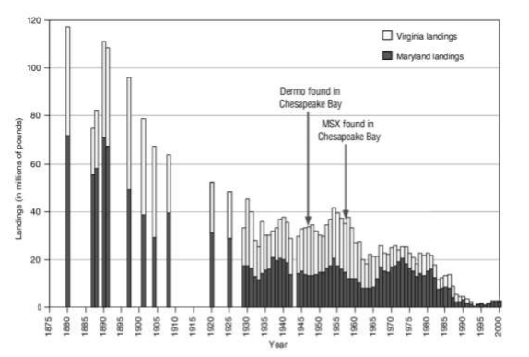
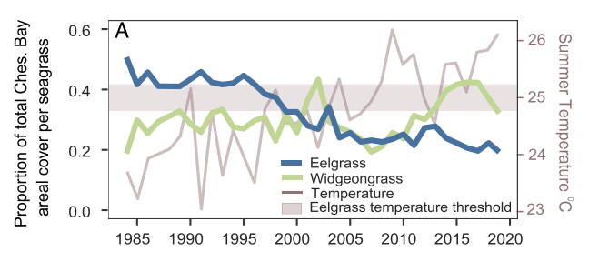
Living Habitats
Oyster Exploitation and Disease
Submerged Aquatic Vegetation (SAV)
120
VA Landings
VA
100
MD Landings
Dermo found
80
MSX found
60
Landings (millions of pounds)
40
20
0
1875
1900
1925
1950
1975
2000
Hensel et al. 2023
Adapted from US Army Corps 2012
Notes:
I probably do not need to say much about living habitats, but in the Chesapeake Bay, they are not at the population sizes that they once were. This plot shows the millions of pounds landed in the Bay on the y-axis, and year on the x-axis going back to 1875, and signals that overexploitation and disease has severely reduced fisheries harvests. It is believed that the population is at less than 1% of its historical abundance.
/next/
Eelgrass has been declining for decades in the Chesapeake Bay and is largely believed to be a problem of water quality, nutrient loading, and climate change. Shown here is the percent of area cover for Eelgrass and another seagrass species, Widgeon grass, on the left y-axis and summer temperature on the right y-axis. The main problem is that summer water temperature is either at or exceeds the Eelgrass temperature threshold, and this problem is getting worse. When Eelgrass vacates an area, widgeongrass moves in, but it is not as well-rooted, the blades are thinner, and it is more susceptible to poor water quality. In all, widgeongrass isn’t believed to serve the same ecological function as Eelgrass.

Slide 3
Virginia Middle Peninsula
Habitat Focus Area
Focused on Piankatank and York Rivers
Oyster restoration complete
Notes:
We are focused on the Virginia Middle Peninsula region that is highlighted in red. This is designated as a Habitat Focus Area, which means NOAA is committed to focusing its programs and investments to address the habitat issues in this region. The circled areas are the specific rivers that focused on: the York river denoted by the long circle in the southern edge of the Middle Peninsula, and the Piankatank River at the northern edge of the zone. I’ll note that we are only considering the saltwater portions of these rivers in our project.

Slide 4
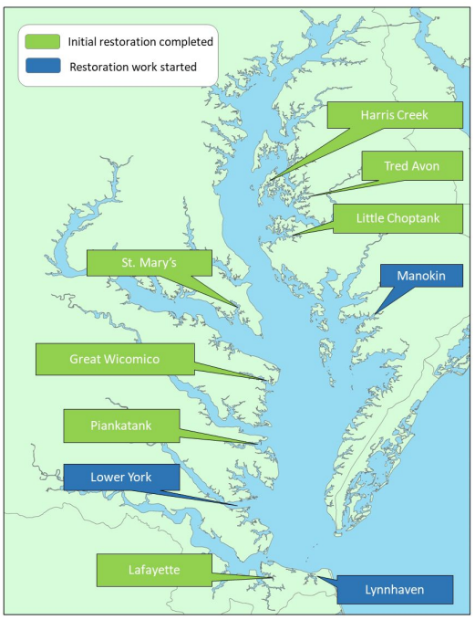
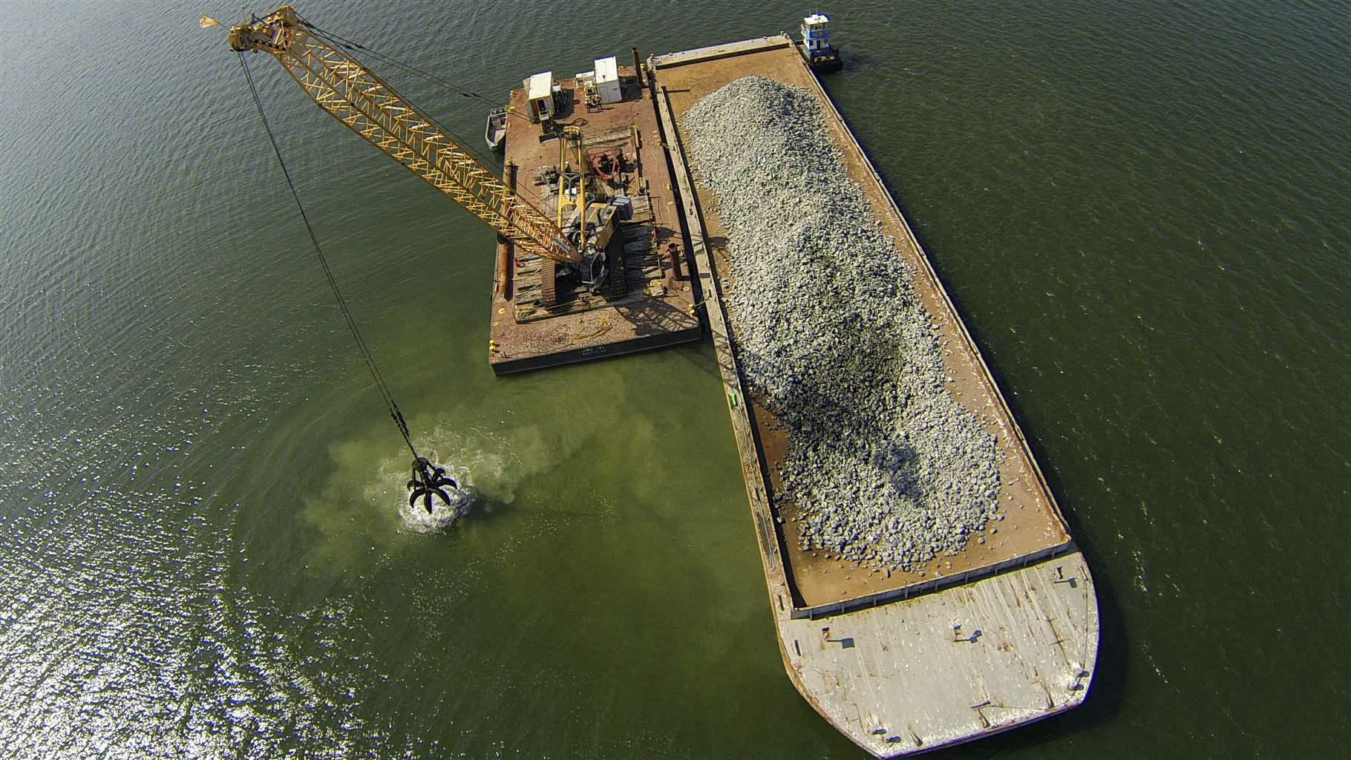
Oyster Restoration
$87 million spent Bay-wide on restoration through 2022
Now complete in the Lower York
Sustainable Fisheries Goal Implementation Team 2022
US Army Corps
Notes:
Both of those rivers had oyster restoration projects. Since this has been a large investment, we want to understand what the potential return on that investment could be. The image on the left shows that the restoration effort has been completed in the Piankatank River with an additional 50 acres added, and since this report was published, the effort is now complete in the lower York

Slide 5
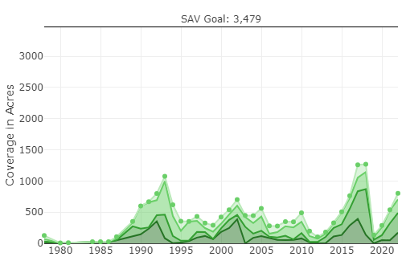
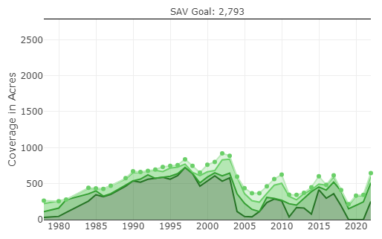
Submerged Aquatic Vegetation (SAV)
Piankatank River
Each river has SAV acreage goal
Maximum observed value in recorded history
Includes all SAV
Annual surveys conducted by VIMS Seagrass group
Many rivers far away from this goal
More Dense
Less Dense
York River
VIMS Seagrass Lab
Notes:
However, in both the Piankatank and York Rivers, submerged aquatic vegetation levels, which includes all seagrasses, is far lower than the current management goals. Both of these plots are showing trends in SAV coverage in covered acres broken into the density categories.
/next/
What I want to point out is the SAV management goal that was set as the maximum observed value in recorded history is essentially off the charts. The VIMS Seagrass group monitors this annually, and many rivers are not close to this goal, including the York and Piankatank.

Slide 6
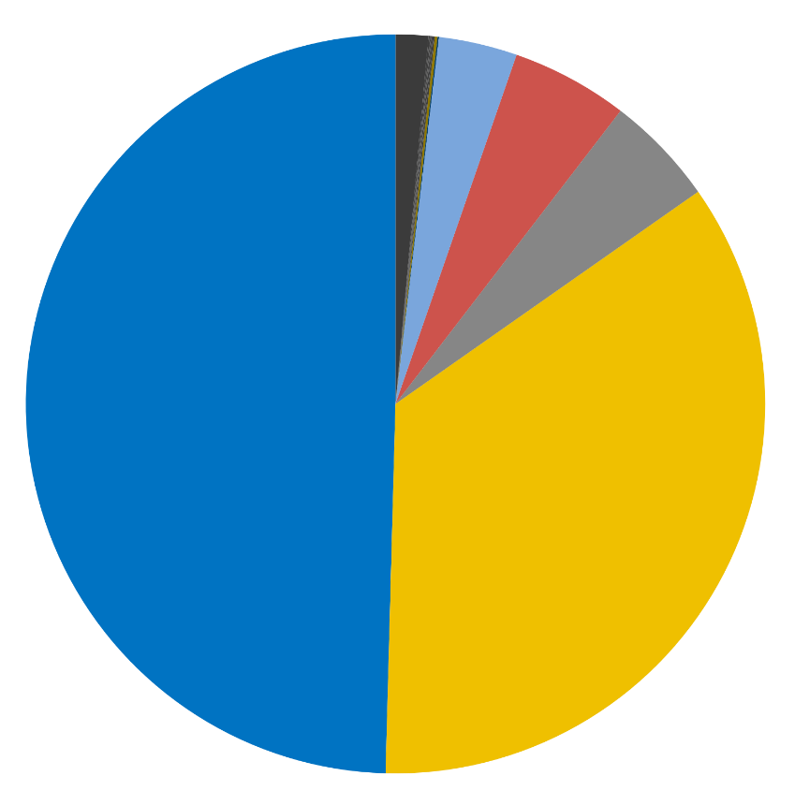
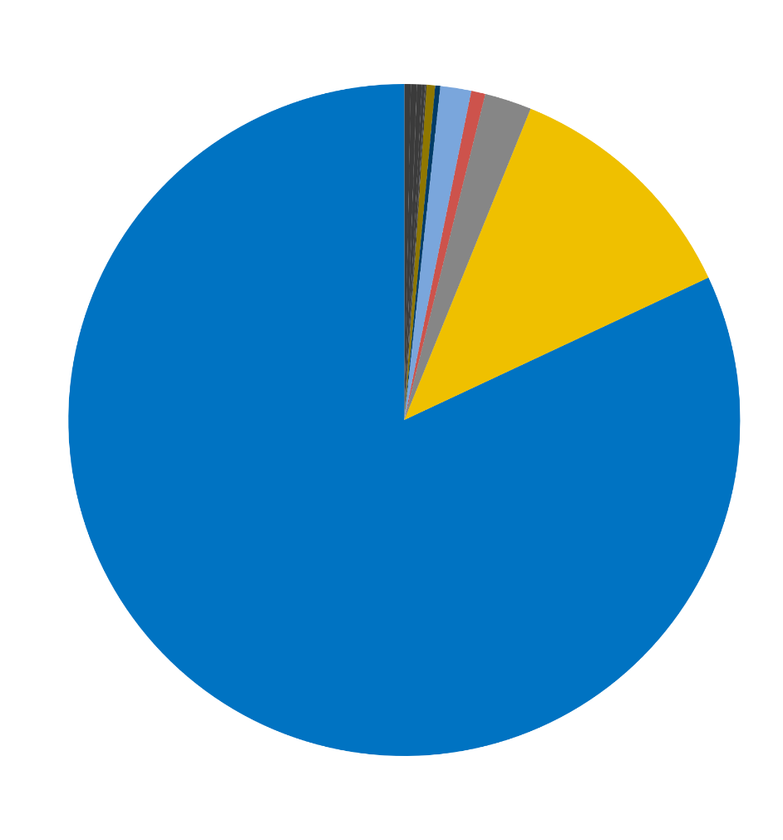
Commercial Fisheries
Proportion of Dockside Sales (2021)
York River
~$6 million dockside sales (2021)
Mostly Blue Crab
More Oyster harvest than Piankatank
$3.1M
$2.2M
Piankatank River
~$350k dockside sales (2021)
Mostly Blue Crab
$42K
$289K
*Aquaculture Not Included
Virginia Marine Resources Commission
Notes:
These rivers both have commercial fishing operations that target species known to either associate with living habitats or consume preys that do. The York River is larger and also has far more fisheries harvest, amounting to around $6 million dollars in annual dockside sales, opposed to the Piankatank River, which is near $350 thousand of sales. For both rivers, Blue Crab is the dominate commercial resource, making the majority of the annual dockside sales in each river, while wild oyster harvest is another lucrative resource. It is important to note that this does not include Aquaculture because our focus was the effect of changes to the wild population. One of our objectives is to predict how these harvest values many change with continued changes to those living habitats.

Slide 7
Project Objectives
1. Develop two ecosystem models in the VA Middle Peninsula
2. Interview watermen
3. Apply ecosystem model output and interview data to an economic model
Overarching Project Goal: Estimate the ecological and economic impacts of Oyster Eelgrass population changes
Notes:
So our project as a whole has three main objectives. The first was to develop two different ecosystem models in the Middle Peninsula, one in each of the rivers I have mentioned. The second objective was to interview watermen from the region to understand more about their annual expenditures through a semi-structured interview process. Third is to combine the results of the first two objectives in an economic impact modeling effort to predict the regional economic impact that changes to living habitats may have for the commercial fishing industry. I’ll touch on our progress in all three of these today.

Slide 8
Ecopath with Ecosim
Allocation of Energy:
Ecopath
Static system (starting point)
Mass-balanced
Data Requirements:
Biomass sizes
Mortality Rates
Consumption Rates
Diets
Fisheries Landings
Predation Mortality
Fishing Mortality
Other Mortality
Unassimilated Energy
Migration
Respiration
Consumption = Mortality + Net Migration + Respiration + Unassimilated Food
Notes:
We used a modeling software called Ecopath with Ecosim, which takes a mass-balanced approach to calculate energy flows throughout the food-web. Imagine the schematic on the right is the amount of energy that a population will consume on an annual basis and there is one of these for each functional group. All of that energy is then allocated to some process, making this a mass-balanced approach. So, we are basically able to track energy and then its effect on population trends. These models require a lot of data regarding population sizes, energetic rates, diets, and fisheries harvests which we acquired from literature, publicly accessible databases, and collaborations with other researchers. This process ends with a static representation of our system, or a food web, which served as a starting point for our simulations.

Slide 9
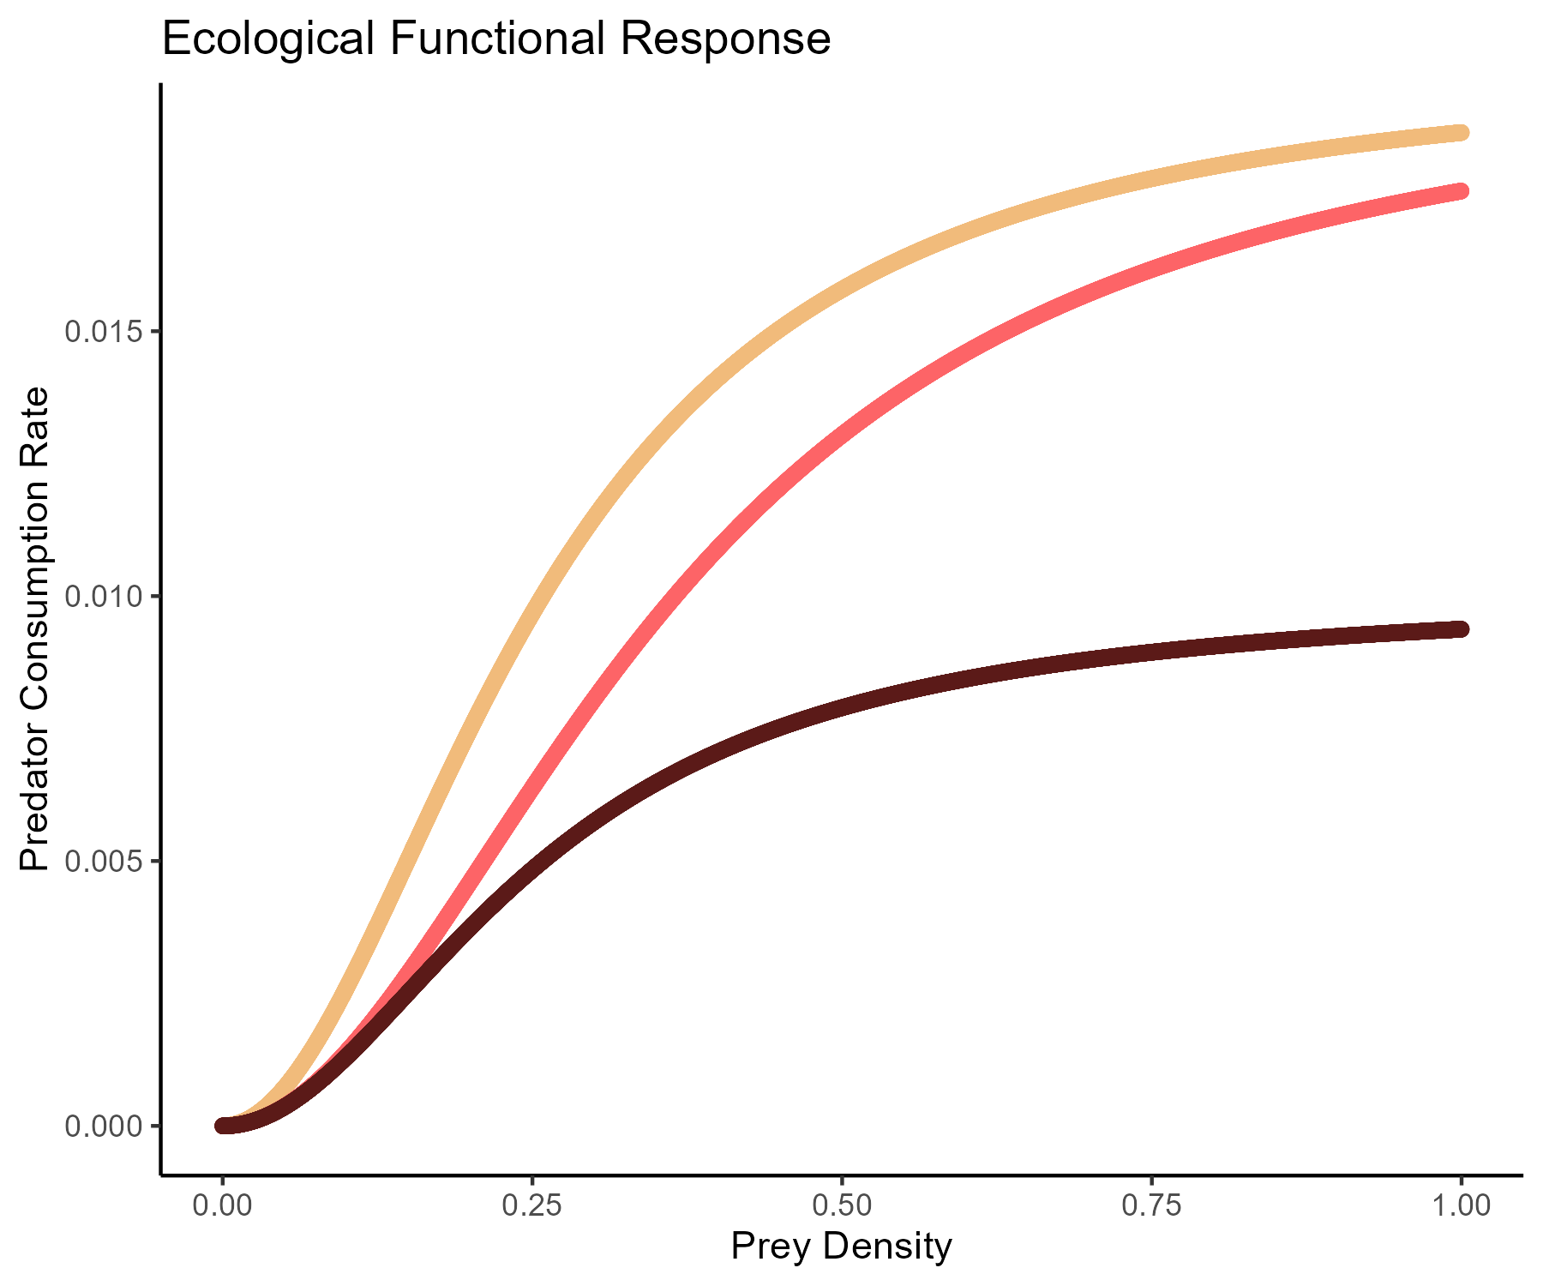
Ecopath with Ecosim
Ahrens et al. 2012
Ecosim
Foraging Arena Theory
Creates nonlinear dynamics
Functional Response Curves
Predator efficiency changes in response to prey density
Requires calibration
Predator 1
Predator 2
Predator Efficiency
Predator 3
Prey Density
Adapted from Holling 1965
Notes:
We then incorporated time. The way Ecosim does this is that uses foraging arena theory, which is the concept that for a given predator/prey interaction, there are a proportion of prey that are unavailable to predation. Examples of this are in the top right schematic, where prey may be in the middle of a school as opposed to the fringes, or they may be hiding in rubble. Mechanistically, this creates nonlinear dynamics and allows for the classic ecological functional response curves where predator efficiency changes as a non-linear function of prey density, with limits to that efficiency and limiting factors associated with learning and handling time. We also underwent a calibration step with these models so that these functional response curves could be customized for each predator.

Slide 10
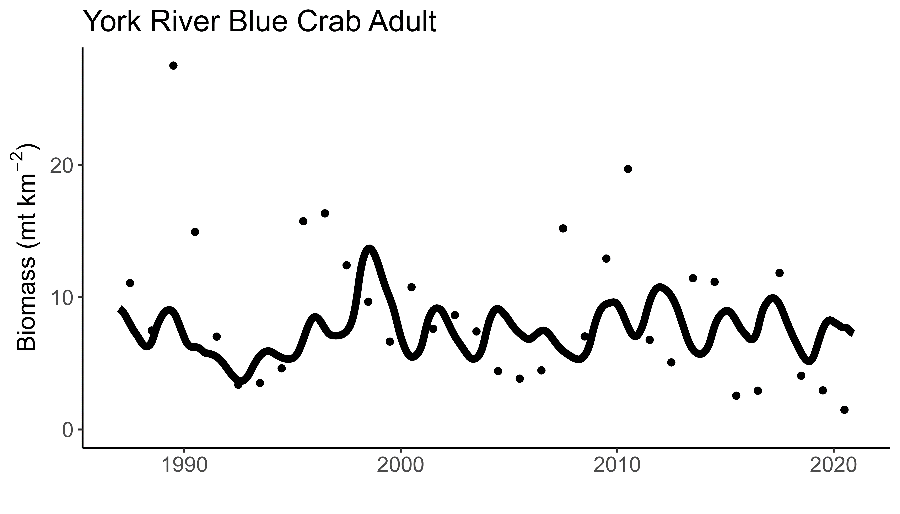
Model Calibration
Develop time series
Abundance indices from VIMS trawl survey (1988–2021)
n = 14 per tributary
Incorporate seasonal environmental factors
Temperature, Salinity, DO, CHLa
Fit model to time series
Adjust Ecosim parameters to simulate ecosystem processes
Observational data
Struggles to hit extremes
Model output
Observational data derived from VIMS Juvenile Trawl Survey
Tributary-Specific Relative Abundance Time Series
American Eel
Atlantic Croaker
Atlantic Menhaden
Bay Anchovy
Blue Crab*
Gizzard Shad
Spot
Striped Bass*
Summer Flounder
White Perch
* = Multiple Age Classes
Notes:
And for this calibration step used historical time series to try and get the model to be able to simulate realistic responses to population trends. Our models were informed by relative abundance indices from the VIMS juvenile trawl survey, which dated back to the 1980s. We then applied seasonal trends in several environmental factors, and finally fit the models to a point where we had confidence that they were responding to the internal food-web processes that they should be. On the right is an example of this calibration, which was a hindcast, for the York River Blue Crab adult population size.
/next/
I want to address that Ecopath models will typically struggle to fit to extreme values in a time series, and this is largely because we cannot incorporate any effects on our populations that may be occurring outside of our system.

Slide 11
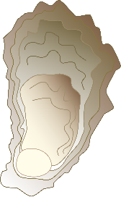
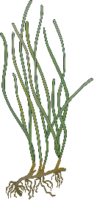
Nine Scenarios
Oysters Only
Oyster Scenarios
Increase = 4.7% annually
Post-restoration field surveys
Constant = stay at post-restoration
Decrease = back to pre-restoration
Eelgrass Scenarios
Increase = to management goal
Constant = stay at current level
Decrease = ~2% annually
Hensel et al. 2023
Widgeongrass has opposite trend
1)
2)
3)
Eelgrass Only
4)
5)
6)
Combined Scenarios
7)
8)
9)
Notes:
Once we have that, we can apply scenarios. Three of our scenarios focused solely on changes to oyster populations. One scenario simulated our post-restoration system plus additional reef growth of 4.7% annually, which was informed by post-restoration monitoring efforts in other restored rivers. We also had a simulation where oyster populations stayed at their post-restoration state with no growth, somewhat as a control. Finally, we simulated how the system would change if oyster restoration did not happen.
/next/
We then simulated Eelgrass population scenarios showing increased, constant, and decreased Eelgrass population trends. Since there is a known inverse relationship between Eelgrass and Widgeongrass, when Eelgrass decreased in a scenario, Widgeon increased, and vise versa. Ecopath is mostly adept at simulated food-web processes, so we needed to also include the non-consumptive effects that these habitats will have animals that associate with these habitats for other reasons, like space for settling. For species known to rely on these habitats for non-consumptive reasons, we also changed their biomass according to their habitats so we could truly get the ecosystem-level effect.
/next/
Finally, we ran three scenarios where we combined oyster and eelgrass population changes. These included scenarios where both oysters and eelgrass increased, one where both oyster and eelgrass decreased, and then a third where oysters increased and eelgrass decreased, which is the anticipated current situation. We ran each scenario for 20 years.

Slide 12
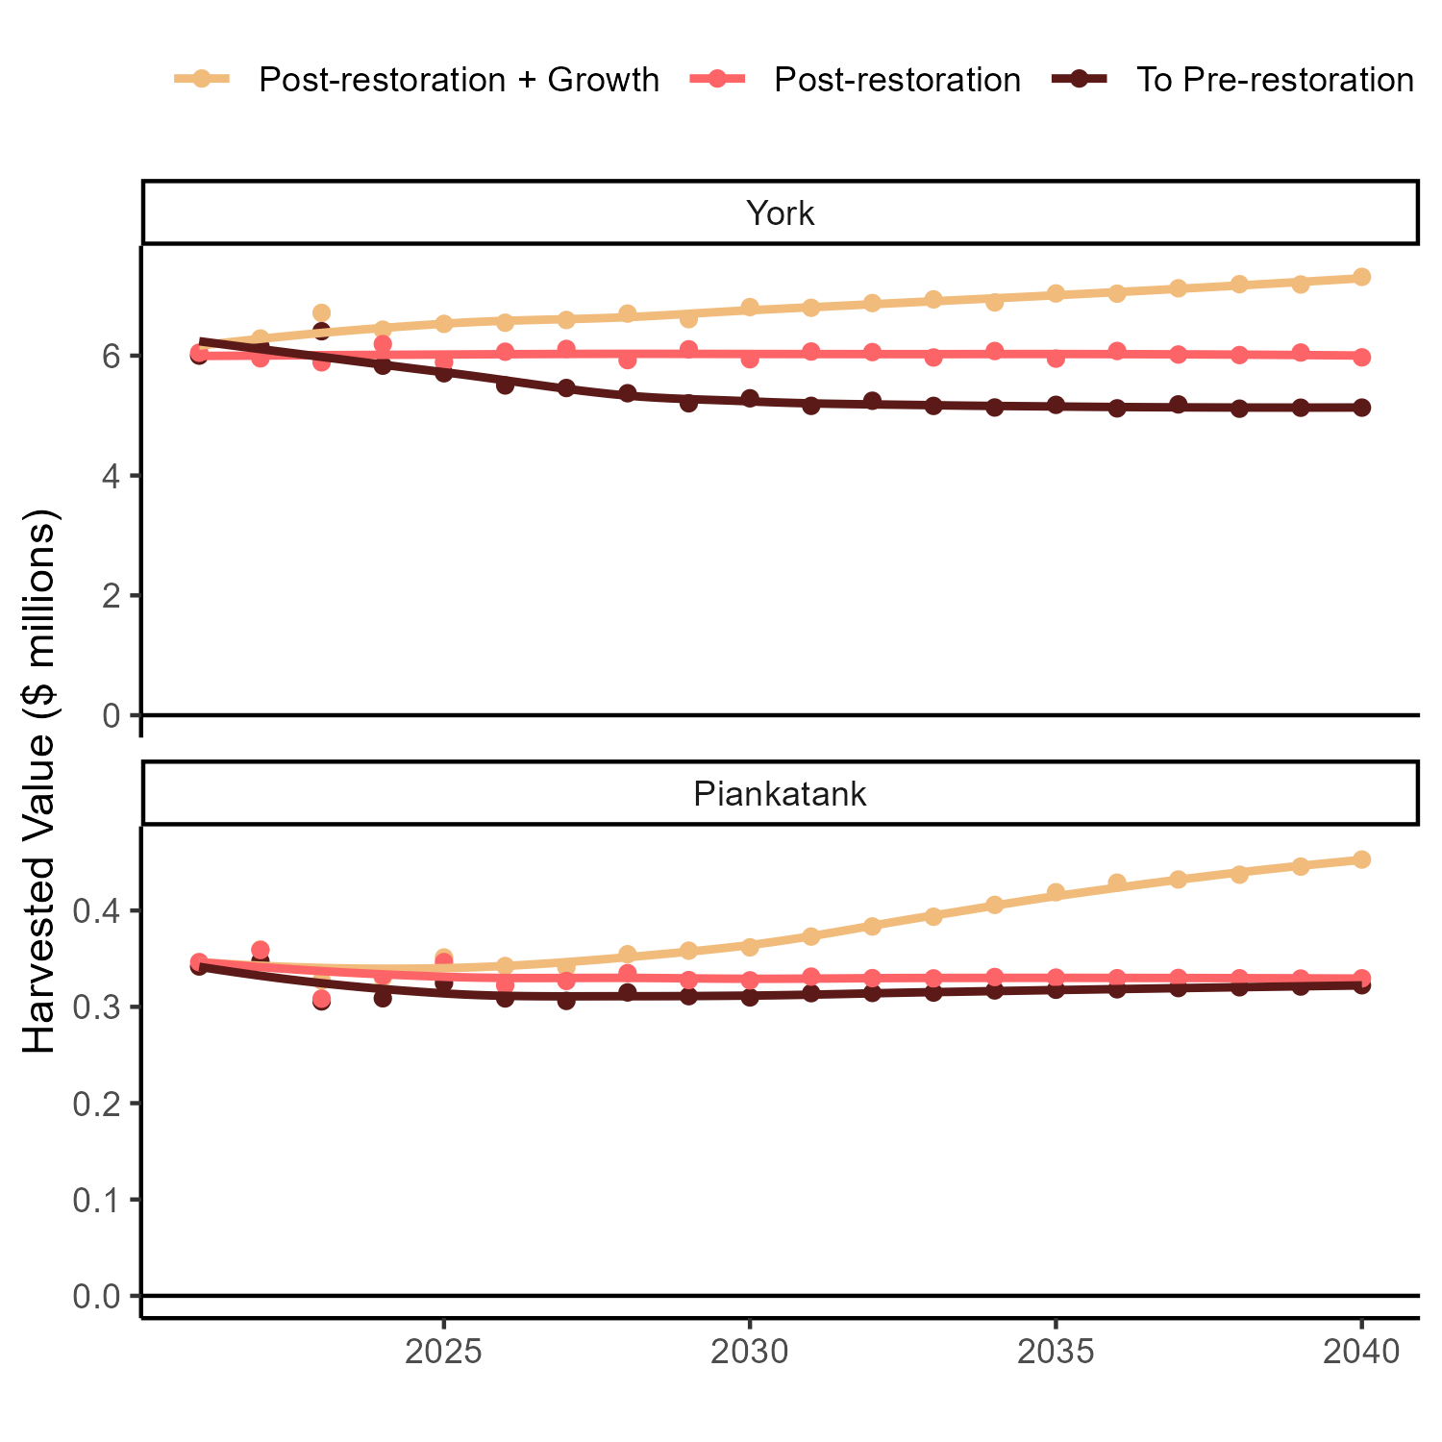
Oyster Only Scenarios
More Oysters = More Value
York:
More Habitat: $1.3M yr⁻¹ increase
Less Habitat: $0.8M yr⁻¹ decrease
Piankatank:
More Habitat: $123K yr⁻¹ increase
Less Habitat: $7K yr⁻¹ decrease
Notes:
We get a lot of ecological results from these models, but I’m going to solely focus on the economic-focused results, mainly changes in annual dockside sales with time in both rivers. In all plots, the brighter yellow line will represent the optimistic scenario where living habitat populations increase, the pink line will represent the scenario where habitats didn’t change, and the maroon line will represent the pessimistic scenario with the worst habitat situation. Note the y-axis is dockside sales in millions of dollars, and the York River amounts are an order of magnitude greater than the Piankatank. In both systems, more oysters means more annual harvest, while less oysters means less dockside sales, but this difference has a greater magnitude change in the York. I’ll also add that we’re currently working on sensitivity analyses

Slide 13
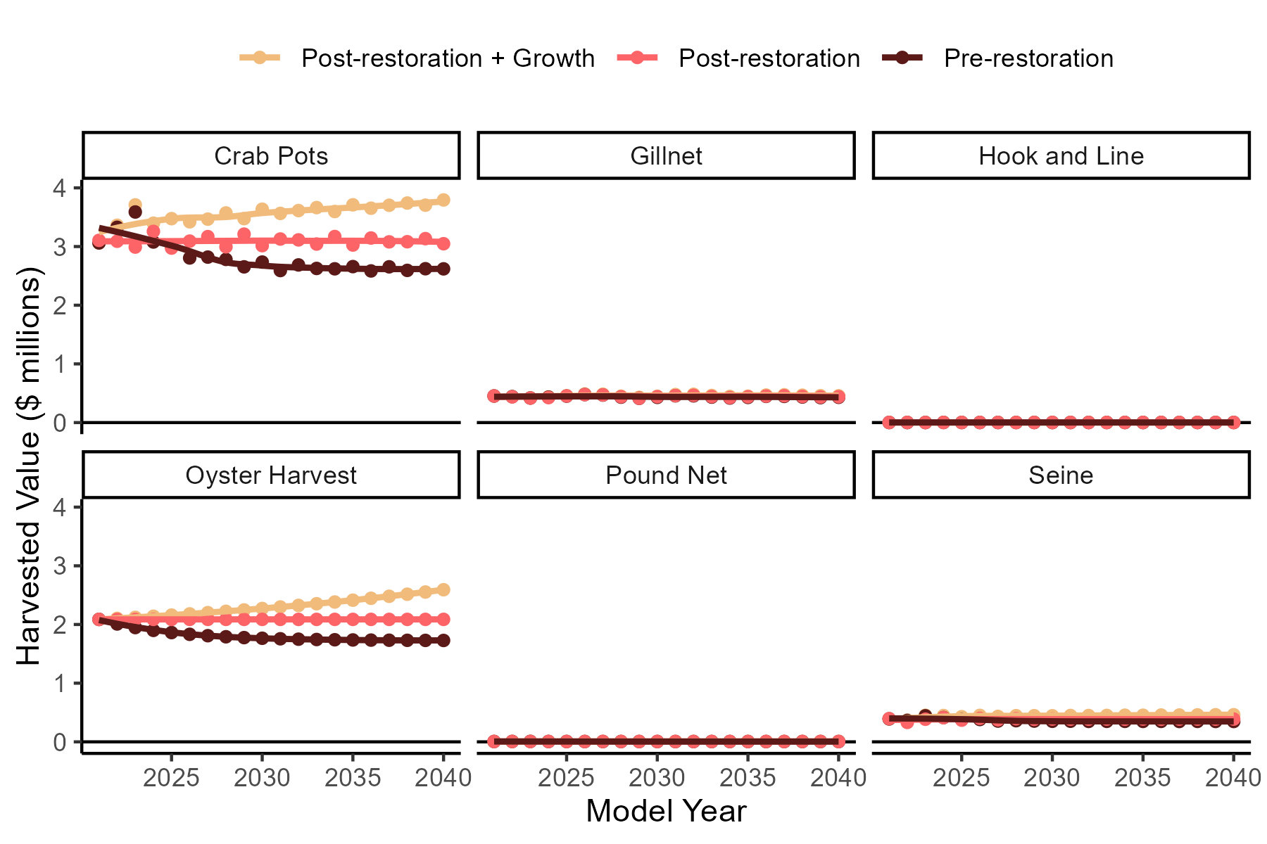
York: Oyster Only Scenarios
More Oysters =
Increased Blue Crab & Oyster harvest
Crab pots:
More Habitat: $746K yr⁻¹ increase
Less Habitat: $428K yr⁻¹ decrease
Notes:
To break this down by gear type in the York River, this trend is largely driven by changes in blue crab pots and oyster harvest. More oyster harvest is largely an artifact of the model since we are telling the model that the oyster population is changing, but with that continued reef growth post restoration, we see an increase in Blue Crab harvest in the York river by ¾ of a million dollars annually.

Slide 14
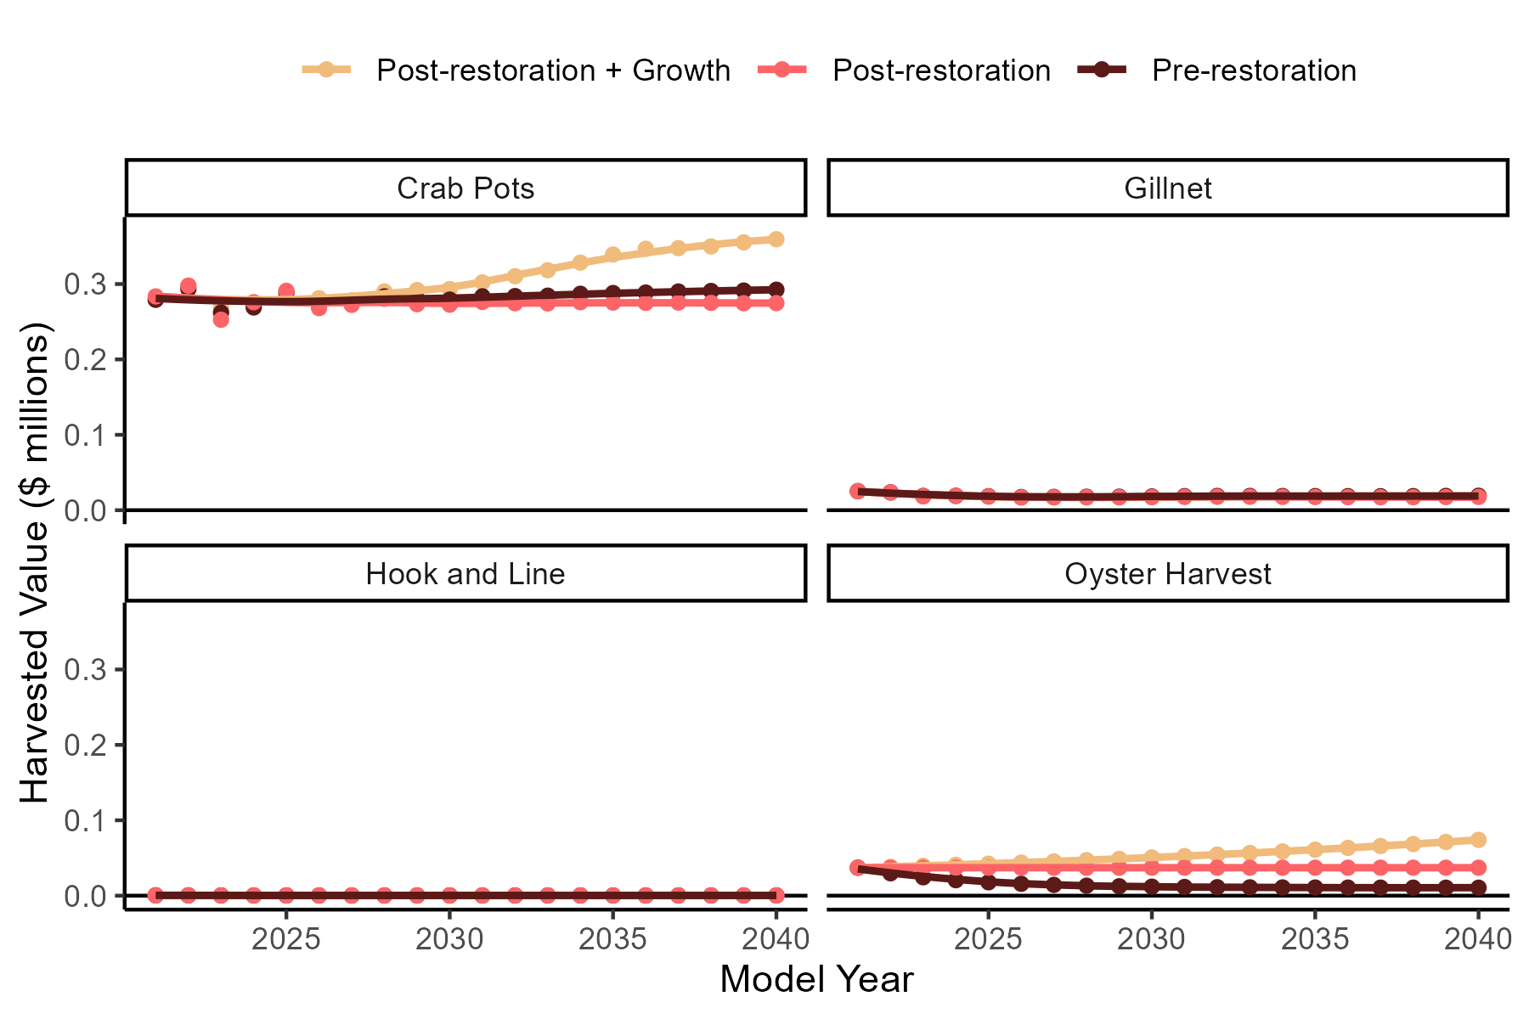
Piankatank: Oyster Only Scenarios
More Oysters =
Increased Blue Crab & Oyster harvest
Crab pots:
More Habitat: $84K yr⁻¹ increase
Less Habitat: < $20K yr⁻¹ difference
Notes:
In the Piankatank River, there is less going on from a commercial fisheries perspective, so we have two less gears. Nevertheless, crab pots and oysters are the main fisheries, and changes in those harvests are driving changes in the total harvest for the system. One weird result is we see a small increase in Blue Crab harvest in the pre-restoration oyster scenario relative to the current oyster population, and this is driven by a small increase in Blue Crab biomass in that pre-restoration scenario.

Slide 15
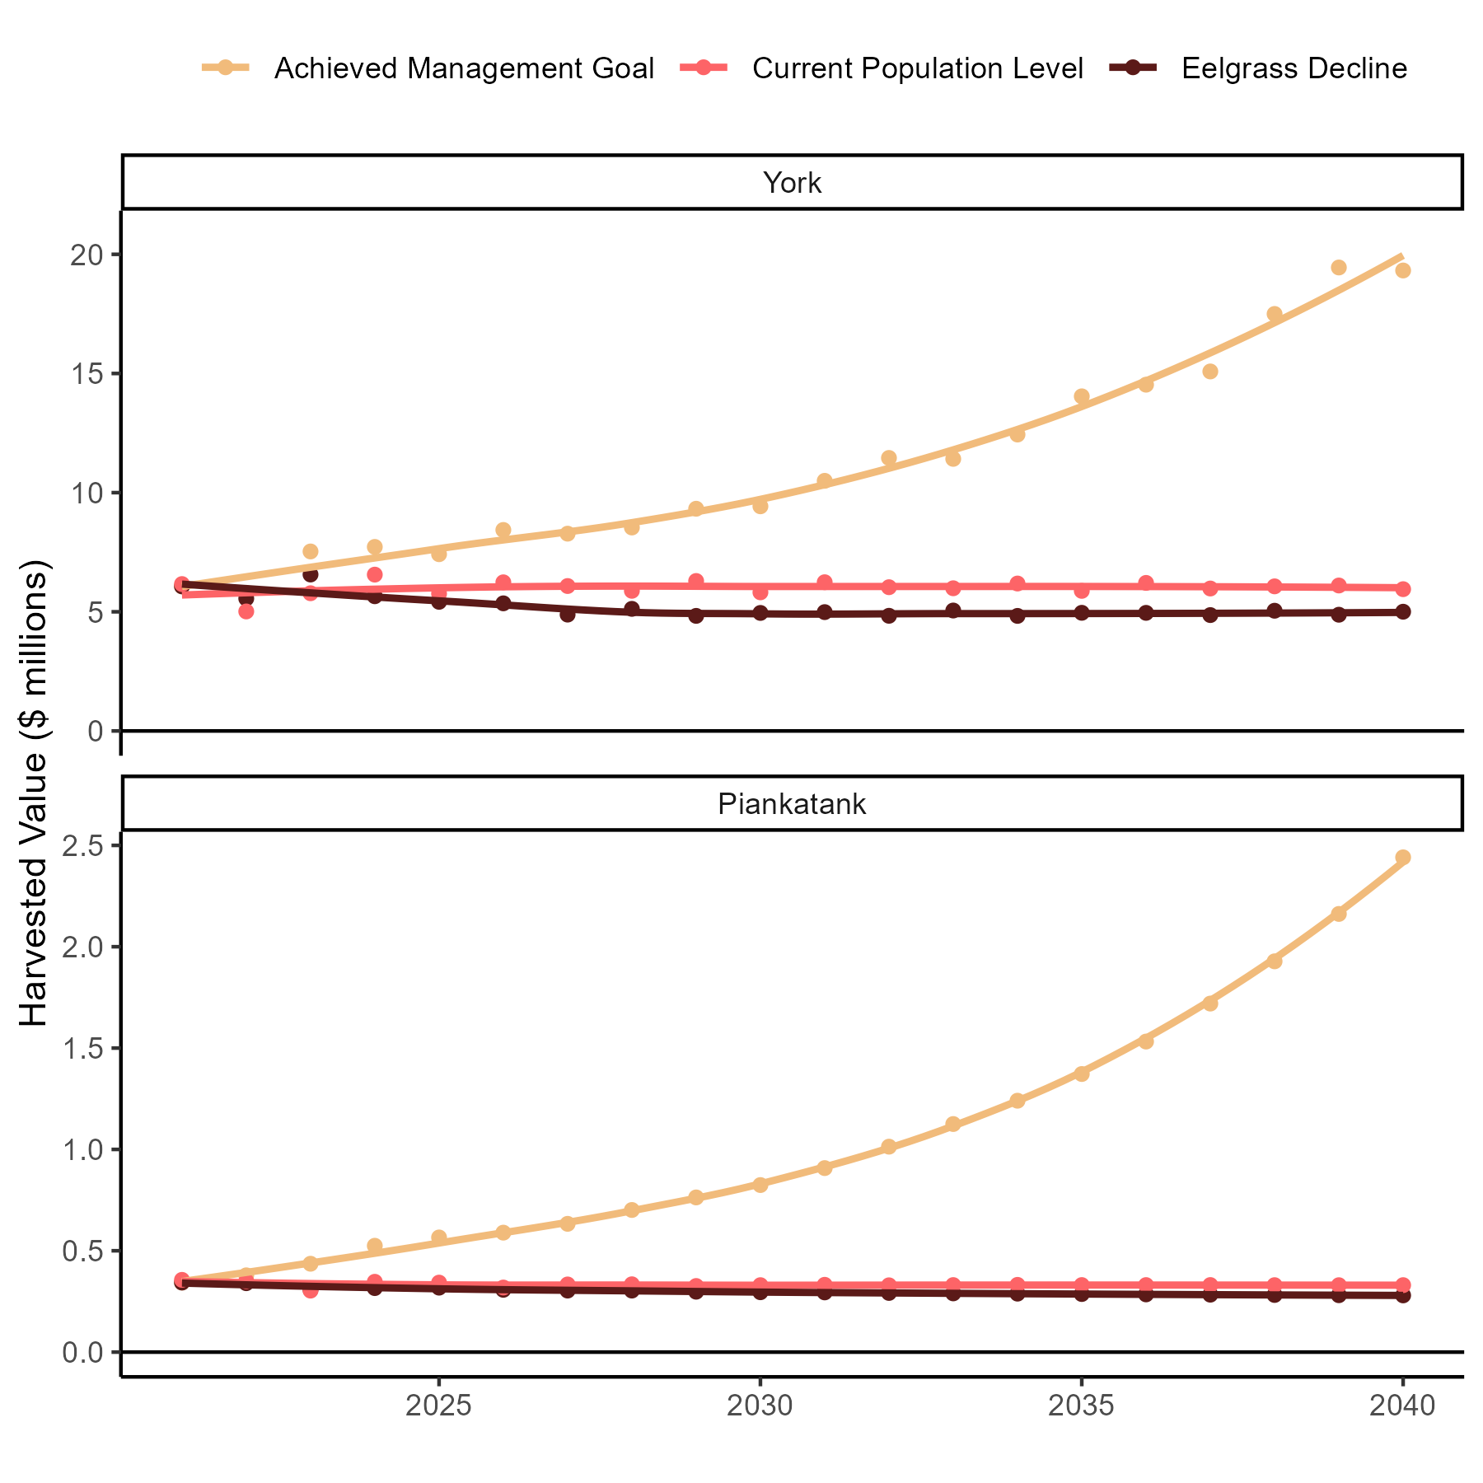
Eelgrass Only Scenarios
More Eelgrass = More Value
York:
More Habitat: $13M yr⁻¹ increase
Less Habitat: $946K yr⁻¹ decrease
Piankatank:
More Habitat: $2.1M yr⁻¹ increase
Less Habitat: $5K yr⁻¹ decrease
Notes:
Looking at the Eelgrass only scenarios, we see a similar trend where more habitat means more dockside sales. Now I want to address this massive increase in harvest when Eelgrass reaches the management goal. This is basically simulating the “What if” scenario, if we were able to restore Eelgrass populations to that management goal that we are very far away from with the current Eelgrass species or another with a similar ecological function. But our results suggest that if that effort is feasible, it could result in a different and more productive Piankatank and York Rivers.

Slide 16
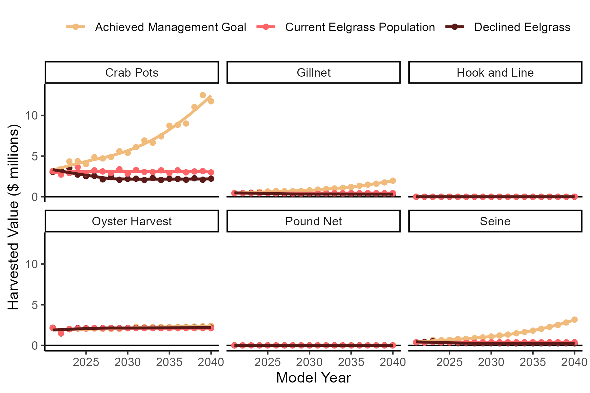
York: Eelgrass Only
More Eelgrass =
Increased Crab Pots, Gillnet & Seine
Crab pots:
More Habitat : $8.7M yr⁻¹ increase
Less Habitat: $763K yr⁻¹ decrease
Gillnet & Seine:
More Habitat : $4.3M yr⁻¹ increase
Less Habitat: $255K yr⁻¹ decrease
Notes:
As with oysters, increases to Eelgrass habitat leads to increases in Blue Crab harvest. Declines to Eelgrass at the current Bay-wide rate of 2% annually may result in $750K less in annual crab pot harvest after the twenty-year simulation. Gillnets and Seine harvest benefits a lot from increased Eelgrass as well, mainly because the species fished with those gears, particularly Striped Bass and Atlantic Croaker increased in biomass.

Slide 17
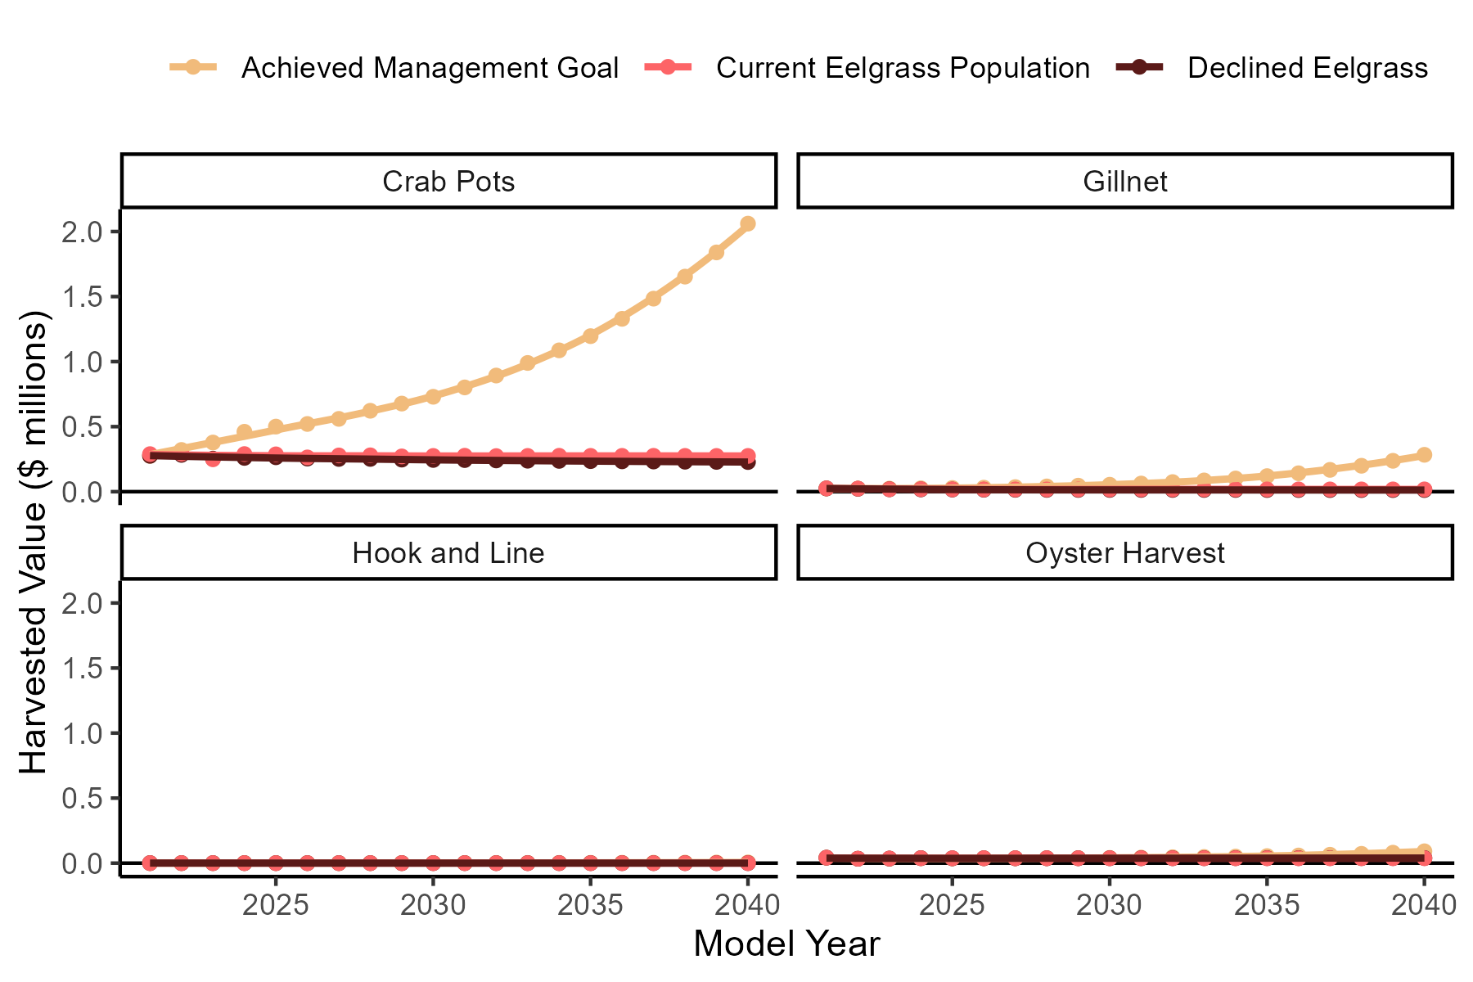
Piankatank: Eelgrass Only
More Eelgrass =
Increased Crab Pots & Gillnet
Crab pots:
More Habitat: $1.8M yr⁻¹ increase
Less Habitat: $47K yr⁻¹ decrease
Gillnet:
More Habitat: $266K yr⁻¹ increase
Less Habitat: $5K yr⁻¹ decrease
Notes:
In the Piankatank, we see a similar result in that gillnet harvest greatly benefits from increased Eelgrass and crab pots increase as well

Slide 18
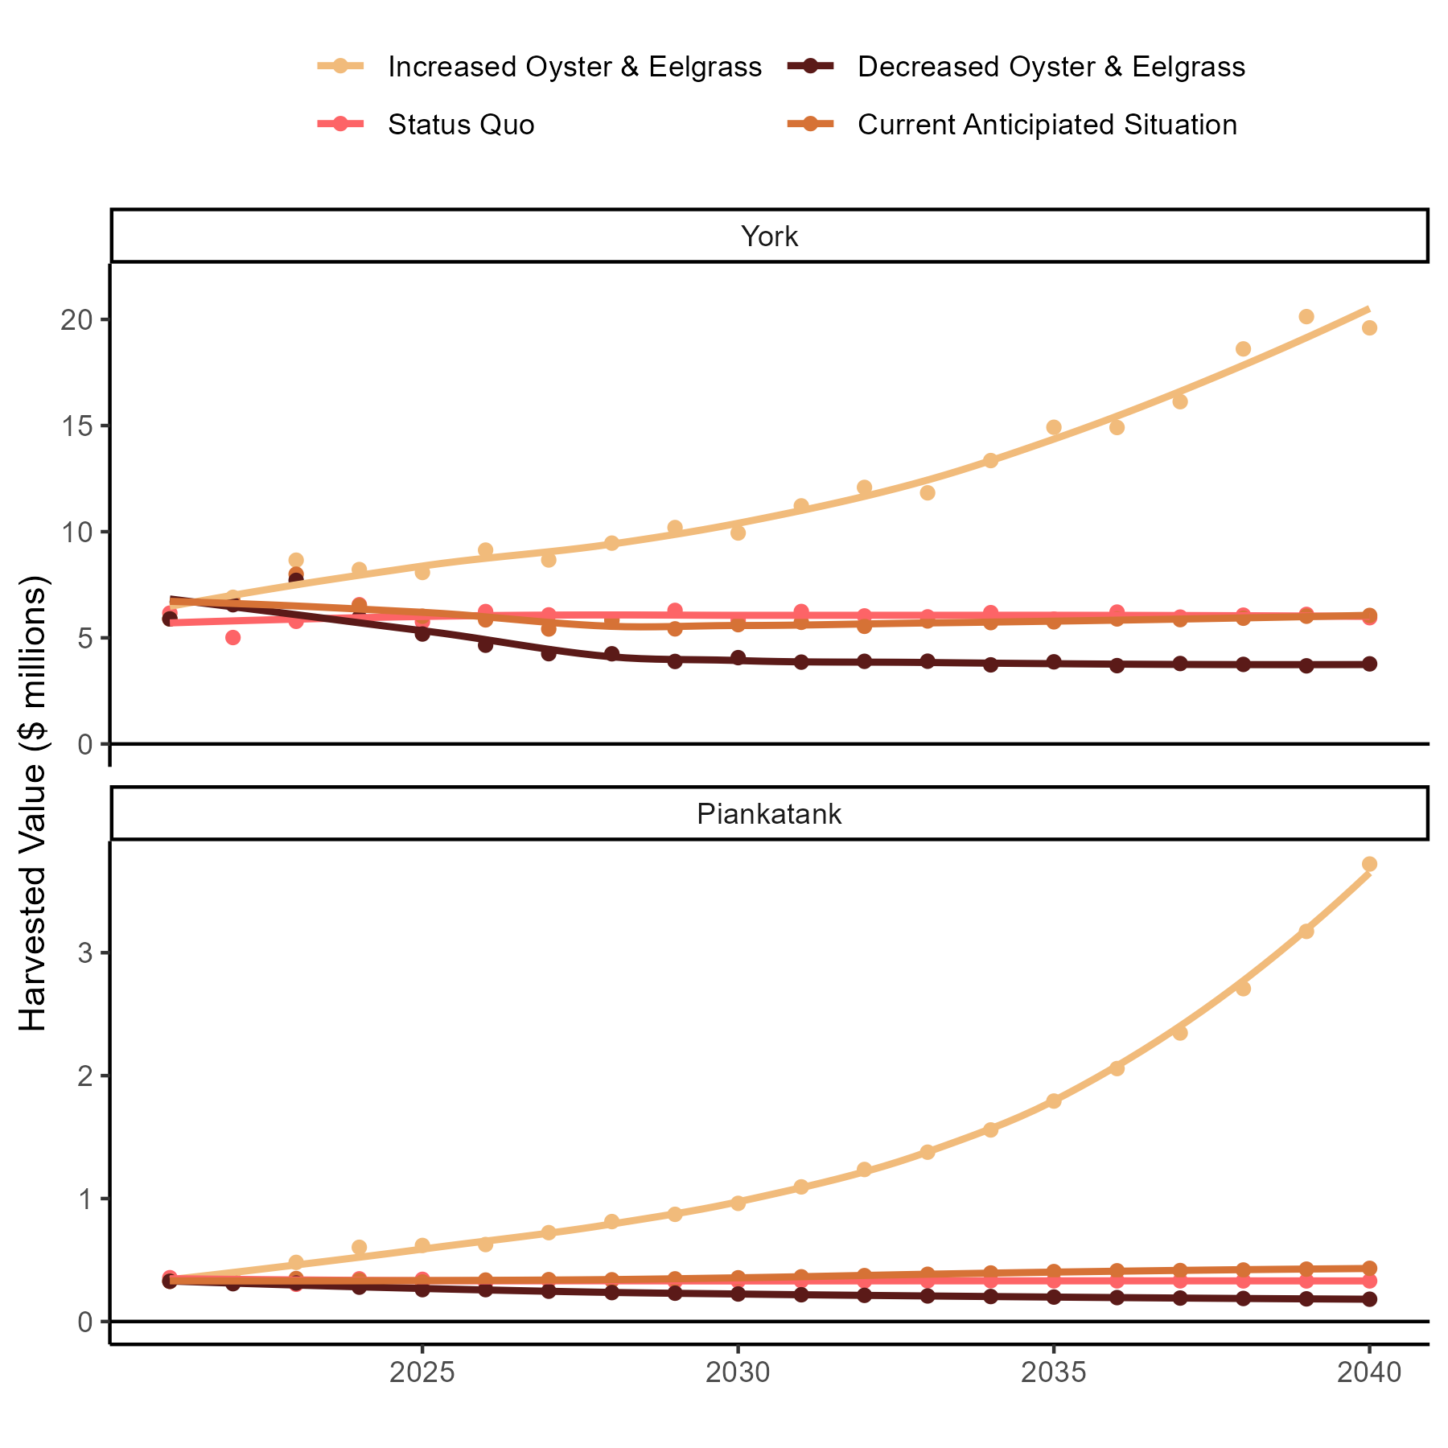
More Habitat Means More Dockside Sales
York
Eelgrass growth necessary for harvest increase
Piankatank
Increased Oysters = higher annual harvest
Eelgrass trends supplement or detract from harvest
Notes:
Nevertheless, looking at the combined scenarios more habitat means more annual harvest revenue. These models suggest that oyster restoration has a positive effect on the system and its harvest, and Eelgrass restoration would have a greater impact. Although in the York, continued Eelgrass decline negates the positive effect of oyster growth.

Slide 19
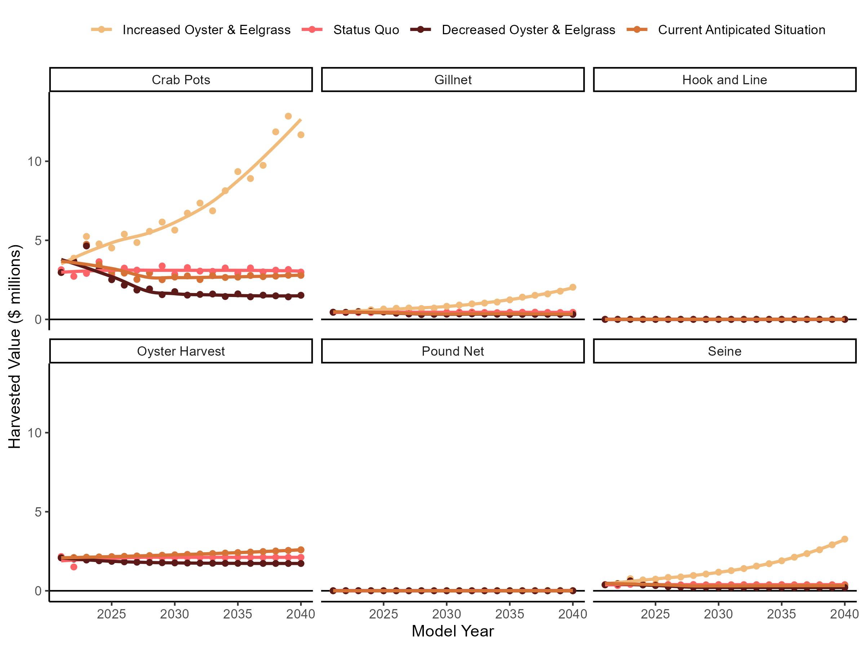
York: Harvest Trends
Annual Harvest trends follow biomass trends
Blue Crab pots ~ 50% harvest value
Total Industry Values:
Initial: $6.2M yr⁻¹
More Habitat: $19.6M yr⁻¹
Less Habitat: $3.8M yr⁻¹
Notes:
In total, the York River started at a dockside sales of around $6 million per year. Blue crabs, since they are the biggest share of the revenue have the biggest effect on the harvest revenue of the industry as a whole. The biggest change comes from the crab pot fishery since it has the largest share of the landed revenue. The most optimistic scenario leads to more than triple the harvest, where decreases to both oysters and eelgrass decreases harvest by about 40%.

Slide 20
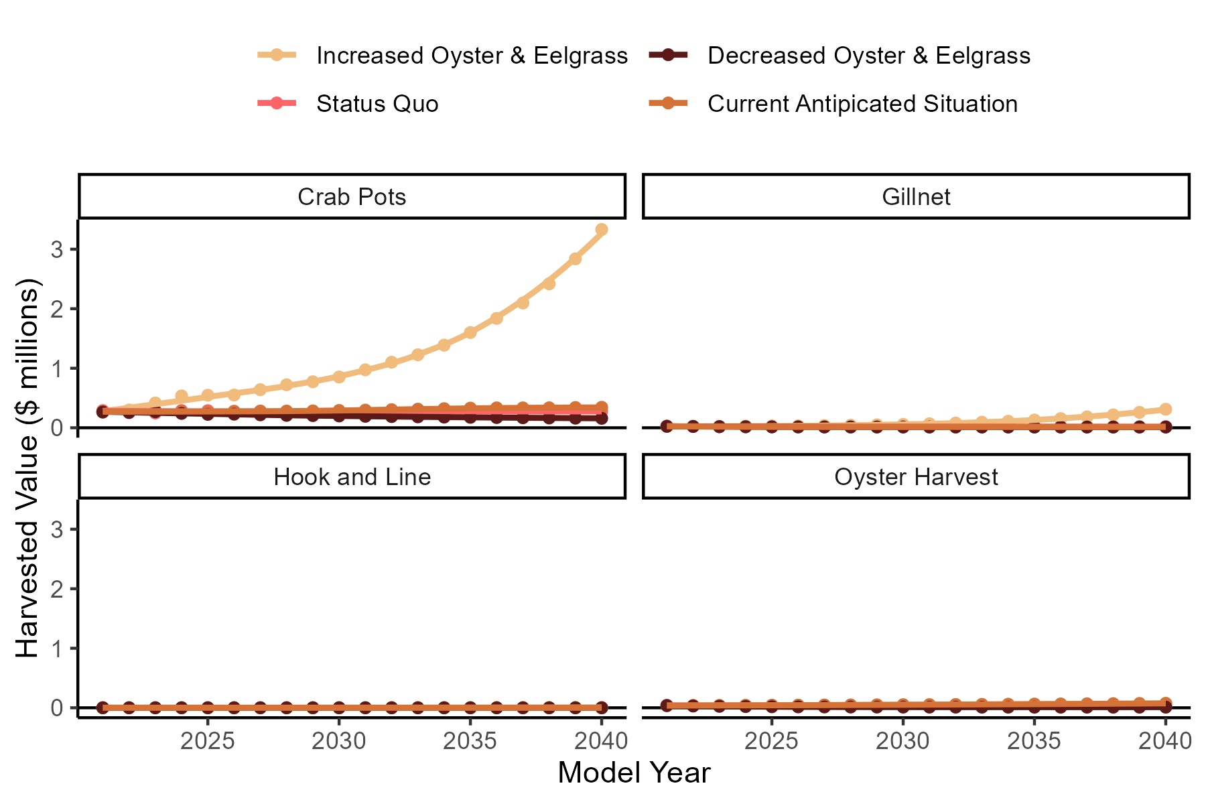
Piankatank: Harvest Trends
Annual Harvest trends follow biomass trends
Blue Crab pots > 70% harvest value
Total Industry Values:
Initial: $352K yr⁻¹
More Habitat: $3.7M yr⁻¹
Less Habitat: $181K yr⁻¹
Notes:
Showing the same results for the Piankatank River model, Blue Crabs are a greater proportion of the harvest, and the result is the same, Blue Crab trends are driving the overall harvest. Our models predict that in this system, when both habitats decline, the dockside sales decreases by about 50% annually, when it increases, the annual harvest value increases by an order of magnitude

Slide 21
Project Objectives
1. Develop two ecosystem models in the VA Middle Peninsula
2. Interview watermen
3. Apply ecosystem model output and interview data to an economic model
Overarching Project Goal: Estimate the ecological and economic impacts of Oyster Eelgrass population changes
Notes:
So aside from our harvest predictions, we had an effort to interview watermen about their annual expenditures for our larger economic impact analysis.

Slide 22
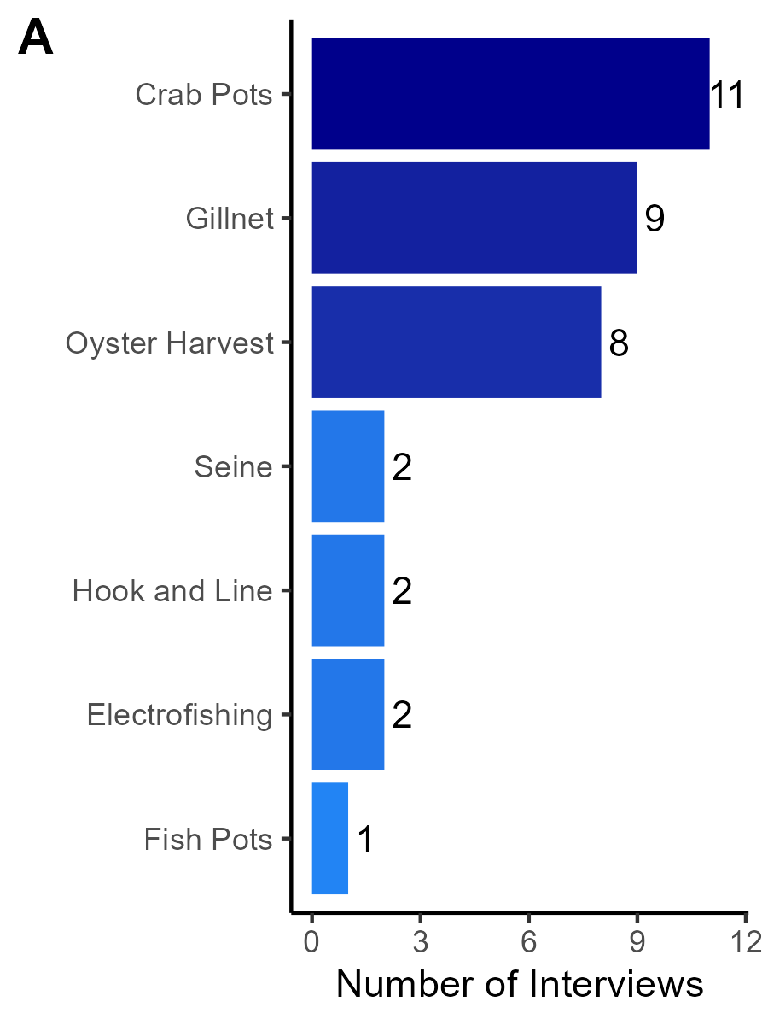
Watermen Interview Methods
Recruited through word of mouth and email
Amazon or Walmart Gift Card
Interviewed 19 watermen
Several watermen fished multiple gears
35 total interviews
Largest participation from crabbers, gillnetters, and oystermen
Notes:
In order to do this, we recruited watermen that work in and around the Middle Peninsula initially through word of mouth, but later through an email blast to commercial license holders. We did offer an incentive in the form of an Amazon or Walmart gift card. In total, I interviewed 19 watermen, and since many watermen in the region fish with multiple gears, this amounted to 35 total interviews, largely from crabbers, oystermen, and gillnetters, which you would expect.
/next/
I did also do a few interviews with electrofishers and one eel pot watermen. These aren’t in our models, but I did the interviews anyway and we have at least some data.

Slide 23
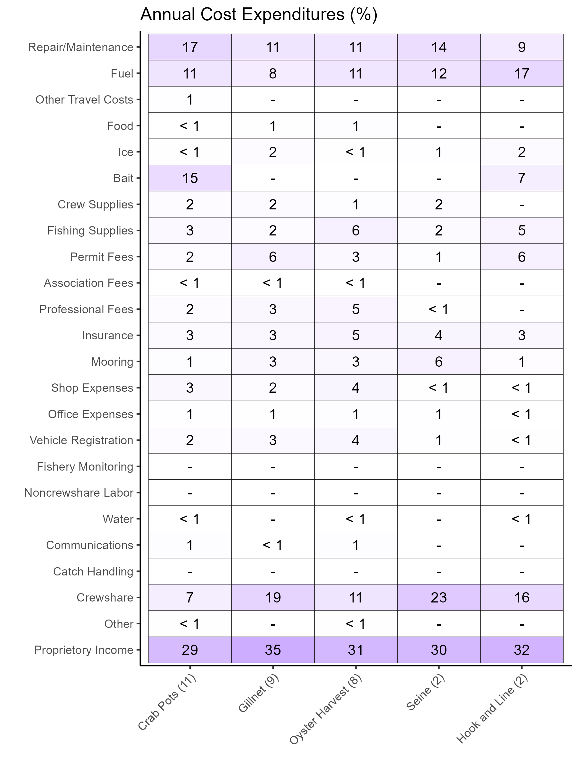
Watermen Interview Results
Largest non-personnel expenses from repairs/maintenance and fuel
Crew and owner income occupy a large proportion
Analysis considered “average” annual expenses
Notes:
And this resulted in this table with each gear as a different column and different cost categories as rows. Aside from personnel expenses, repairs and maintenance, and fuel were consistently the largest expenses among gears, with bait being an important expense for crabbers. The anecdote that I came across was 1/3 for the captain, 1/3 for the crew, and 1/3 for the boat. For watermen that said they consistently operated with a crew, that seemed to hold true. Not all watermen in this region do have a crew, or maybe they just do for some days, which served to drive that average crew share value down. A caveat to note is that this is considered the “average” annual expenses, so it doesn’t include one-off expenses that you may have in a rainy day fund.

Slide 24
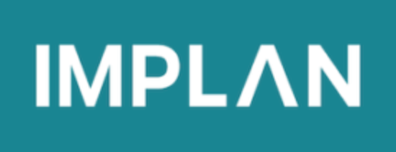
Regional Economic Impacts
Description:
Direct Effects: Dockside sales
Indirect Effects: Supply chain purchases
Induced Effects: Spending of income
Analysis being conducted by partners at the NOAA restoration center
Goal:
Estimate habitat change effects for both the fishing community and VA Middle Peninsula Region
 | Sales ($) | Income ($) | Value Added ($) | Jobs (FTE)
Direct | $11.2M | $3.9M | $6.8M | 209
Indirect | $7.7M | $2.3M | $4.0M | 72
Induced | $3.8M | $1.2M | $2.2M | 33
Total | $22.7M | $7.4M | $13.0M | 314
Results from the Choptank River model
Knoche et al. (2020)
Notes:
These values allow us to create a custom industry in the economic modeling software, IMPLAN. IMPLAN will use those harvest results along with our interview results and estimate how this affects the entire supply chain through direct effects, indirect effects, and induced effects. Direct effects are our dockside sales predictions that I’ve been showing you. Indirect effects are the supply chain-related expenses necessary for the dockside sales to happen, so expenses that go into repairing boats, wholesalers catching bait, etc. Induced effects are the costs incurred when employees of the industry go spend their income within the region. All of these things add up to account for the fishing industries effect on the regional economy.
/next/
The economic modeling will actually be done by NOAA, and we’re ready for that to get started. Similar to a previous effort in the Choptank River, this will calculate the sales, income, value added, and full-time equivalent of jobs for each scenario.

Slide 25
Summary
Interview Results
Harvest Outputs
Regional Economic Impacts
+
 | Sales ($) | Income ($) | Value Added ($) | Jobs (FTE)
Direct | $7.8M | $2.8M |  | 104
Indirect | Coming Soon!
Induced
Total
York + Piankatank: Post-Restoration + Growth Impacts
Notes:
So again, for our first objective, we have our harvest outputs from all scenarios and we are currently running sensitivity analyses to understand how uncertainty in input parameters may influence our estimates. For our second objective, we have completed our watermen interviews, and third, we can calculate some of our direct IMPLAN values since that is a function of the harvest outputs. We’ll be working with NOAA to estimate the indirect and induced effects for the regional economic impacts of oyster restoration and Eelgrass population changes in the Virginia Middle Peninsula.

Slide 26
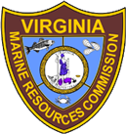
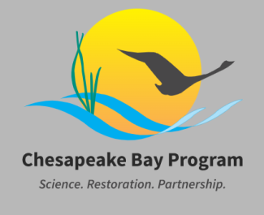
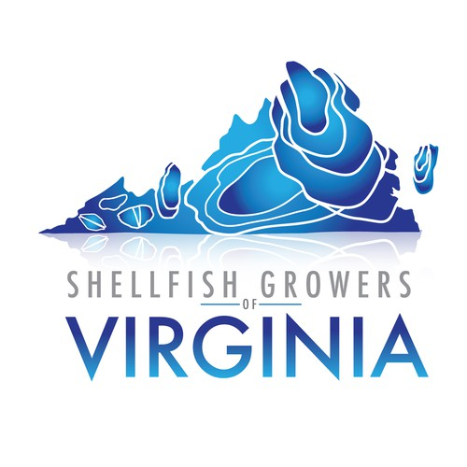
Thank You!
Watermen
Advisory Panel
Contact Us:
matthew.woodstock@morgan.edu (Through 9/30)
thomas.ihde@morgan.edu
Molluscan Ecology Lab
Seagrass Lab
ChesMMAP survey
Center for Coastal Resources Management
Juvenile Trawl Survey
Lisa Kellogg
Federal Award No. NA21NMF4570527
Notes:
With that, these models require a lot of data and we are grateful for a lot of people and organizations listed here for helping us develop this either by directly communicating with us or for hosting their data in a publicly accessible format. Also huge thanks to the watermen that I interviewed and that helped share information about this project. We also have a great advisory panel that has given us a lot of advice. Finally, this project is funded by the NOAA-Chesapeake Bay Office. With that, I will take questions.

