Slide 1
Application of Vertical Array Data for the 4D Interpolator
Rebecca Murphy
UMCES at CBP
rmurphy@chesapeakebay.net
Sustainable Fisheries Goal Implementation Team Meeting
Sept. 19, 2023

Slide 2
4-D interpolator development team
BORG = Bay Oxygen Research Group:
Leadership
  Peter Tango (USGS/CBP), Rebecca Murphy (UMCES/CBP), August Goldfischer (CRC/CBP)
Development to-date
  Elgin Perry (statistician); Jon Harcum and Erik Leppo (Tetra Tech); Angie Wei and Rebecca Murphy (UMCES/CBP)
Guidance, ideas, direction
  Gary Shenk and Breck Sullivan (USGS/CBP), Isabella Bertani and Richard Tian (UMCES/CBP), Kaylyn Gootman (EPA/CBP), Jim Hagy (EPA)

Slide 3
Purpose: Build a tool for more complete criteria assessment
DO criteria that currently can be evaluated with existing approaches and data
*
*Note a 30-day mean 6 mg/L MSN value is evaluated for purpose of the WQ indicator.
From EPA 2003 Ambient Water Quality Criteria

Slide 4
Purpose: Build a tool for more complete criteria assessment
With higher frequency interpolation tool and data
*
From EPA 2003 Ambient Water Quality Criteria

Slide 5
4-D interpolator development timeline
Calendar Year | 2022 |  |  |  | 2023 |  |  |  | 2024 |  |  |  | 2025 |  |  |  | 2026 |  |  |  | 2027
Calendar Quarter | Q1 Jan-Mar | Q2 Apr-Jun | Q3 Jul-Sep | Q4 Oct-Dec | Q1 Jan-Mar | Q2 Apr-Jun | Q3 Jul-Sep | Q4 Oct-Dec | Q1 Jan-Mar | Q2 Apr-Jun | Q3 Jul-Sep | Q4 Oct-Dec | Q1 Jan-Mar | Q2 Apr-Jun | Q3 Jul-Sep | Q4 Oct-Dec | Q1 Jan-Mar | Q2 Apr-Jun | Q3 Jul-Sep | Q4 Oct-Dec | Q1 Jan-Mar | Q2 Apr-Jun | Q3 Jul-Sep | Q4 Oct-Dec
Project Year | Year 1 |  |  |  | Year 2 |  |  |  | Year 3 |  |  |  | Year 4 |  |  |  | Year 5 |  |  |  | Year 6
1. Development-daily estimates (Phase 1)
2. Develoment-hourly estimates (Phase 2)
3. Development - shallow water
4. Development - GIS tasks
5. Development -combined daily & hourly (Phase 3)
6. Development-criteria evaluation
7. Software
8. Documenting
9. Training
10. Year of Review
11. Operational

Slide 6
WQ Assessment with 4D interpolator
tool
WQ assessment
GAMs
data
product
Observed data
Mean daily prediction
Multiple feasible hourly realizations
Attainment
Statistical simulation
From Gary Shenk

Slide 7
Uses of the Vertical Array data
Exploratory: Examine the DO cycles and patterns
Development of 4D hourly interpolation method, including both:
  Calibration
  Validation
Eventually:
  Criteria assessment in select segments, and
  Aid in estimation of high frequency variability in locations without monitoring

Slide 8
Uses of the Vertical Array data
Exploratory: Examine the DO cycles and patterns
Development of 4D hourly interpolation method, including both:
  Calibration
  Validation
Eventually:
  Criteria assessment in select segments, and
  Aid in estimation of high frequency variability in locations without monitoring

Slide 9
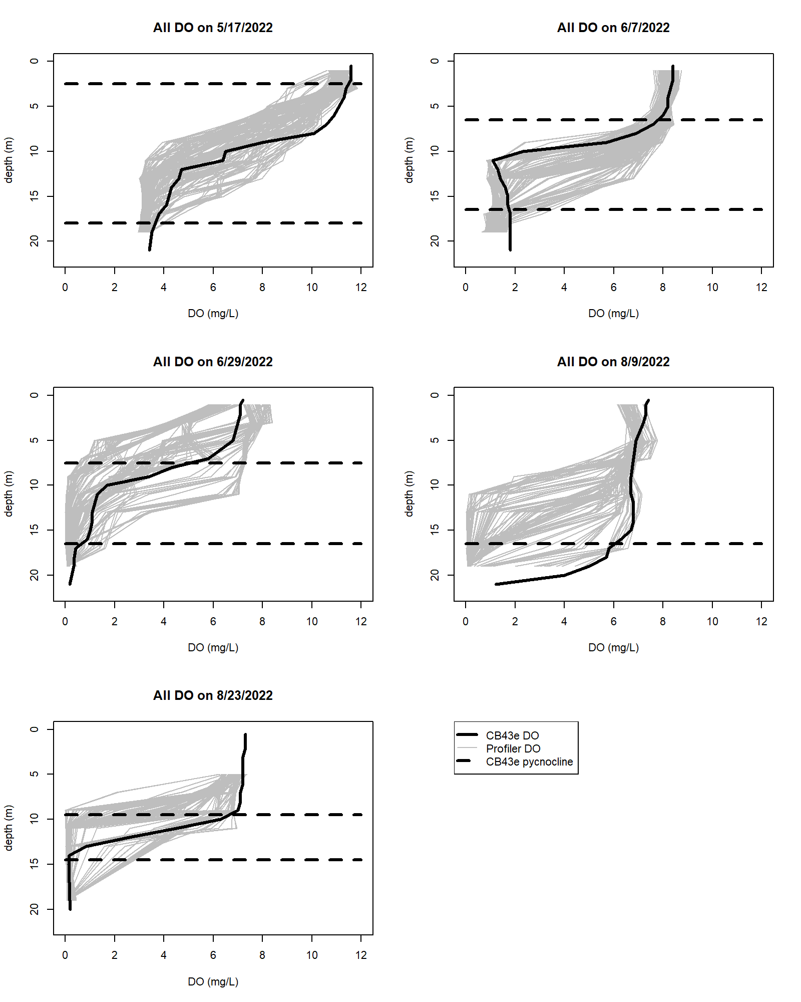
Exploratory work
Example: East Goose Vertical Array Data (grey lines) at dates with fixed station sampling (black line) in 2022
OW
As array data becomes available, we are using it to examine short-term variability, and its impact on:
The statistical techniques we use to build the interpolator
Pycnocline computation (determining designated use)
Spatial co-variability of high frequency dynamics
What we can learn about implementing short-term criteria evaluation
DW
DC
OW
DW
Note: on 8/9/22 the array data had an 8-hour gap
9
9

Slide 10
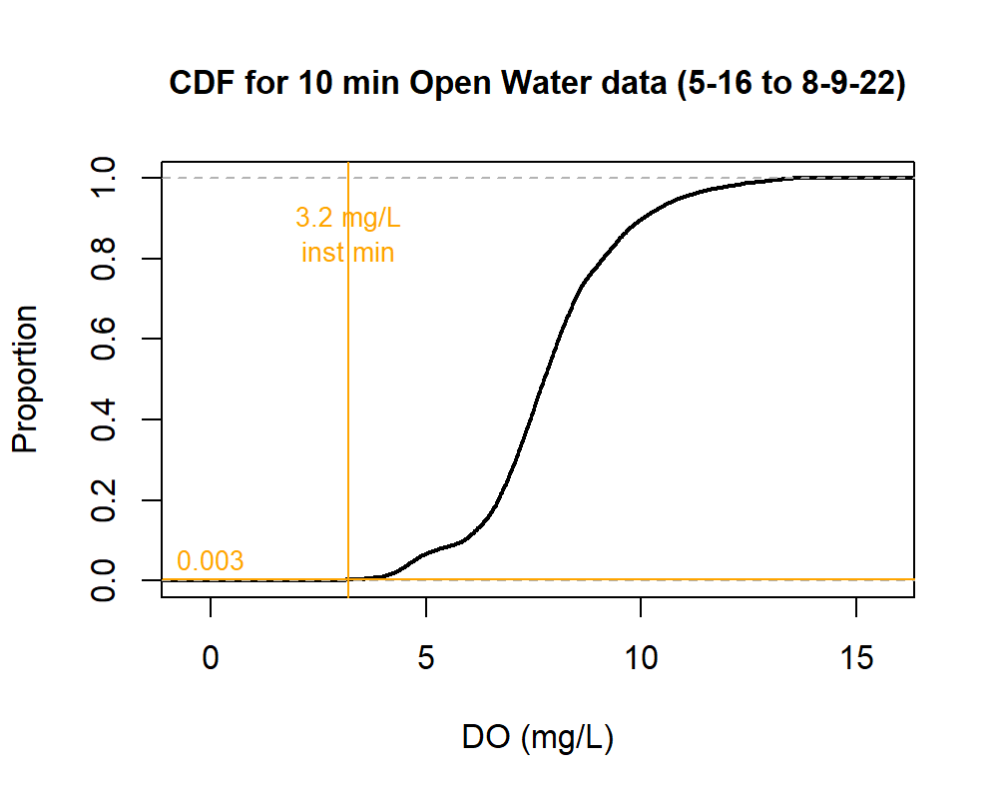
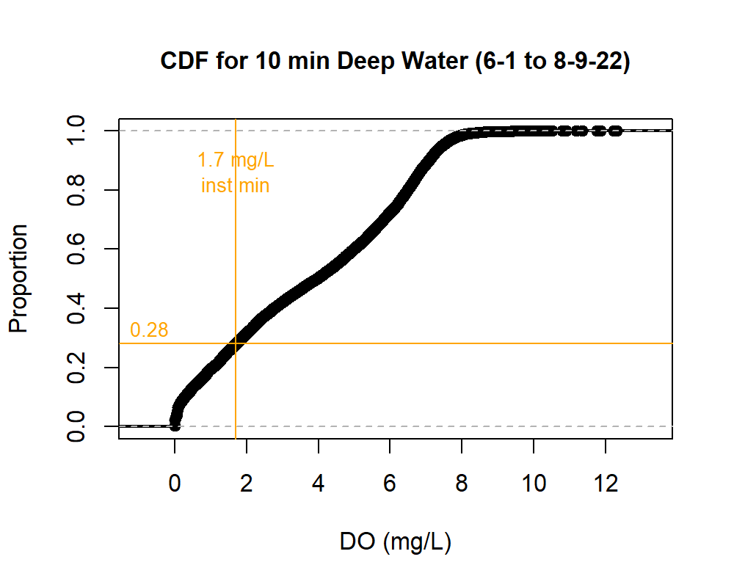
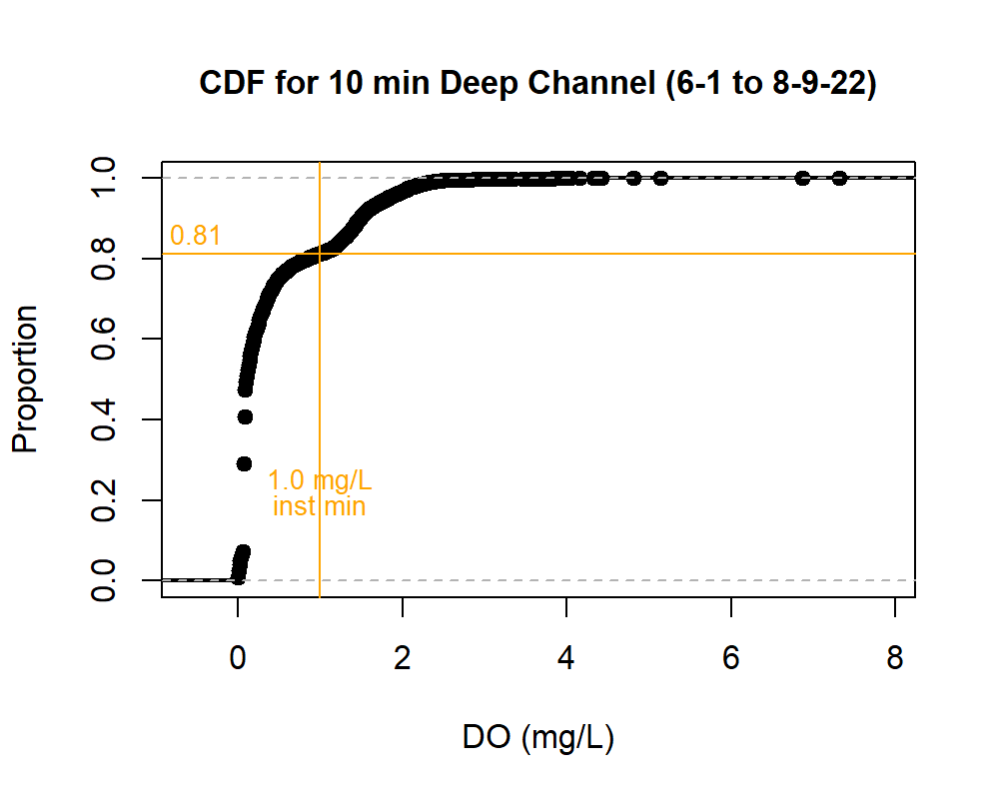
Exploratory work
Example: Cumulative Frequency of DO levels in each Designated Use from East Goose Profiler DO in 2022
As array data becomes available, we are using it to examine short-term variability, and its impact on:
The statistical techniques we use to build the interpolator
Pycnocline computation (determining designated use)
Spatial co-variability of high frequency dynamics
What we can learn about implementing short-term criteria evaluation
10
10
10
10
10

Slide 11
Uses of the Vertical Array data
Exploratory: Examine the DO cycles and patterns
Development of 4D hourly interpolation method, including both:
  Calibration
  Validation
Eventually:
  Criteria assessment in select segments, and
  Aid in estimation of high frequency variability in locations without monitoring

Slide 12
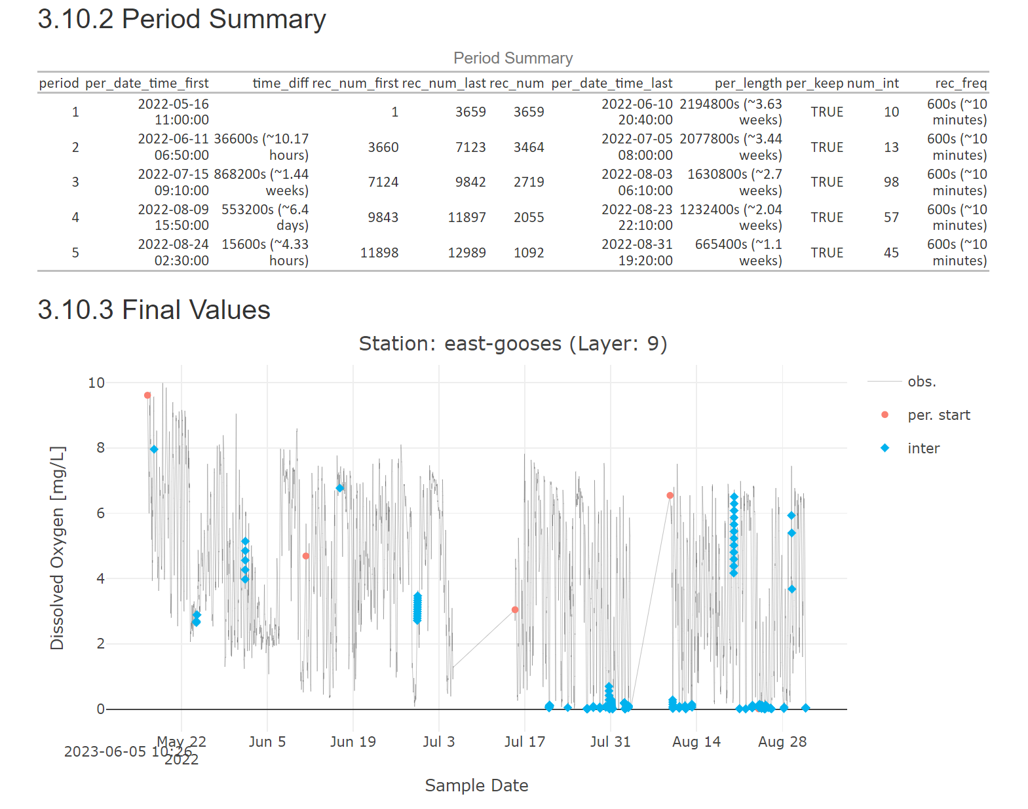
Method development with high frequency data
Download, read codes, plot
Example: Current processing technique from Tetra Tech team using East Goose’s array in 2022 at 9m
Interpolate short gaps and delimit blocks by longer gaps
From Jon Harcum (Tetra Tech)

Slide 13
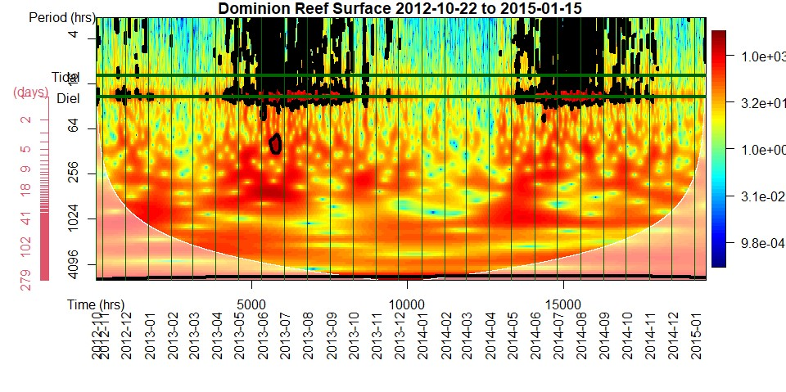
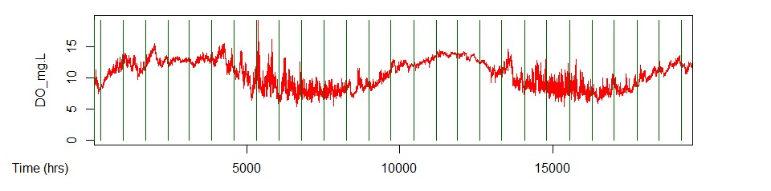
Method development with high frequency data
Download, read codes, plot
Example: Wavelet analysis of gap-filled data to identify cycles
Interpolate short gaps and delimit blocks by longer gaps
Do a wavelet analysis for each depth and block
Identify common cycles at each depth (tidal, daily, etc)
From Elgin Perry

Slide 14
Method development with high frequency data
Download, read codes, plot
Interpolate short gaps and delimit blocks by longer gaps
Example: Fourier analysis with just daily cycle to fit hourly DO (DO_{h})
$${DO}_{h}=lc∗h+sc∗sin\left(\frac{2π∗h}{24}\right)+cc∗cos\left(\frac{2π∗h}{24}\right)+τ_{h } h=1:24$$
Do a wavelet analysis for each depth and block
coefficients
h = hour 1:24
Identify common cycles at each depth (tidal, daily, etc)
From Elgin Perry
Fit coefficients of Fourier analysis for each observed cycle
Explore for relationships to other features (depth, month, DO, flow)

Slide 15
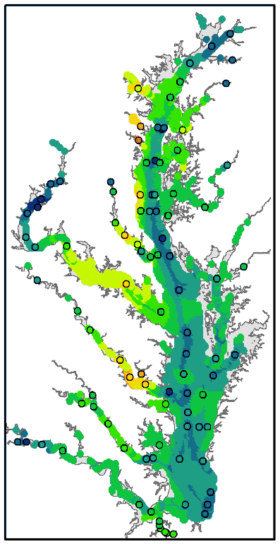
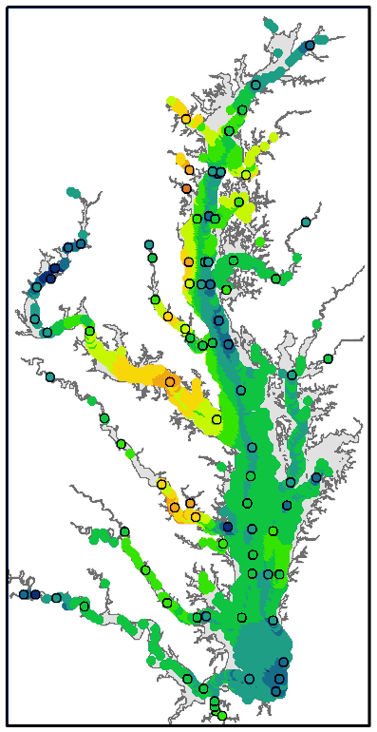
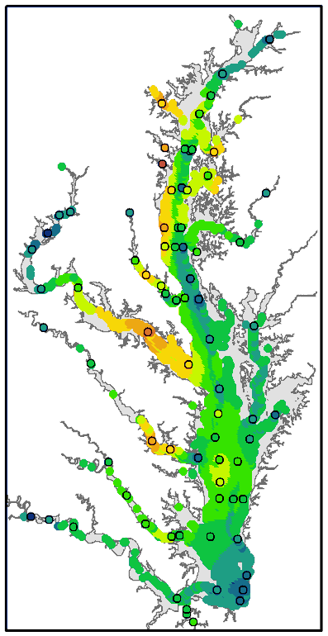
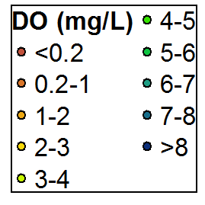
Method development with high frequency data
Download, read codes, plot
“4d” Spatial & temporal estimates of DO
Interpolate short gaps and delimit blocks by longer gaps
d₁, t₁
d₂, t₁
d₃, t₁
Do a wavelet analysis for each depth and block
d₁, t₂
…
Identify common cycles at each depth (tidal, daily, etc)
d₂, t₂
d₃, t₂
Fit coefficients of Fourier analysis for each observed cycle
Explore for relationships to other features (depth, month, DO, flow)
Ultimately: generate hourly DO estimate bay-wide that are calibrated and validated with observed data
…

Slide 16
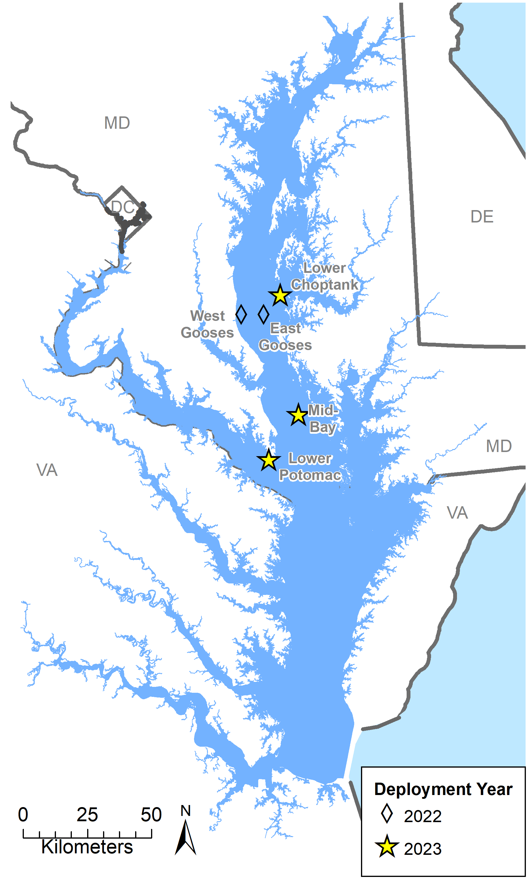
Locations?
Discussion is ongoing for location of future arrays with the Hypoxia Collaborative Team.
4-D team thoughts (input here from Peter Tango):
Pairing stations within a region may be useful, including:
  Spanning the boundaries of hypoxic zone
  Pairing stations laterally in a wide segment
  Making shallow-to-deep station matches
Duration considerations:
  Year-round is ideal b/c there are 12-month criteria
  3-year periods important for assessment
  Long-term deployments will be useful for dynamic modeling needs and tracking trends related to climate change
But almost any location will be helpful for our 4D method development because we have many gaps in high frequency DO knowledge. Collaborating with fisheries needs makes a lot of sense.
→ These and more diverse needs may lead to hybrid approach of some long-term stations and some 3-year rotating stations.

