Slide 1
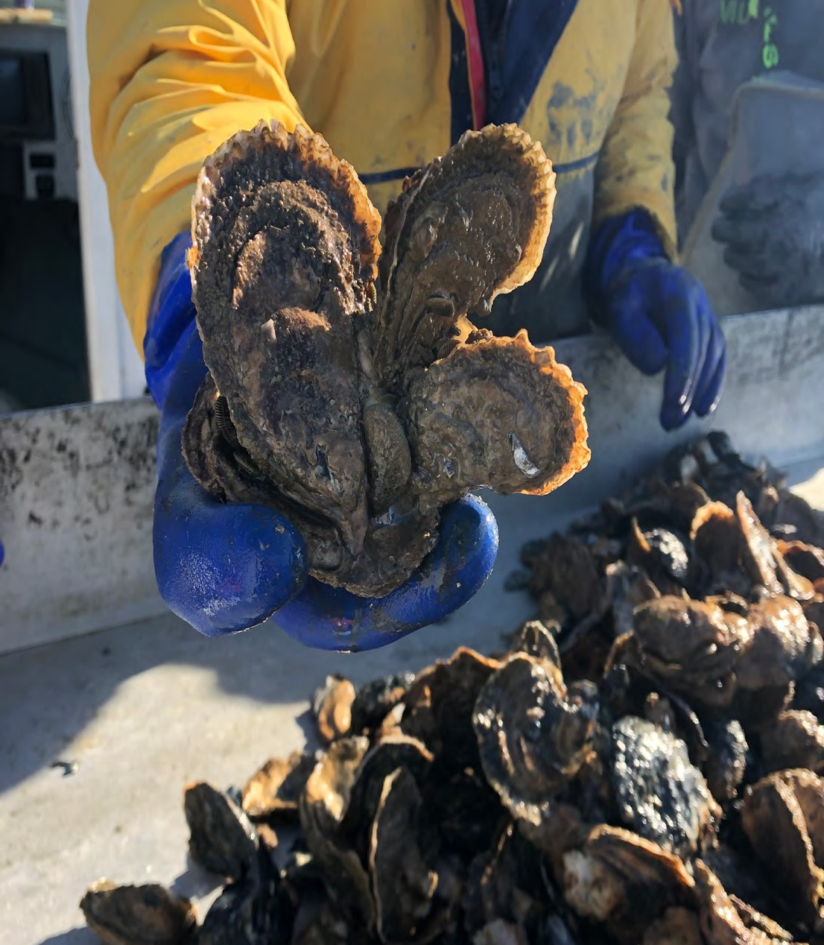
Draft
Chesapeake Bay Oyster Restoration Goal for 2035
Stephanie Westby, NOAA
Stephanie.westby@noaa.gov

Slide 2
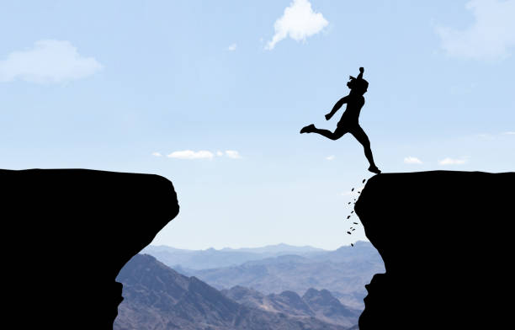
Why do we need a
Next Gen/ Post-2025 oyster goal?
Prep for next Chesapeake Bay Agreement
Prep for gap between current and next Bay Agreement/ initiative
Maintain momentum, partnerships, progress
Build on success
2025
(current Bay Agreement goal deadline)
Next
Bay Agreement
(or not…)

Slide 3
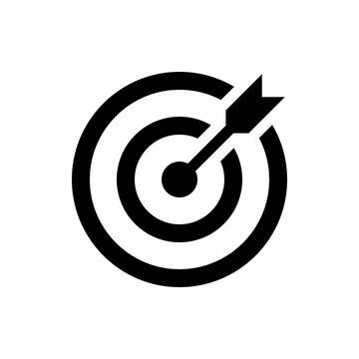
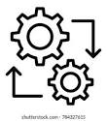
Operating Principles for Developing Next Gen Oyster Goal/s
Goal
Goal setting &
restoration implementation process
Inclusive:
-Human community is important (“Oysters are easy; people are hard”)
Partnerships are key
-Collective: goal; metrics; planning; implementation; tracking; monitoring; adapting
-States manage the oyster resource, so they are critical partners; we need them as champions
Maintain momentum- need to set this goal now-ish
Rebuilding networks (clusters) of sanctuary reefs, at large scale, will likely remain a key tool.
Recognize & communicate the value of ecosystem services, beyond the SMART oyster goal**
SMART goal (specific, measurable, achievable, relevant, timebound)
Ambitious (maintain or increase scale)
Understandable, concise
Ecologically sound (scale; clustered; recognizes climate change impacts)

Slide 4
‘Goal Translator’
Goal Translator User Guide
X Tribs
(X human & ecological communities; X rec fishing hubs, etc.)
Pick a box
Pick a value for X
Recognize, quantify, and message around all boxes
Additional, out-of-the-box boxes welcome and encouraged
X units of community engagement
X% historic oyster bottom
$X economic impact
X acres functioning at Y level
(of reefs; of fish habitat; of rec fishing grounds, etc.)
X% increase in oyster reproductive capacity
X gallons of water filtered annually
(X% of the Bay’s volume filtered annually; X% of a trib filtered annually, etc.)
X pounds striped bass primary production
(or some other species…)
X pounds of N and P removal annually

Slide 5
Draft 2035 Oyster Goal
Oyster Goal
(analogue to ‘10 Tribs’ goal)
Additional Co-Goals
(“Oysters and…”)
(“Oysters with a side of…”)
(in some specific tribs)
Restoration goal:
restore oysters in 15 Chesapeake Bay tributaries*
totaling at least 2700 acres of high-functioning** reefs
and ensure their protection.
Potential Examples:
Oysters & SAV
Oysters & shoreline protection
Large-scale oyster restoration in conjunction with meeting water quality goals (BMP).
Sanctuary restoration in conjunction with wild fishery and aquaculture
Oysters & Environmental justice/ community engagement
Using next gen restoration as a research platform; develop the research questions alongside the restoration plans; ex: do we see a tributary-level system response to large-scale oyster restoration?
Engaging more citizen/ community scientists
Oyster stewardship goal:
Maintain, and/ or continue to improve upon, the restoration work under the 2014 Chesapeake Bay Agreement.
* Large, targeted, clustered, distinct geographic areas- could include, ex: a slice of a larger river, or a segment of Bay mainstem/ clustered geographies
** Per current GIT Oyster Metrics definitions, or as modified for the Next Gen oyster goal
Potential Target Tributaries
(Based on Corps of Engineers Master Plan, CESR Report, ongoing work)
Eastern Bay (MD)
Arundel Rivers (MD)
Tangier Sound (VA)
Barren Is/Hoopers (MD)
Mobjack Bay (VA)
Hampton River (VA)
Pocomoke Sound (VA)
TBD (Choptank, re: CESR*)
TBD (York, re: CESR)
TBD (Pocomoke, re: CESR)
TBD (Patuxent, re: CESR)
TBD (Rappahannock re: CESR)
TBD (Potomac, re: CESR)
TBD
TBD
TBD
‘CESR’: A Comprehensive Evaluation of System Response, https://www.chesapeake.org/stac/cesr/

Slide 6
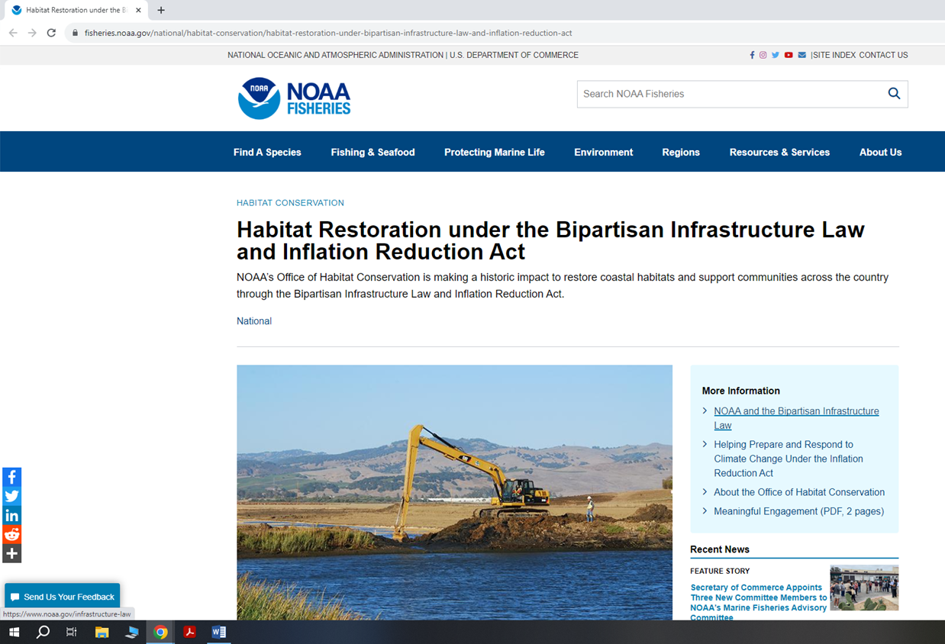
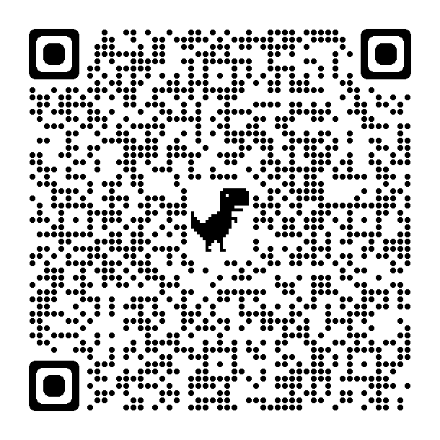
NOAA Funding Opportunities Currently Open
fisheries.noaa.gov/habitat-BIL-IRA

