Slide 1
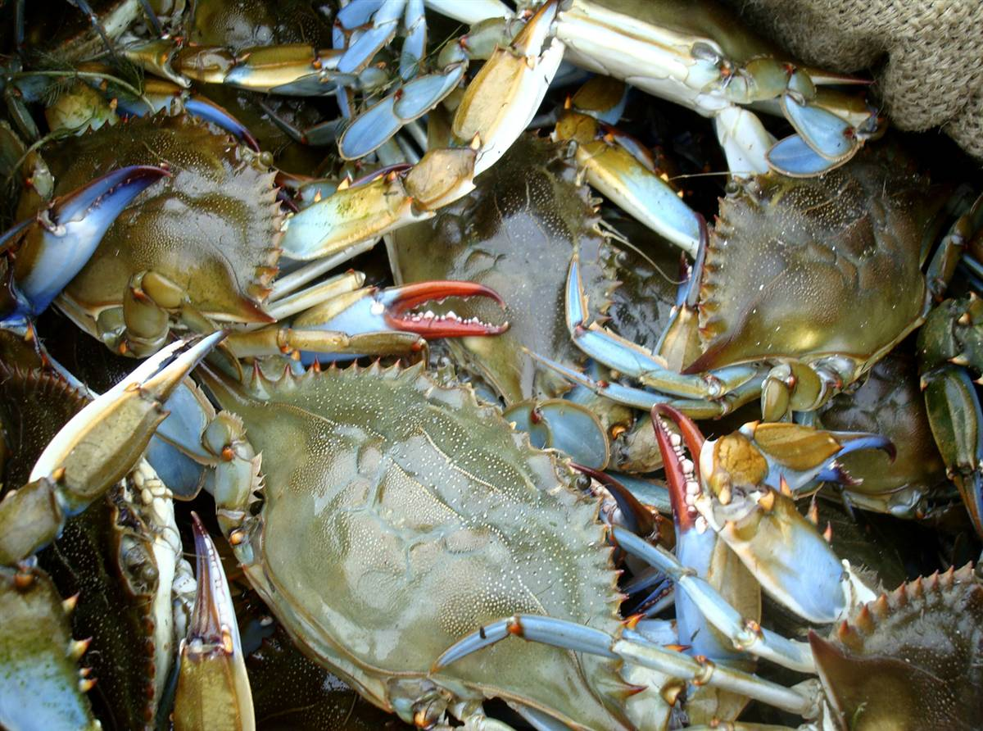
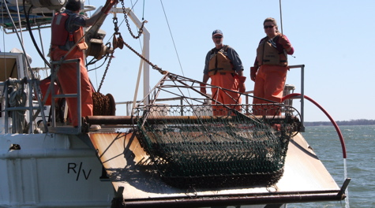

2023 Blue Crab Advisory Report
J. Page
www.vims.edu
Pat Geer (VMRC)
Chair, Chesapeake Bay Stock Assessment Committee
September 18, 2023
Sustainable Fisheries GIT Meeting

Slide 2





CBSAC Members
Pat Geer (Chair) Virginia Marine Resources Commission
Mandy Bromilow (Coordinator) ERT/NOAA Chesapeake Bay Office
Bruce Vogt (Staffer) NOAA Chesapeake Bay Office
Ingrid Braun Potomac River Fisheries Commission
Glenn Davis Maryland Department of Natural Resources
Alexa Galvan Virginia Marine Resources Commission
Daniel Hennen NMFS, Northeast Fisheries Science Center
Tom Ihde Morgan State University - PEARL
Eric Johnson University of North Florida
Rom Lipcius Virginia Institute of Marine Science
Genine McClair Maryland Department of Natural Resources
Tom Miller UMCES, Chesapeake Biological Laboratory
Amy Schueller NMFS, Southeast Fisheries Science Center
Mike Seebo Virginia Institute of Marine Science
Alexei Sharov Maryland Department of Natural Resources
Mike Wilberg UMCES, Chesapeake Biological Laboratory

Slide 3
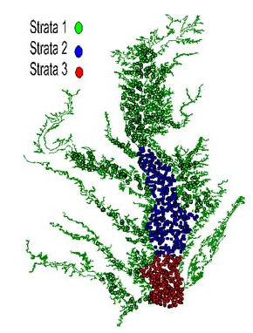
Winter Dredge Survey Results
Conducted jointly by VIMS and MD DNR since 1989-90
Samples 1500 random sites annually from December to March
Objectives:
  Describe the size and sex composition of the bay wide blue crab population
  Develop accurate estimates of bay wide blue crab abundance
  Estimate exploitation and fishing mortality and evaluate the
  status of the stock annually.
Chesapeake Bay Stock Assessment Committee (CBSAC)
  Reviewed results at May 18th meeting
  2023 Blue Crab Advisory Report released on June 27th
    https://www.chesapeakebay.net/what/publications/2023-
    blue-crab-advisory-report

Slide 4
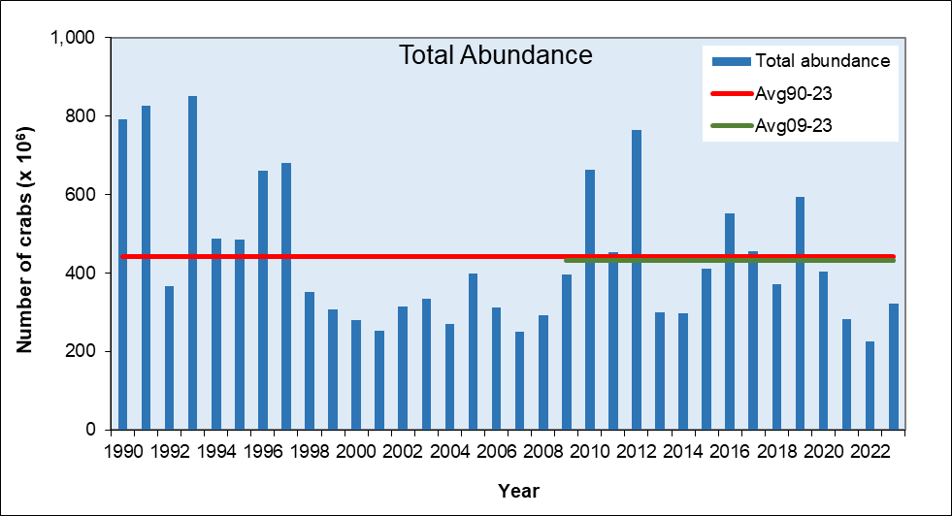
Results of 2022/23 Winter Dredge Survey
(Figure 1)

Slide 5
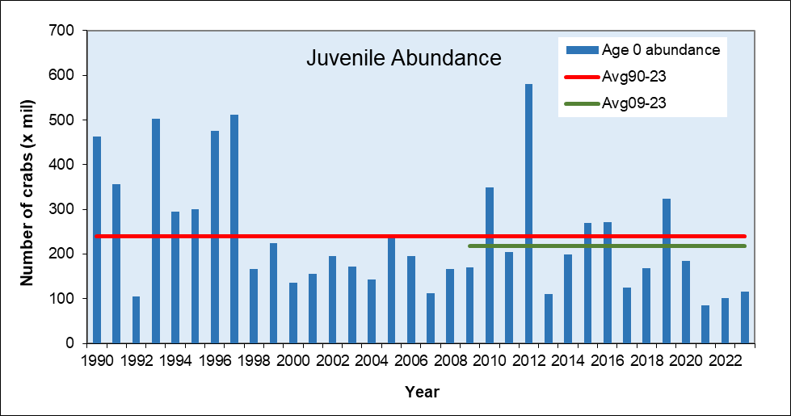
Results of 2022/23 Winter Dredge Survey
(Figure 2)

Slide 6
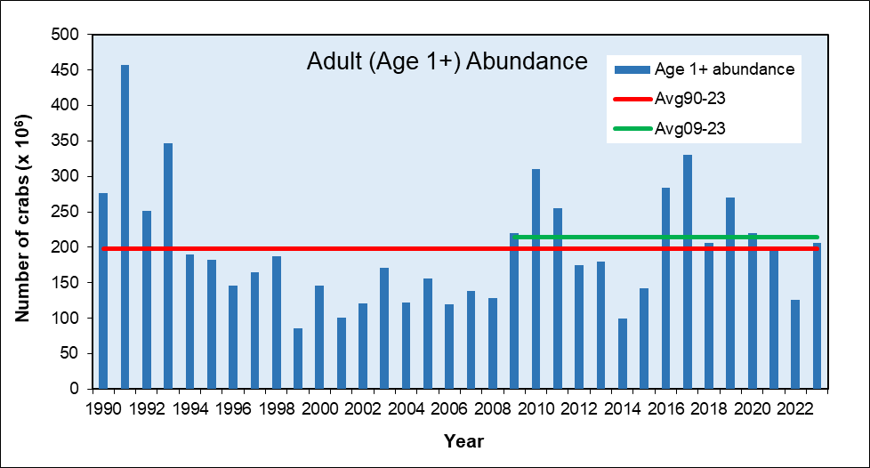
Results of 2022/23 Winter Dredge Survey

Slide 7
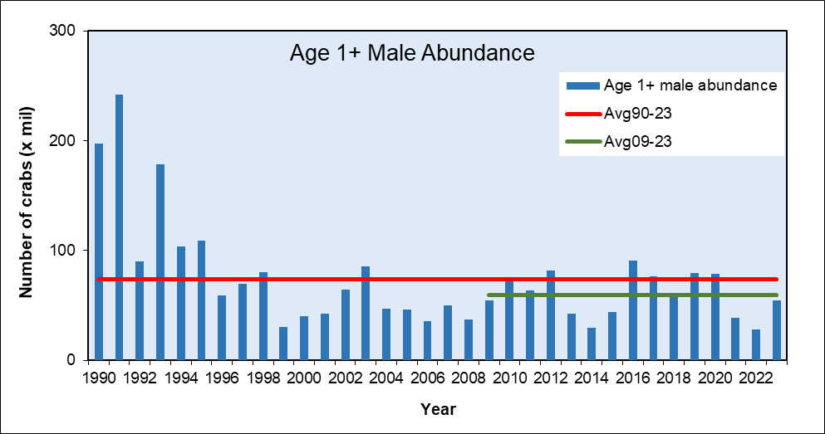
Results of 2022/23 Winter Dredge Survey
(Figure 3)

Slide 8
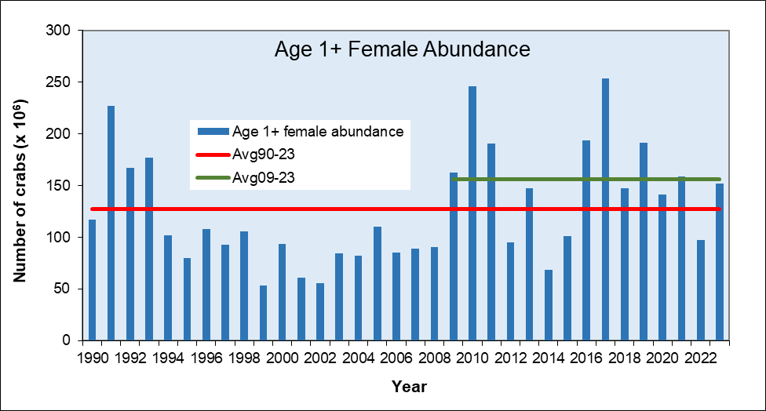
Results of 2022/23 Winter Dredge Survey

Slide 9
2023 WDS Abundance Summary
All abundance estimates increased from 2022
  Most abundances higher than 2021-2022 but lower than 2015-2020
Total crab abundance increased 42% to 323 million
  Ranks 22nd in 34 years of survey
Juvenile abundance increased 15% to 116 million
  Still amongst lowest years of survey (29/34)
Adult female abundance increased 56% to 152 million
  Above the abundance threshold of 72 million crabs
  Below the abundance target of 196 million crabs
Adult male abundance almost doubled to 55 million

Slide 10
Overwintering Mortality
Overwintering mortality in 2023 was the lowest ever observed.
(Table 2, pg 8 in Report)
Vessel-specific estimates combined.
MD data from re-sampled sites in March
VA data from random sites in March

Slide 11
2022 Blue crab harvest

Slide 12
2022 Management
The WDS produced abundance estimates in 2022 that were at all-time lows for juveniles and adult males, with a 39% decline in spawning stock abundance.
The Bay Jurisdictions agreed to take a 5-10% harvest reduction
to conserve the future spawning stock and prevent overfishing.
VA: Lower Bushel Limits over 121 days instead of 15 days
MD: Lower Bushel Limits by Sex and Time of Year
  Recreational Harvest Limited to 1 bushel/day
PRFC: Created Male Bushel Limits, Lower Female Bushel Limits

Slide 13
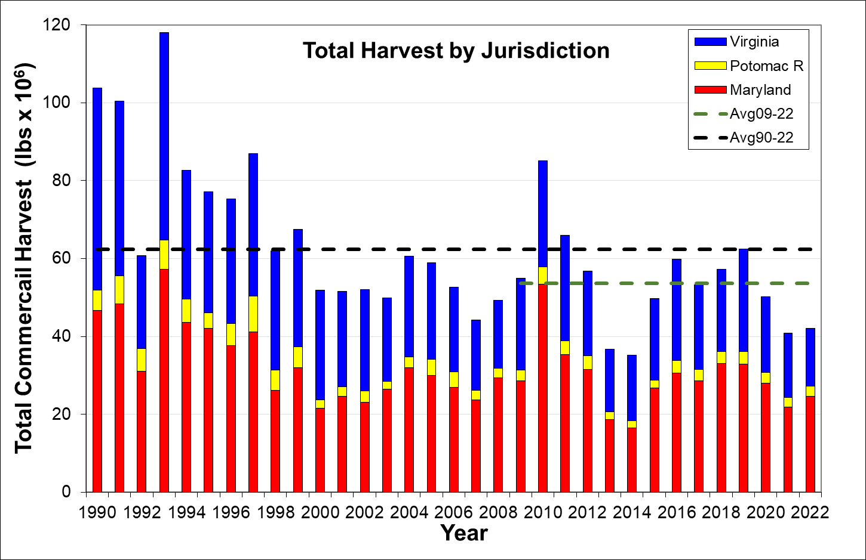
(Figure 4 in Report)

Slide 14
Status of The Stock

Slide 15
Control Rules – Table 3 in Report
Stock Status: The Chesapeake Bay blue crab stock is
not depleted (overfished) and overfishing is not occurring.

Slide 16
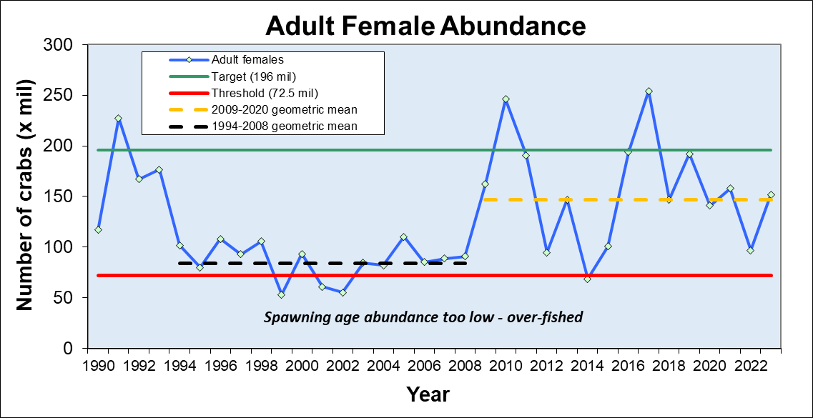
Control Rule - Adult Female Abundance
(Figure 6 in Report)

Slide 17
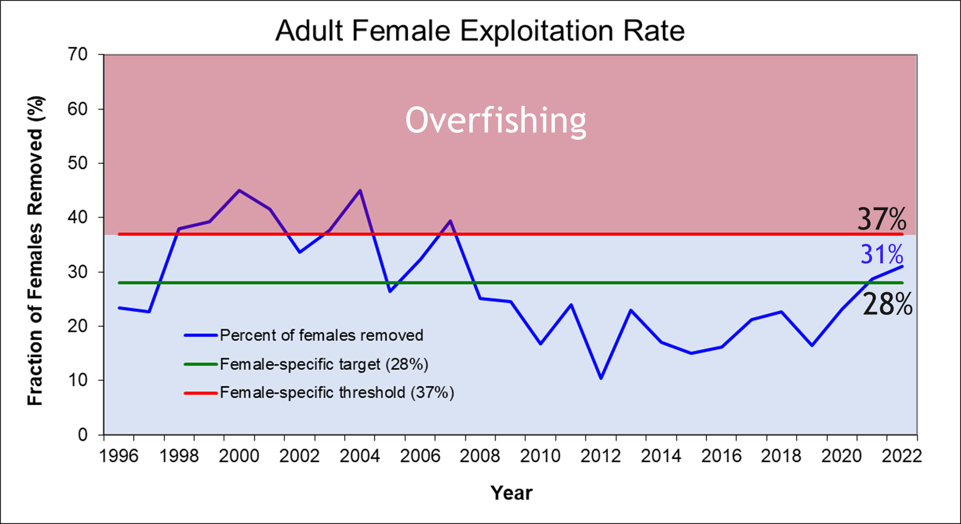
(Figure 5 in Report)

Slide 18
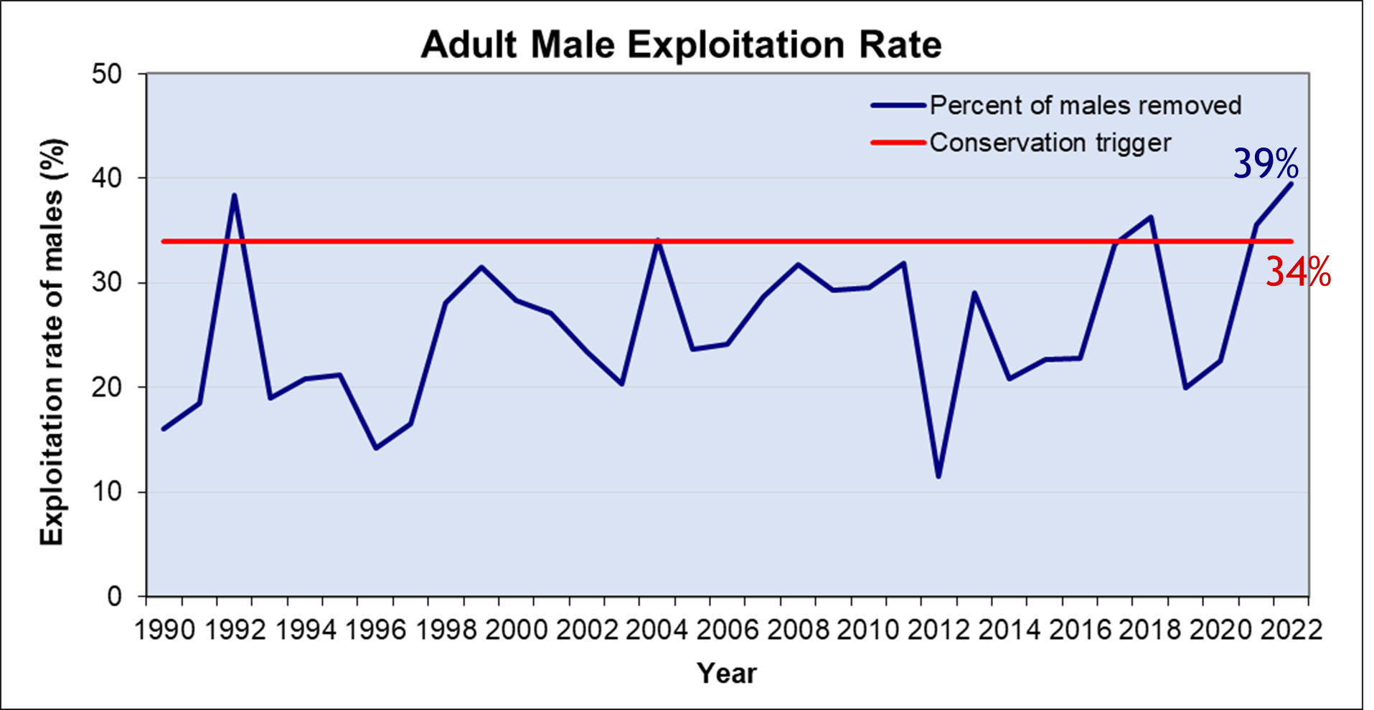
Male Conservation Trigger
(Figure 9 in Report)

Slide 19
2023 WDS Summary
Spawning stock abundance is comfortably above the threshold (72.5 m) at 152 m crabs but not near the target of 196 m crabs. Not Overfished.
Adult Female Exploitation Rate is not above the threshold of 37% (ie. Overfishing is not occurring). However, the fishing mortality rate is trending upwards and has been above the target the past two years.
The Adult Male exploitation rate has exceeded the target the past two years. This is not a biological reference point but as a “conservation trigger” it can alert managers that something is happening and should be watched carefully.

Slide 20
2023 Management Advise
Juvenile abundance is still a concern. These crabs will began entering the fishery in August. Poor recruitment can impact the adult population.
  Warming water temperatures may be influencing juvenile catchability and availability on the survey.
The Control Rules for Management (Age +1 Female Abundance and Female Exploitation Rate) are still within acceptable ranges but management actions taken in 2022 (up to 10% harvest reduction) may still be necessary to further protect male and juvenile abundance.

Slide 21
Management Advise pg2
CBSAC recommends a new benchmark stock assessment be conducted.
  The last benchmark was in 2011.
  The population may be behaving differently now.
  Additional datasets may be available.
  Explore new modelling methods.
Workshop held September 20-21, 2022 (VMRC) to discuss recruitment and drivers influencing the population.
Jurisdictions have agreed to maintain the 2022 conservation measures for the 2023 fishing season.

Slide 22
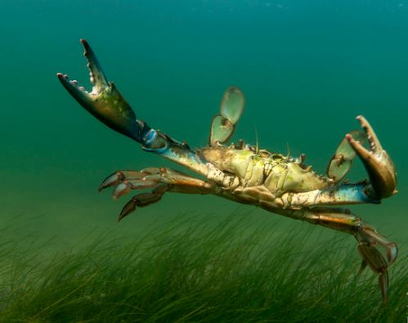
Questions
Jay Fleming

Slide 23
Additional Slides

Slide 24
Management Actions for 2022-23 Season
Maryland
  Commercial Bushel limits on Males (Aug to Sep)
    (varies depending on pot license)
  Recreational Harvest Limit – 1 bushel males per person/boat
Virginia
  Reduced Commercial Crab Pot Bushel Limits
    Oct-1-Nov-30, Mar-17-May-15 (4 months vs 2 weeks)
    Season for all other gears: Apr 15-Oct 15 (30 days less)
    Other Potential Measures by March 2023
PRFC – Established bushel male bushel limits and reduced female bushel limits

Slide 25
Virginia Bushel Limits
The changes of July 5, 2023 were to make the reductions equitable between the license types, roughly at 20-24%

Slide 26
Maryland Pot Regulations

Slide 27
PRFC Bushel Limits

Slide 28
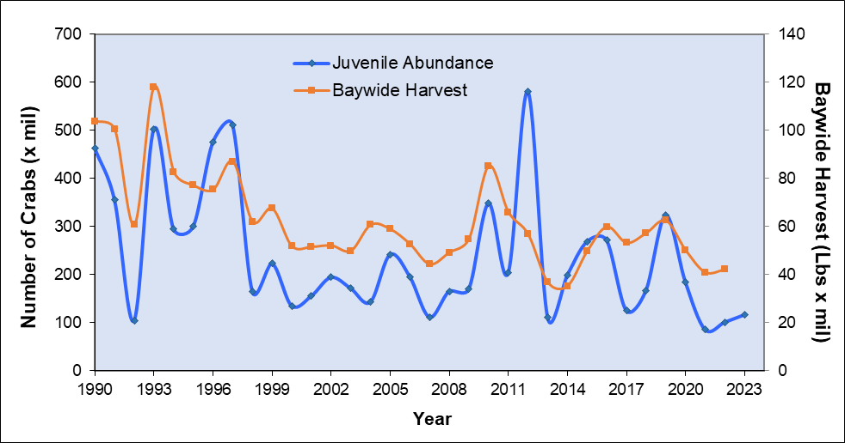
Recruitment VS Harvest

Slide 29
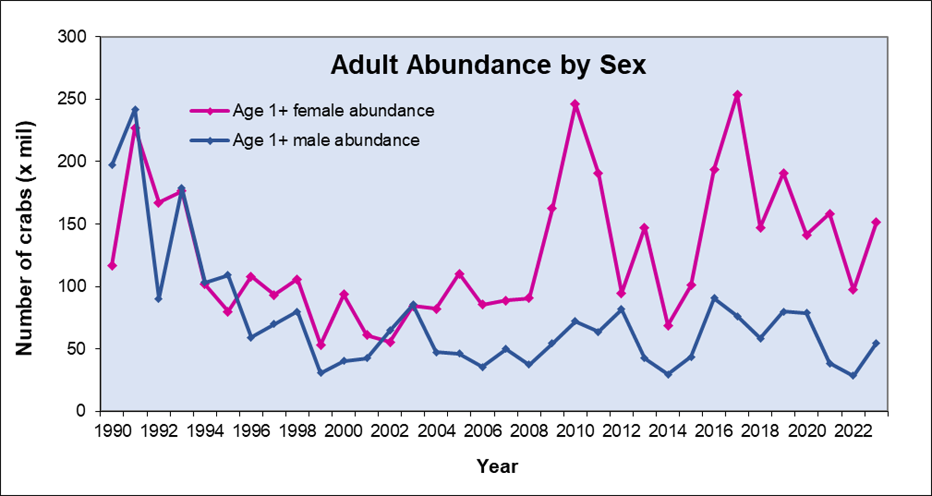

Slide 30
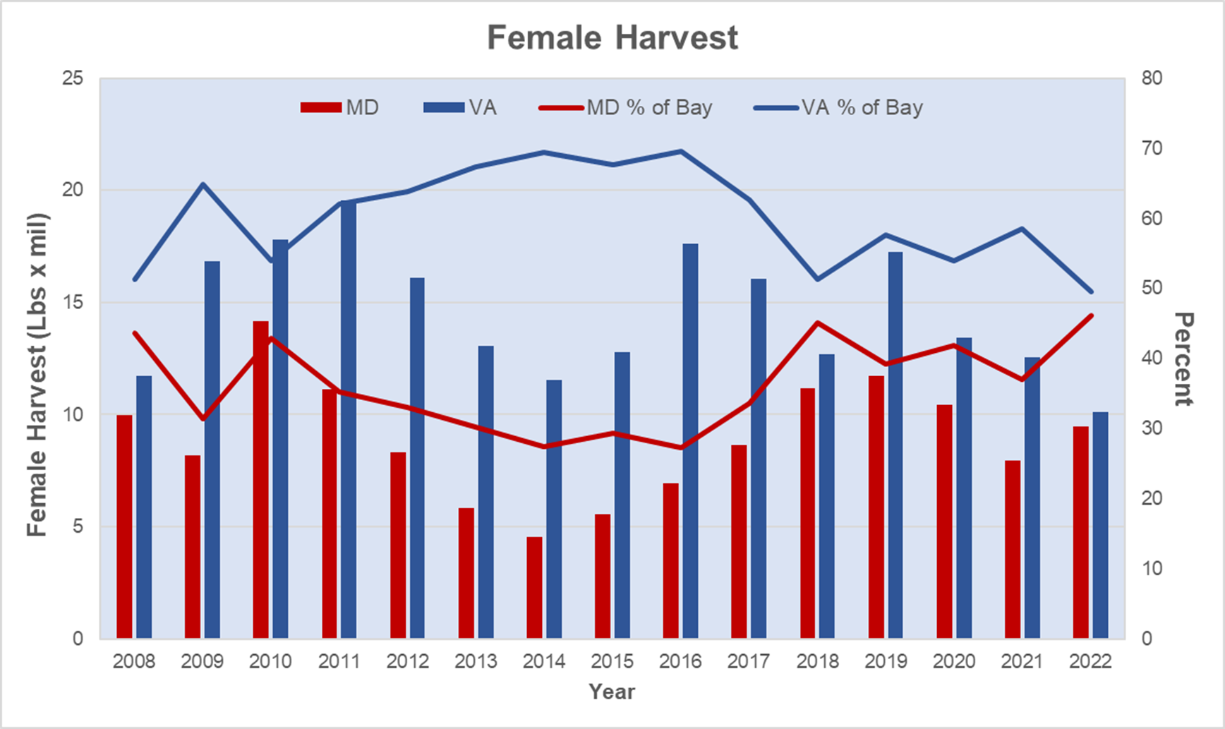

Slide 31
