Slide 1
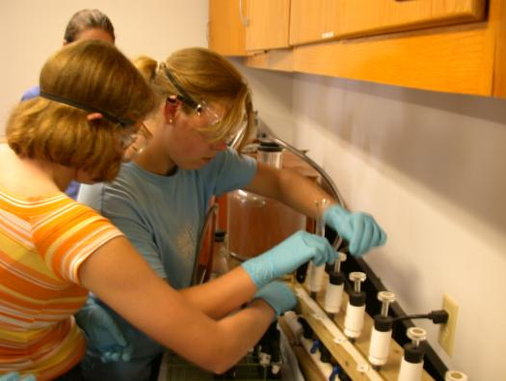
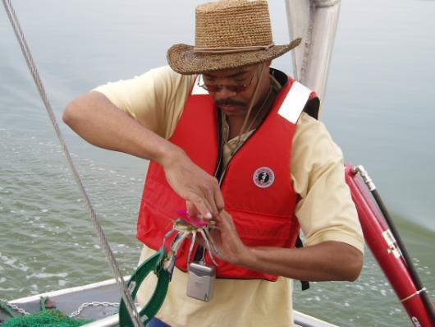
Policy and Metrics
April 11, 2017

Slide 2
School District Engagement
Notes:
Our last outcome focuses on environmental literacy policy and metrics.
School system level implementation is important for SYSTEMIC and SUSTAINABLE programs
Environmental Literacy Indicator Tool (ELIT) collected baseline data for 2014-2015 school year
Degree of preparedness to provide Environmental Literacy programming
Extent to which MWEEs are being provided to students
Number of sustainable schools

Slide 3
ELIT Survey
OMB approved survey ready for distribution May 1, 2017
Due date September 30, 2017
States can include up to 3 state specific questions
Ask questions in three areas:
Environmental literacy Planning
Student Participation in MWEEs in each grade band
Sustainable Schools

Slide 4
Discussion Guide
For states:
What can you do to distribute the ELIT survey so we get a strong response rate?
What 3 questions would you like to include on ELIT to ask school districts?
For everyone:
What can you do to encourage and support LEAs in developing and implementing systemic programs?

Slide 5
Education Directive 98-1

Slide 6
Executive Council/Bay Program will…
Encourage the State Departments of Education become/remain active partners in the Bay Program
Maintain the Education Workgroup
Convene a biennial Environmental Literacy Leadership Summit to bring together the Superintendents of Education, state natural resource agencies, and others
Report outcomes of the Education Summit to the Executive Council

Slide 7
States signed onto outcomes will…
Participate in Education Workgroup
Provide actions for biennial workplans
Support state interagency EL group led or co-led by state department of education
Encourage each Department of Education to:
Encourage and support school districts to conduct EL
Collect data and information from local school districts
Send senior level reps to biennial Management Board meetings focused on EL progress; Alert PSC if issues arise
Provide annual summary to their Executive Council member
Invite and encourage higher education to get involved

Slide 8
Discussion Guide
Review revisions to Directive 98-1 to ensure that they will work for your agency/state
Be ready to indicate whether your table supports moving the directive forward as is, supports with changes, or does not support moving the document forward.
If changes are requested, be prepared to provide written comments

Slide 9
State Discussions

Slide 10
Discussion Guide
Continue incomplete conversations from throughout the day
Identify 2-4 priority actions for implementation in 2017/2018, including responsible agency
If time allows, begin discussing how to move forward with these actions

