Slide 1
Citizens Advisory Committee
Solar Panel Development and Water Quality Impacts
May 18, 2022

Slide 2
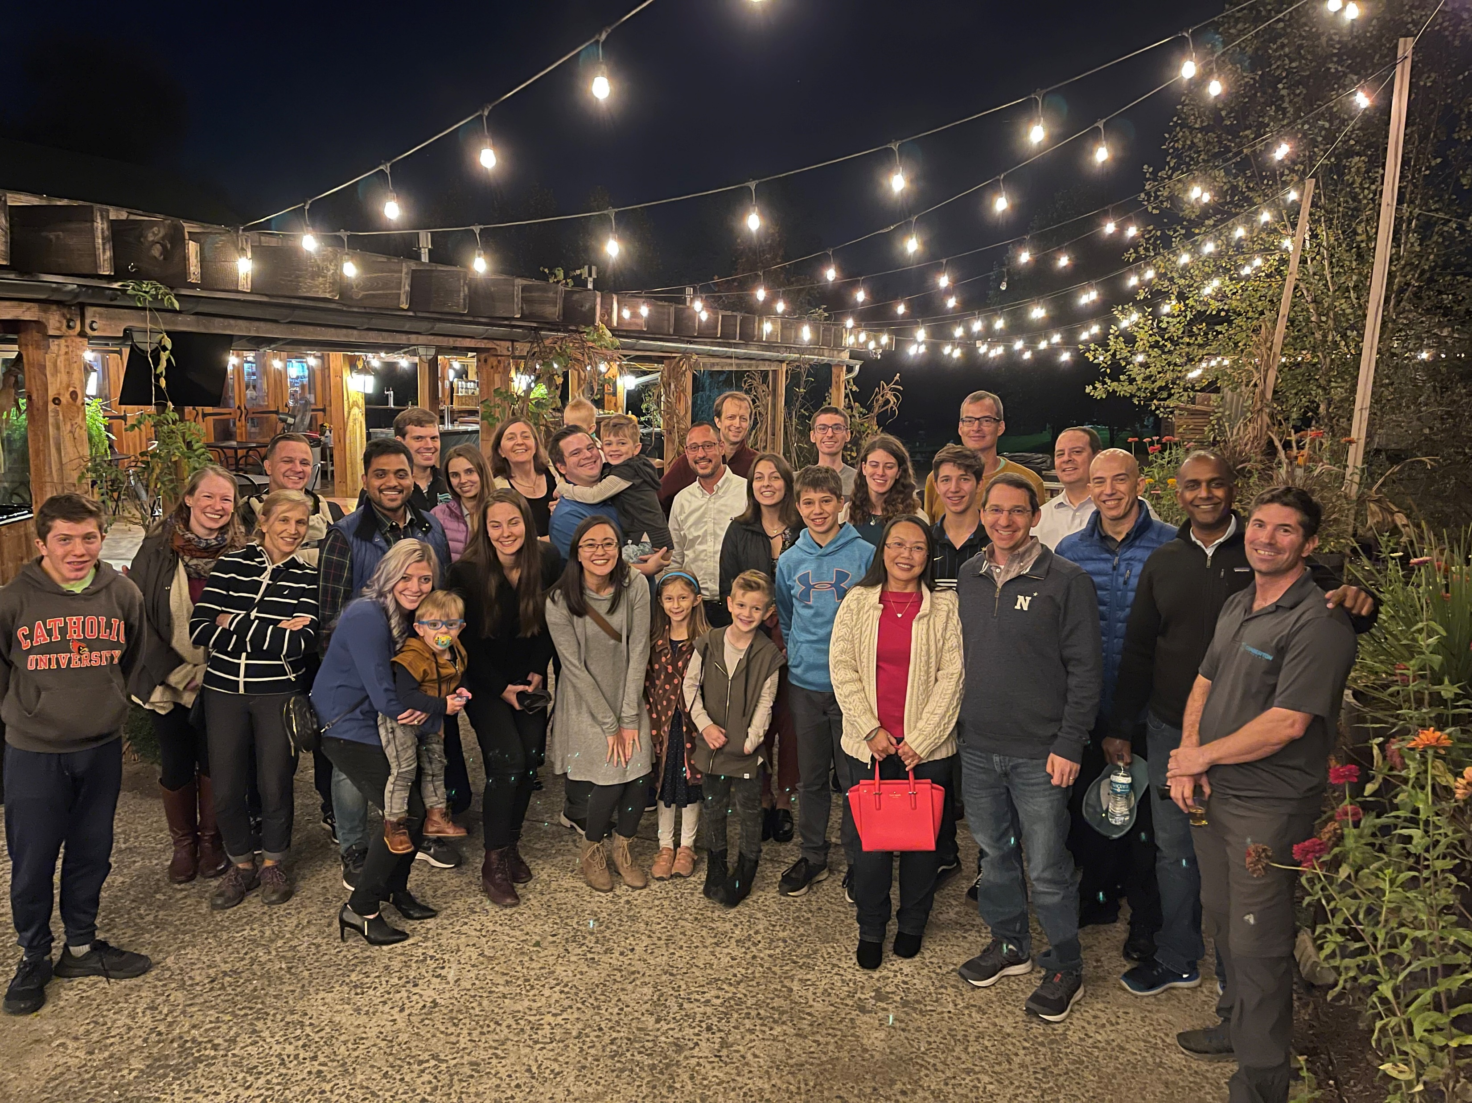
Chaberton Energy Is a Leading Regional Developer
We have a very experienced team, with a strong focus on solar generation projects that serves communities and customers in the Mid-Atlantic
We find project hosts, then we develop the projects from inception through construction, work with the local landowner to best design the project, the local jurisdictions to permit the project, the local utility for the interconnection, we prepare the site and project plans, and we arrange financing;
Our portfolio is composed of community solar projects, aggregate net meter projects for institutional clients, and other PPA-based projects with commercial and industrial customers, focused on projects <10 MW, such as this one
We have a portfolio of more than 50 projects under development
We leverage our network of local engineering firms, financing partners, and other subject matter experts to ensure project success;
We are well-capitalized through our partnership with Greenbacker Capital, which has a portfolio over $2B of operational renewable energy projects
Our corporate office is in North Bethesda, Maryland

Slide 3
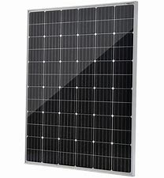
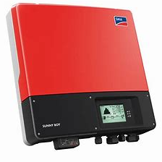
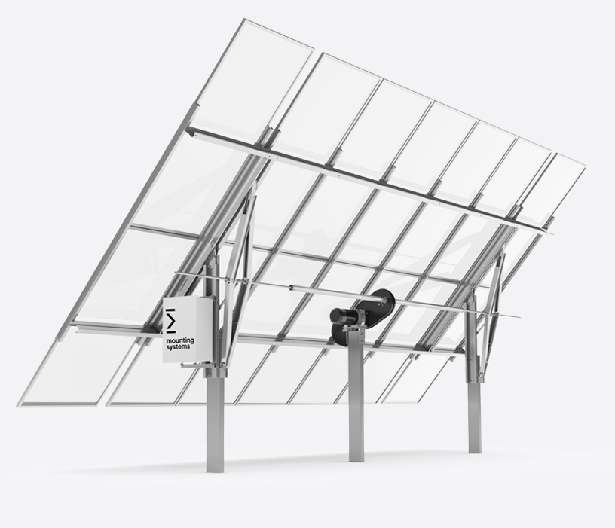
Components of a Solar Facility
Solar Panel
Produces energy from sunlight
Tempered Glass
Aluminum Frame
Laminated Backing
Silicon Cells
Plastic Junction Box
Copper Wiring
Inverter
Converts energy from DC to AC
Basically a computer
Internal components similar to residential transformers / electrical boxes
Does not contain liquid or containments
Racking
Typically pile driven galvanized steel I-Beams or Posts
Not different than other types of steel posts / foundations used in standard construction
Does not require large holes or poured concrete
Very small in ground footprint
There are no pollutants that can result in contaminated runoff in these components

Slide 4
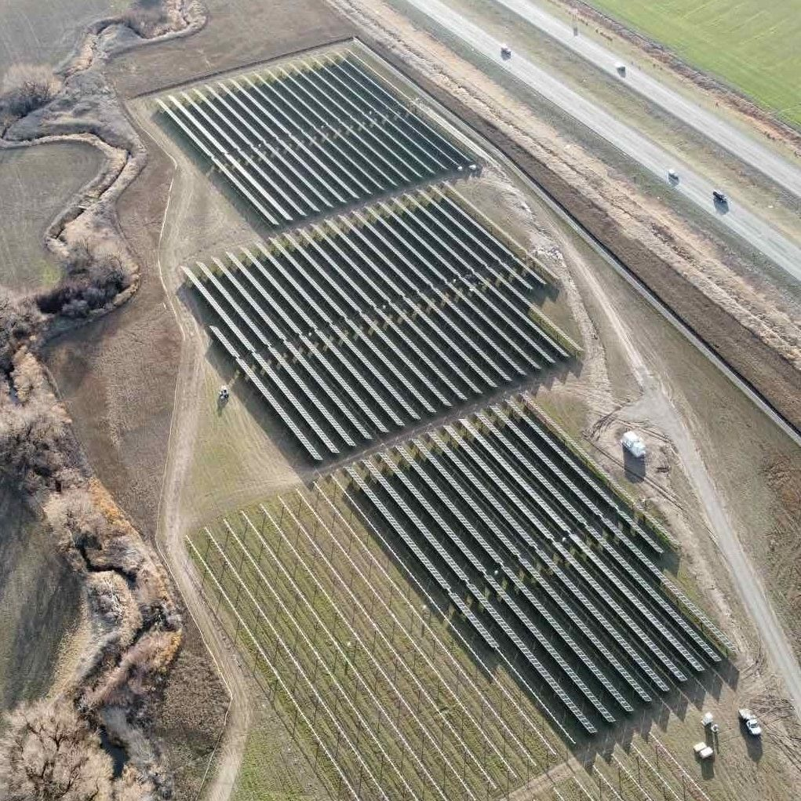
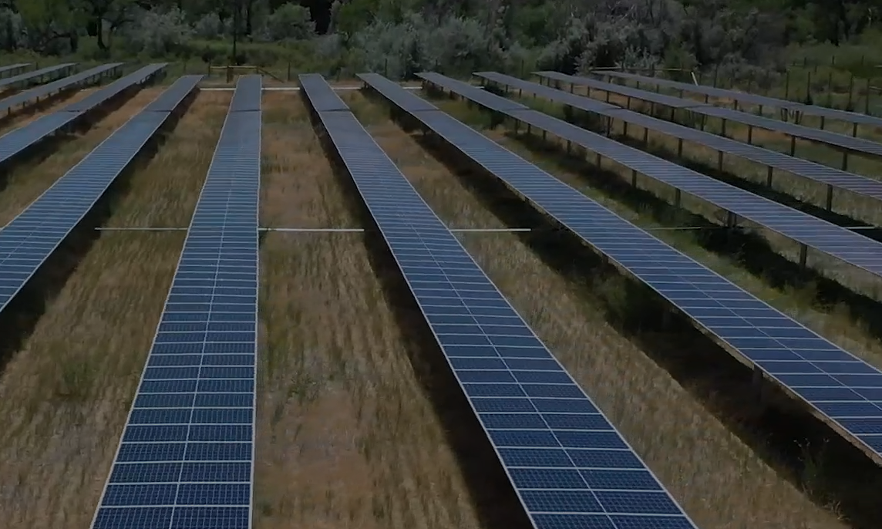
Reference Photos of Solar Facilities
Colorado- Owned by Greenbacker
Washington- Owned by Greenbacker

Slide 5
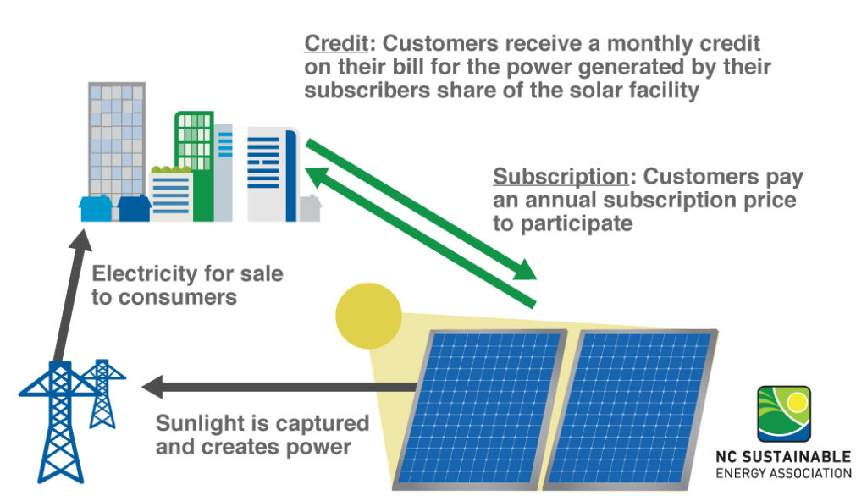
What is Community Solar?
The subscription price is a discount to the energy credits produced
Solar savings available to:
Homes that cannot accommodate solar
Renters or those who may have restrictions on their homes
Customers who might not be able to afford purchasing and installing solar themselves
Savings off utility bill are guaranteed
Increases grid’s reliability
Decarbonizes our electricity

Slide 6
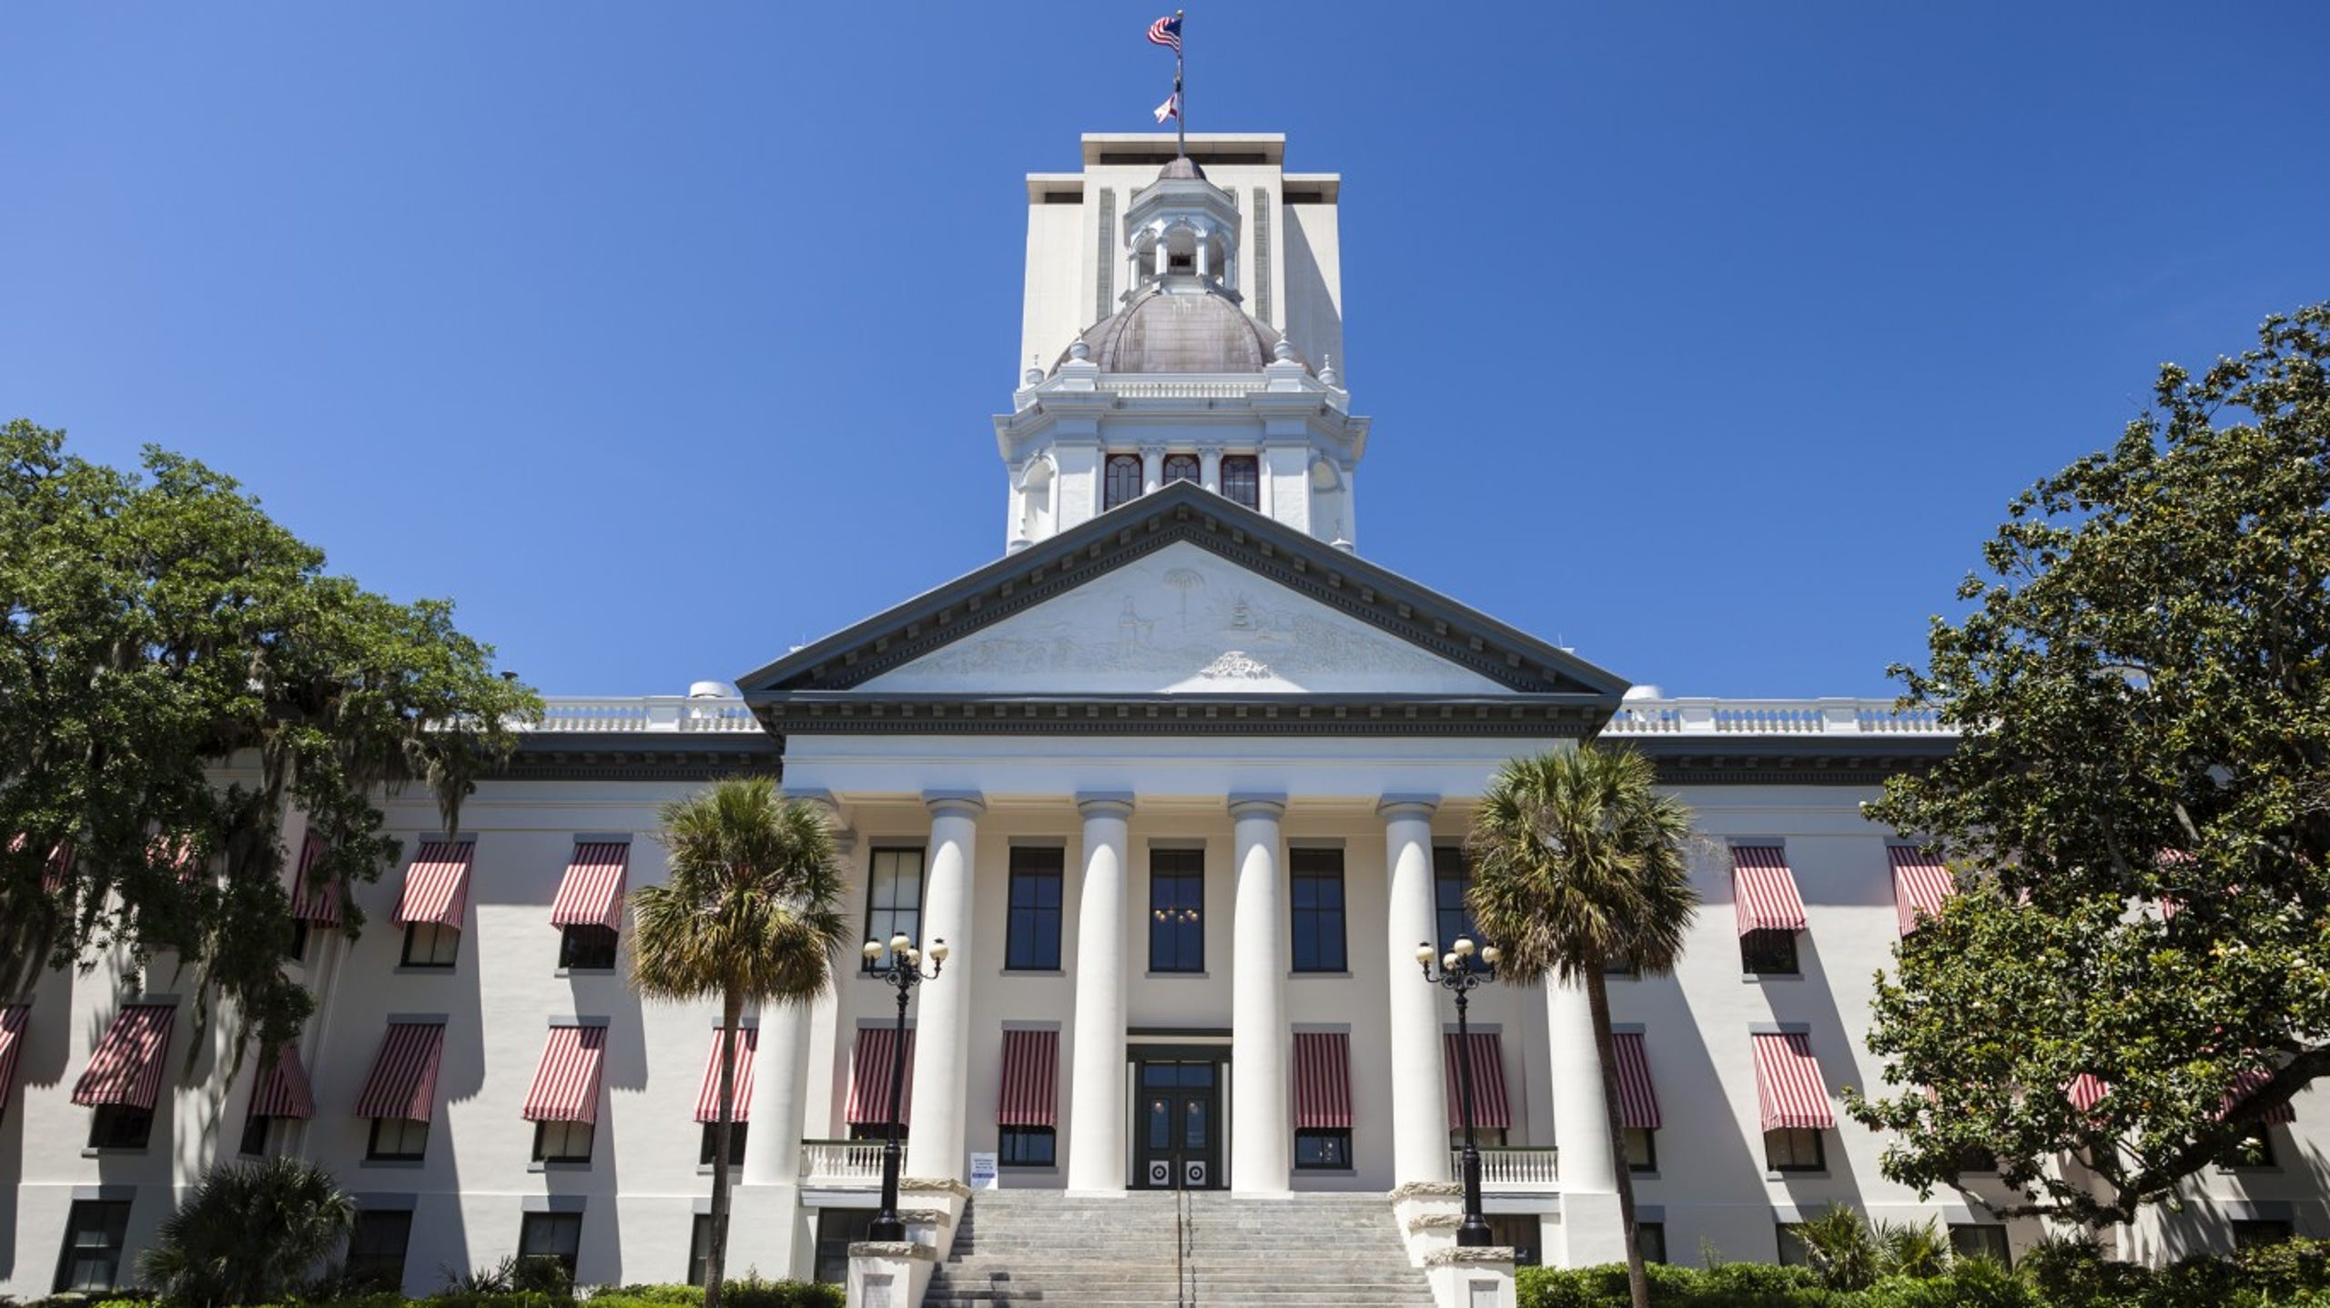
Why here?
Drivers of Solar Development
Renewable Portfolio Standard (RPS)
A requirement that electricity suppliers meet a prescribed minimum load of their portfolio from renewable energy sources
Recognizes the benefits of a diverse energy supply with a renewable energy component
In MD, the RPS is 50% by 2030; of that, 14.5% is the solar carve out
Electricity Price Increases
Maryland has the 14th highest average electricity cost at 11.15 cents per kWh (US Energy Information Administration)
The current 12-month Consumer Price Increase percentage increase is the highest for the energy sector under major categories at 30.3%; Electricity has risen 11% in the past 12 months (US Bureau of Labor Statistics)
Sustainability
Solar energy produces renewable, carbon free electricity
The federal government, as well as many States, recognize the tangible environmental benefits from renewable energy facilities and encourage development
Notes:
Utility Infrastructure
We need access & proximity to the point in the utility infrastructure we want to connect to
Grid needs to accommodate electrical generation
The grid infrastructure needs to be in good condition for us to connect
Land characteristics
The flatter the land the better – we want to avoid shade to our system
The type of soil is key – not all the soils work for solar
We need to make sure there are no sensitive environmental features such as wetlands - may deter us from a site or cut the amount of land we can use in a parcel
3, Landscaping
Our sites need strategic placement next to woods, or pre-existing vegetation to aid in our screening plans

Slide 7
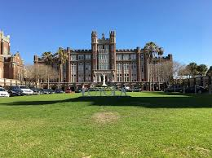
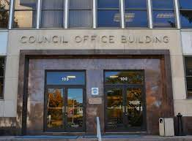
Why here?
Solar Benefits Multiple Stakeholders
Land Owners
Long term, stabile revenue
Ability to return land at end of the project
Power Off Takers
Immediate saving on utility bills
Long term, stabile energy pricing
Enhancement of Sustainability / ESG Goals
Localities
Added tax revenue with no drain on services
Support climate change / sustainability
Local power generation
Notes:
Utility Infrastructure
We need access & proximity to the point in the utility infrastructure we want to connect to
Grid needs to accommodate electrical generation
The grid infrastructure needs to be in good condition for us to connect
Land characteristics
The flatter the land the better – we want to avoid shade to our system
The type of soil is key – not all the soils work for solar
We need to make sure there are no sensitive environmental features such as wetlands - may deter us from a site or cut the amount of land we can use in a parcel
3, Landscaping
Our sites need strategic placement next to woods, or pre-existing vegetation to aid in our screening plans

Slide 8
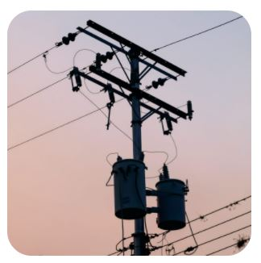
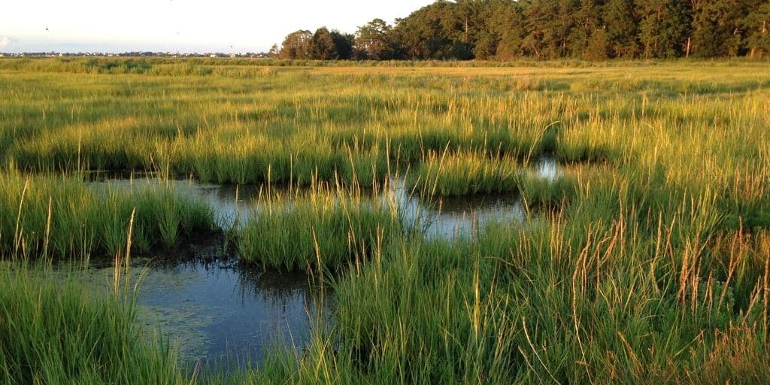
Why here?
Finding a site for solar is not easy…
We need to check a lot of boxes to find a property that works for solar
Proximity to
3 phase Powerlines with open capacity
Positive Environmental Impact
Gentle Slope
Screening
Notes:
Utility Infrastructure
We need access & proximity to the point in the utility infrastructure we want to connect to
Grid needs to accommodate electrical generation
The grid infrastructure needs to be in good condition for us to connect
Land characteristics
The flatter the land the better – we want to avoid shade to our system
The type of soil is key – not all the soils work for solar
We need to make sure there are no sensitive environmental features such as wetlands - may deter us from a site or cut the amount of land we can use in a parcel
3, Landscaping
Our sites need strategic placement next to woods, or pre-existing vegetation to aid in our screening plans

Slide 9
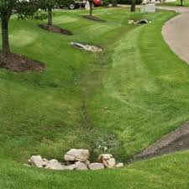
Why here?
Stormwater Considerations are a High Priority
We consider stormwater management starting day one in our design considerations. Stormwater calculations, inclusion of stormwater features, and the development of a Stormwater Pollution Prevention Plan (SWPPP) are standard for solar development.
Natural Mitigation
Man Made Mitigation
A solar facility has very little impervious surface
There is significant area between each row of panels, and the area underneath the panels are natural vegetation
It is typical to plant native vegetation and a pollinator habitat in the project area, which typically are better at absorbing stormwater
Super silt fence during construction
Creation of swales, basins, and bioretention facilities to collect and slow down stormwater
Use of level spreaders / stone trenches to direct stormwater and allow highest chance of absorption
Limited mowing or ongoing disturbance
Notes:
Utility Infrastructure
We need access & proximity to the point in the utility infrastructure we want to connect to
Grid needs to accommodate electrical generation
The grid infrastructure needs to be in good condition for us to connect
Land characteristics
The flatter the land the better – we want to avoid shade to our system
The type of soil is key – not all the soils work for solar
We need to make sure there are no sensitive environmental features such as wetlands - may deter us from a site or cut the amount of land we can use in a parcel
3, Landscaping
Our sites need strategic placement next to woods, or pre-existing vegetation to aid in our screening plans

Slide 10
Why here?
Stormwater Permitting
The Maryland Department of the Environment (MDE) sets minimum requires for stormwater management
Each individual County has an agency that reviews our applications specific to stormwater management, which use the requirements set forth by MDE and sometimes enacts more rigorous requirements
A qualified civil engineer creates a Stormwater Plan as well as a Soil Erosion and Sediment Control Plan for submittal
Typically, there are at least two levels of review of these plans: a Concept Level stormwater plan and a Detailed stormwater plan
Upon approval of the Stormwater and Pollution Prevention Plan & Soil Erosion and Sediment Control Plan, and Site Plan approval, a Notice of Intent (NOI) & National Pollutant Discharge Elimination System (NPDES) permit is issued by the MDE
Stormwater features are typically monitored by local inspectors during & post construction
It is standard for the Project to sign a management & maintenance agreement with the County to maintain the stormwater features
Notes:
Utility Infrastructure
We need access & proximity to the point in the utility infrastructure we want to connect to
Grid needs to accommodate electrical generation
The grid infrastructure needs to be in good condition for us to connect
Land characteristics
The flatter the land the better – we want to avoid shade to our system
The type of soil is key – not all the soils work for solar
We need to make sure there are no sensitive environmental features such as wetlands - may deter us from a site or cut the amount of land we can use in a parcel
3, Landscaping
Our sites need strategic placement next to woods, or pre-existing vegetation to aid in our screening plans

Slide 11
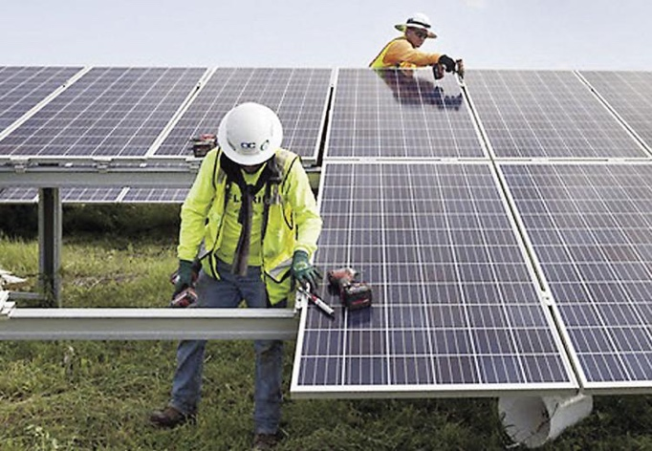
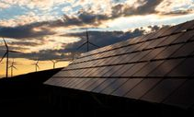
Construction Timeframe Is Short
Construction: 4 to 6 months with ~2 months of “peak” activity
Truck traffic
Lay down area used so trucks can drop off their equipment and leave; trucks will not block the road
Virtually no post-construction traffic
Hours of Construction
Excludes Sundays and holidays
Normally 10 hours/day in daylight hours
Willing to exclude specific dates / times as requested

Slide 12
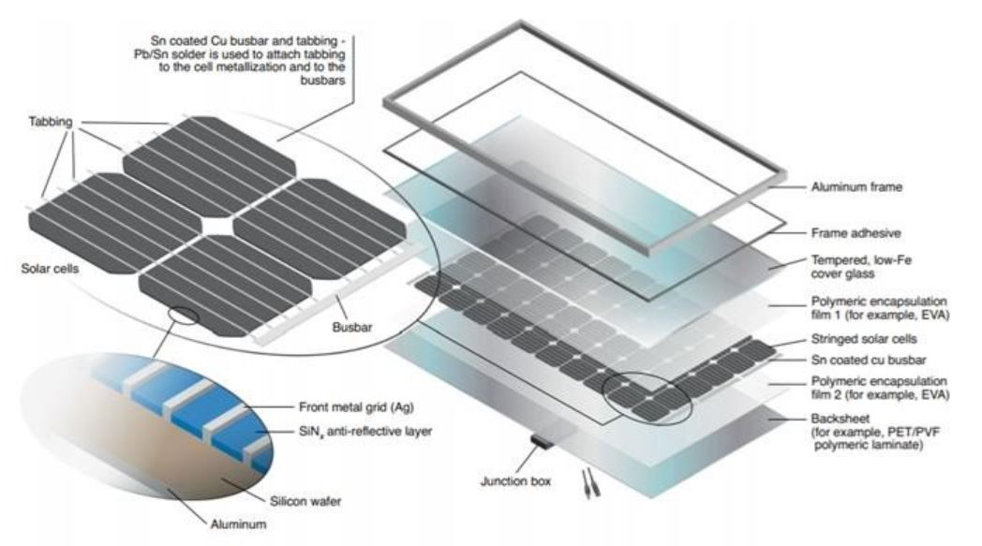
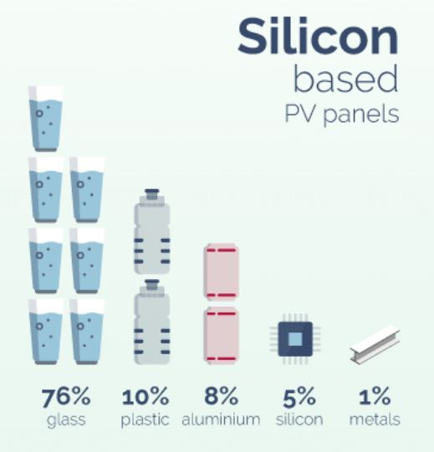
Most of the Solar Array Equipment is Recyclable
All the recoverable components in this solar array can be recycled at the end of life
Most of the parts are recyclable:
Silicon cells
Aluminum frame
Tempered glass
Also recyclable:
Inverters
Transformers
Racking
Plastic junction box
Copper wire
Source: GreenMatch website on Solar Panel Recycling
Source: EPA website on Solar Panel Recycling

Slide 13
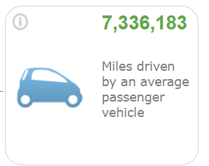
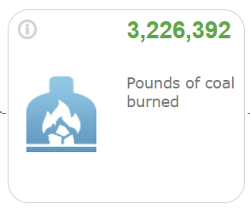
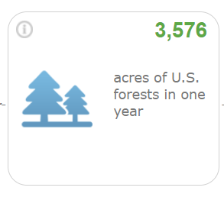
Solar Projects Provide Significant Environmental Benefits
Solar Project will generate clean, renewable electricity
Reduces the use of high-pollution energy sources, increasing air quality, saving lives, reducing incidence of respiratory and cardiovascular diseases, and improving life quality
A 2MWac solar array eliminates carbon emissions to the tune of 2,900 tons of CO2 a year, equivalent to*:
Increased stormwater management and lack of runoff or pollution will provide benefits to local waterways
No use of pesticides or other pollutants inside the solar array
Planting of native & stable ground cover
Emissions From:
CO2 Captured By:
* Estimates based on EPA GHG Calculator. Actual results will vary.

Slide 14
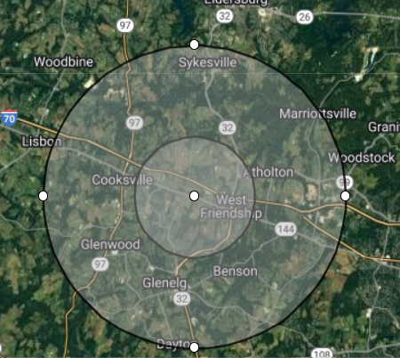
Pollinator Habitat Brings Significant Local Benefits
Pollinator friendly ground cover planted on site:
Improves local crop pollination within a five-mile radius, which will increase yields and crop quality near the facility
Over 75% of flowering plants need pollination
A single bee colony can pollinate over 300 million flowers a day
Pollinator habitat also works to stabilize the soil and improve water quality
Pollinators bring tangible benefits to nearby agriculture*:
Soybeans show an 18% higher yield and have heavier seeds when honeybees are present
Green bean seed yields are 9% to 35% higher with bumble bees present
Watermelons require at least 8 visits from pollinators for proper fruit set, and strawberries require at least 20 bee visits per receptacle
Apple flowers are self-sterile and depend heavily on cross pollination by bees
Pollinator benefits extend up to 5 miles, and are most pronounced within 2 miles
*Source: Maryland Pollinator Protection Plan from the Maryland Department of Agriculture

Slide 15
Unique Technology- Floating Solar
A floating solar farm is a solar energy installation on a body of water
Modular floats are assembled together to support PV modules
The floats are anchored to the banks or to the bottom of the body of water, depending on the specific configuration
Works very well for drinking water reservoirs, near shore application, irrigation ponds, and waste treatment ponds
Does not take up valuable, or environmentally sensitive, space on land
Helps generate significant amounts of renewable energy at competitive cost, through lower civil engineering cost, higher production from cooling, etc.
The solar installation shades the water, limiting algae growth and helping reduce evaporation

Slide 16
Thank you

