Slide 1
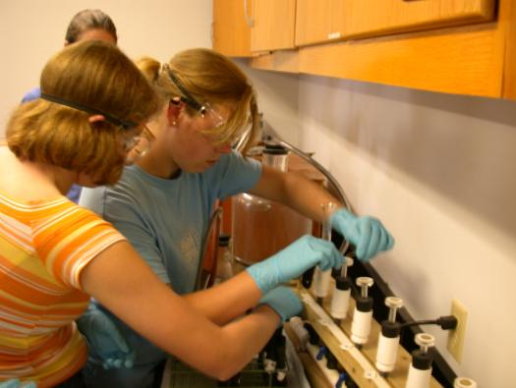
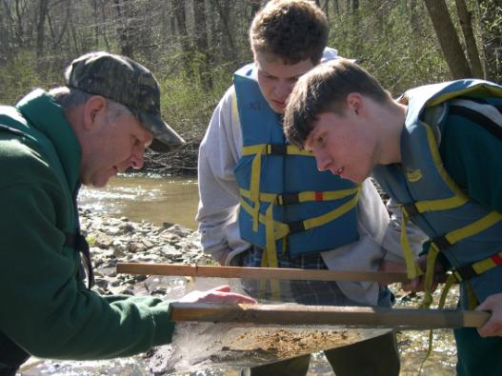
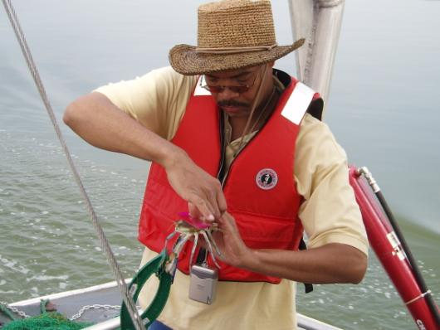
Chesapeake Bay Program Environmental Literacy Goal
April 20, 2016

Slide 2
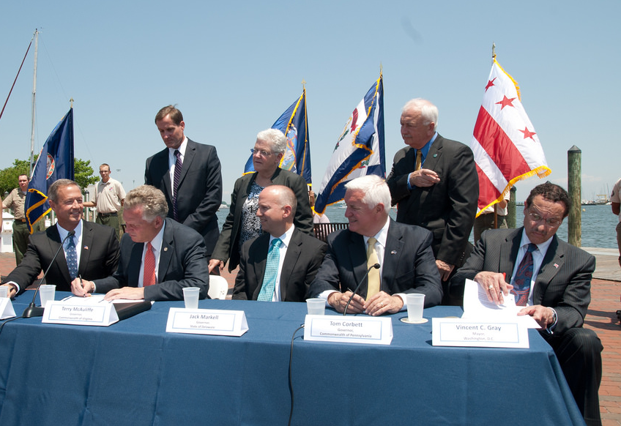
Environmental Literacy Goal
GOAL: Enable students in the region to graduate with the knowledge and skills to act responsibly to protect and restore their local watershed
OUTCOMES:
Student MWEEs
Sustainable Schools
Policy & Metrics
Notes:
As Nick mentioned, the Bay Program signed the new Chesapeake Bay Watershed Agreement on June 16, 2014.
The Agreement included an Environmental Literacy Goal that committed us to enabling students to graduate with the knowledge and skills to protect and restore their local watershed.
There were three associated outcomes for
Providing student Meaningful Watershed Educational Experiences – affectionately called MWEEs – in each elementary, middle, and high school
Increasing the number of Sustainable Schools and ensuring that students are actively engaged in those efforts
Establishing supportive policies, programs, and metrics at all levels to advance this work

Slide 3
Student MWEEs
Notes:
MWEEs are so much more than a field trip! They are an integrated approach to learning both in the classroom and out in the field designed to create a deeper understanding of the environment and its stressors.
They are not add ons. MWEEs can help schools and teachers teach core subjects, including NGSS, in a thought provoking and engaging way. In fact, Stanford University is just finishing up a review of
research that looks at the evidence in support of environmental education and K-12 student
outcomes. In 81 studies that examined knowledge, 98% reported student knowledge gains. See the handout in your packets for more preliminary findings from their study.
Teachers are essential to MWEE implementation, guiding their students through the entire process and ensuring that it remains grounded in core subjects. Therefore, professional development that includes both content and outdoor education pedagogy is important.
The MWEE is revisited by teachers over time as the students engage in four essential elements:
Issue Definition
Outdoor Field Experiences
Action Projects
Synthesis and Conclusions
The definition of a MWEE can be found in your packets. The Workgroup is also working with partners to put together a Handbook for Practitioners, which will be available later this year.
You are going to see several examples of MWEEs as we move forward with today’s agenda.

Slide 4
Student MWEEs
Notes:
MWEEs are so much more than a field trip! They are an integrated approach to learning both in the classroom and out in the field designed to create a deeper understanding of the environment and its stressors.
They are not add ons. MWEEs can help schools and teachers teach core subjects, including NGSS, in a thought provoking and engaging way. In fact, Stanford University is just finishing up a review of
research that looks at the evidence in support of environmental education and K-12 student
outcomes. In 81 studies that examined knowledge, 98% reported student knowledge gains. See the handout in your packets for more preliminary findings from their study.
Teachers are essential to MWEE implementation, guiding their students through the entire process and ensuring that it remains grounded in core subjects. Therefore, professional development that includes both content and outdoor education pedagogy is important.
The MWEE is revisited by teachers over time as the students engage in four essential elements:
Issue Definition
Outdoor Field Experiences
Action Projects
Synthesis and Conclusions
The definition of a MWEE can be found in your packets. The Workgroup is also working with partners to put together a Handbook for Practitioners, which will be available later this year.
You are going to see several examples of MWEEs as we move forward with today’s agenda.

Slide 5
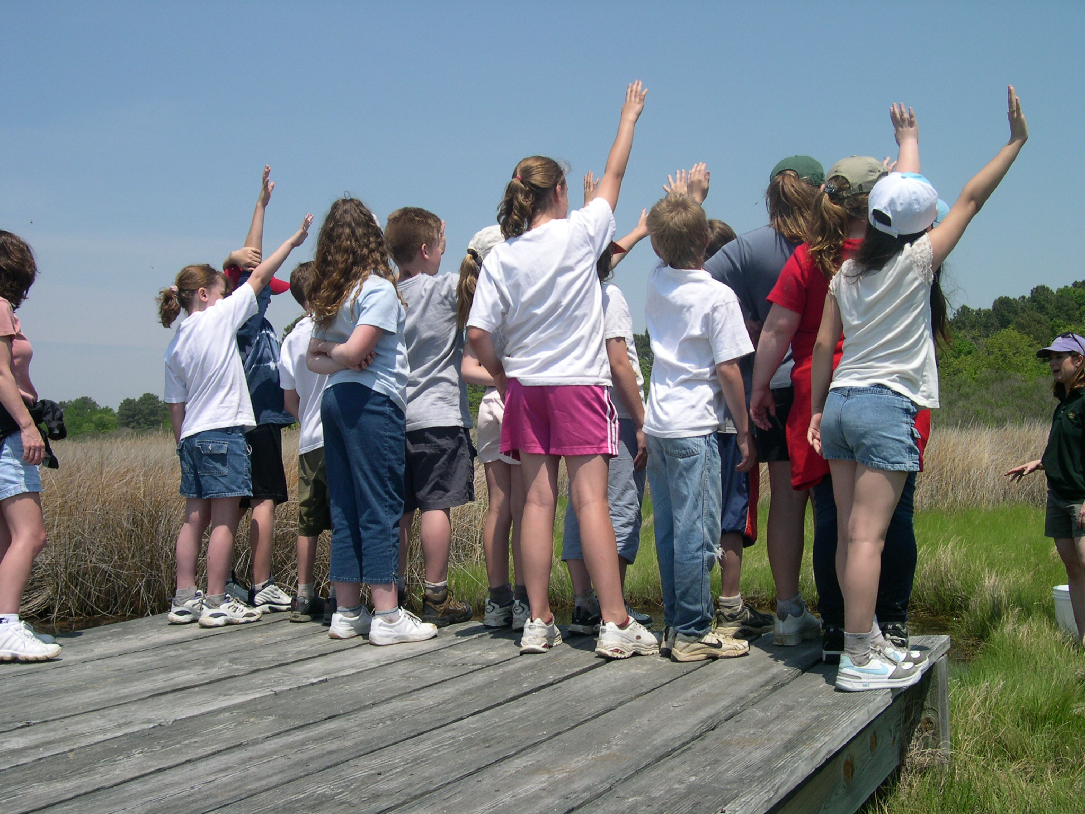
Notes:
MWEEs are so much more than a field trip! They are an integrated approach to learning both in the classroom and out in the field designed to create a deeper understanding of the environment and its stressors.
They are not add ons. MWEEs can help schools and teachers teach core subjects, including NGSS, in a thought provoking and engaging way. In fact, Stanford University is just finishing up a review of
research that looks at the evidence in support of environmental education and K-12 student
outcomes. In 81 studies that examined knowledge, 98% reported student knowledge gains. See the handout in your packets for more preliminary findings from their study.
Teachers are essential to MWEE implementation, guiding their students through the entire process and ensuring that it remains grounded in core subjects. Therefore, professional development that includes both content and outdoor education pedagogy is important.
The MWEE is revisited by teachers over time as the students engage in four essential elements:
Issue Definition
Outdoor Field Experiences
Action Projects
Synthesis and Conclusions
The definition of a MWEE can be found in your packets. The Workgroup is also working with partners to put together a Handbook for Practitioners, which will be available later this year.
You are going to see several examples of MWEEs as we move forward with today’s agenda.

Slide 6
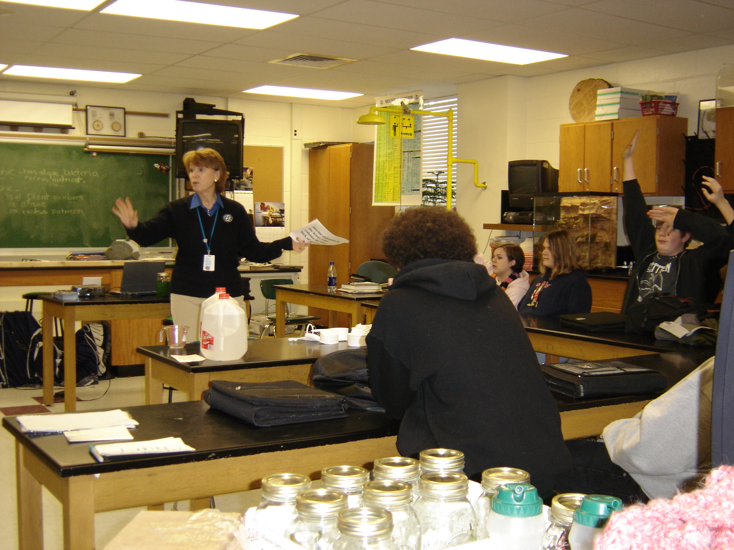
Notes:
MWEEs are so much more than a field trip! They are an integrated approach to learning both in the classroom and out in the field designed to create a deeper understanding of the environment and its stressors.
They are not add ons. MWEEs can help schools and teachers teach core subjects, including NGSS, in a thought provoking and engaging way. In fact, Stanford University is just finishing up a review of
research that looks at the evidence in support of environmental education and K-12 student
outcomes. In 81 studies that examined knowledge, 98% reported student knowledge gains. See the handout in your packets for more preliminary findings from their study.
Teachers are essential to MWEE implementation, guiding their students through the entire process and ensuring that it remains grounded in core subjects. Therefore, professional development that includes both content and outdoor education pedagogy is important.
The MWEE is revisited by teachers over time as the students engage in four essential elements:
Issue Definition
Outdoor Field Experiences
Action Projects
Synthesis and Conclusions
The definition of a MWEE can be found in your packets. The Workgroup is also working with partners to put together a Handbook for Practitioners, which will be available later this year.
You are going to see several examples of MWEEs as we move forward with today’s agenda.

Slide 7
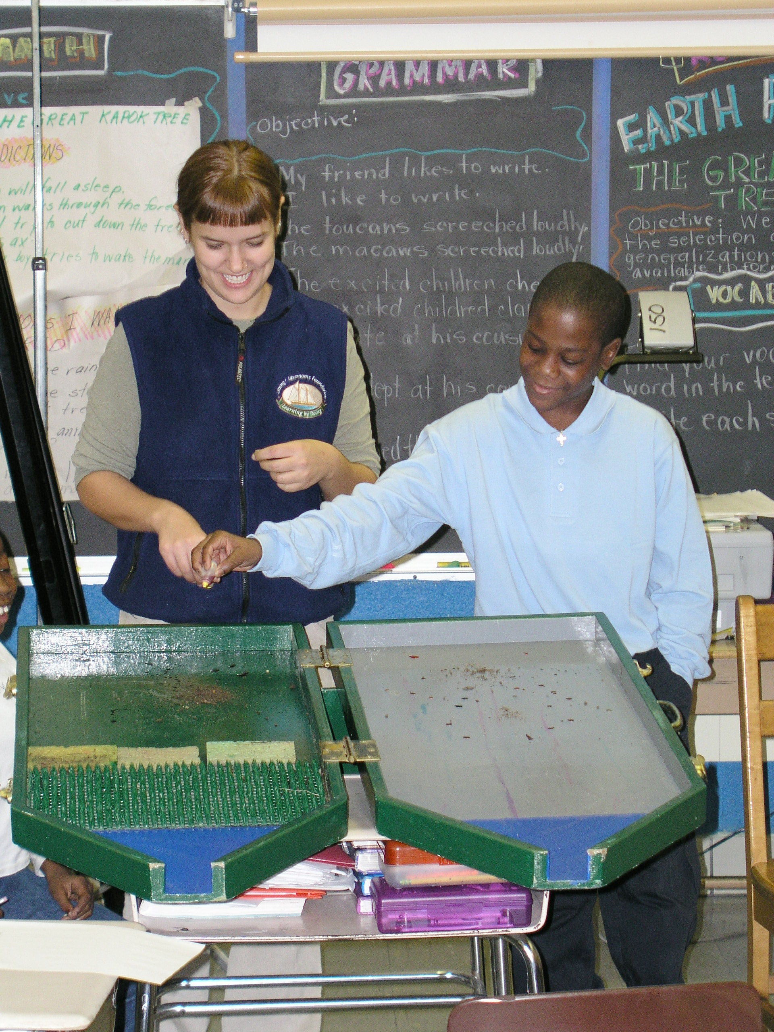
Notes:
MWEEs are so much more than a field trip! They are an integrated approach to learning both in the classroom and out in the field designed to create a deeper understanding of the environment and its stressors.
They are not add ons. MWEEs can help schools and teachers teach core subjects, including NGSS, in a thought provoking and engaging way. In fact, Stanford University is just finishing up a review of
research that looks at the evidence in support of environmental education and K-12 student
outcomes. In 81 studies that examined knowledge, 98% reported student knowledge gains. See the handout in your packets for more preliminary findings from their study.
Teachers are essential to MWEE implementation, guiding their students through the entire process and ensuring that it remains grounded in core subjects. Therefore, professional development that includes both content and outdoor education pedagogy is important.
The MWEE is revisited by teachers over time as the students engage in four essential elements:
Issue Definition
Outdoor Field Experiences
Action Projects
Synthesis and Conclusions
The definition of a MWEE can be found in your packets. The Workgroup is also working with partners to put together a Handbook for Practitioners, which will be available later this year.
You are going to see several examples of MWEEs as we move forward with today’s agenda.

Slide 8
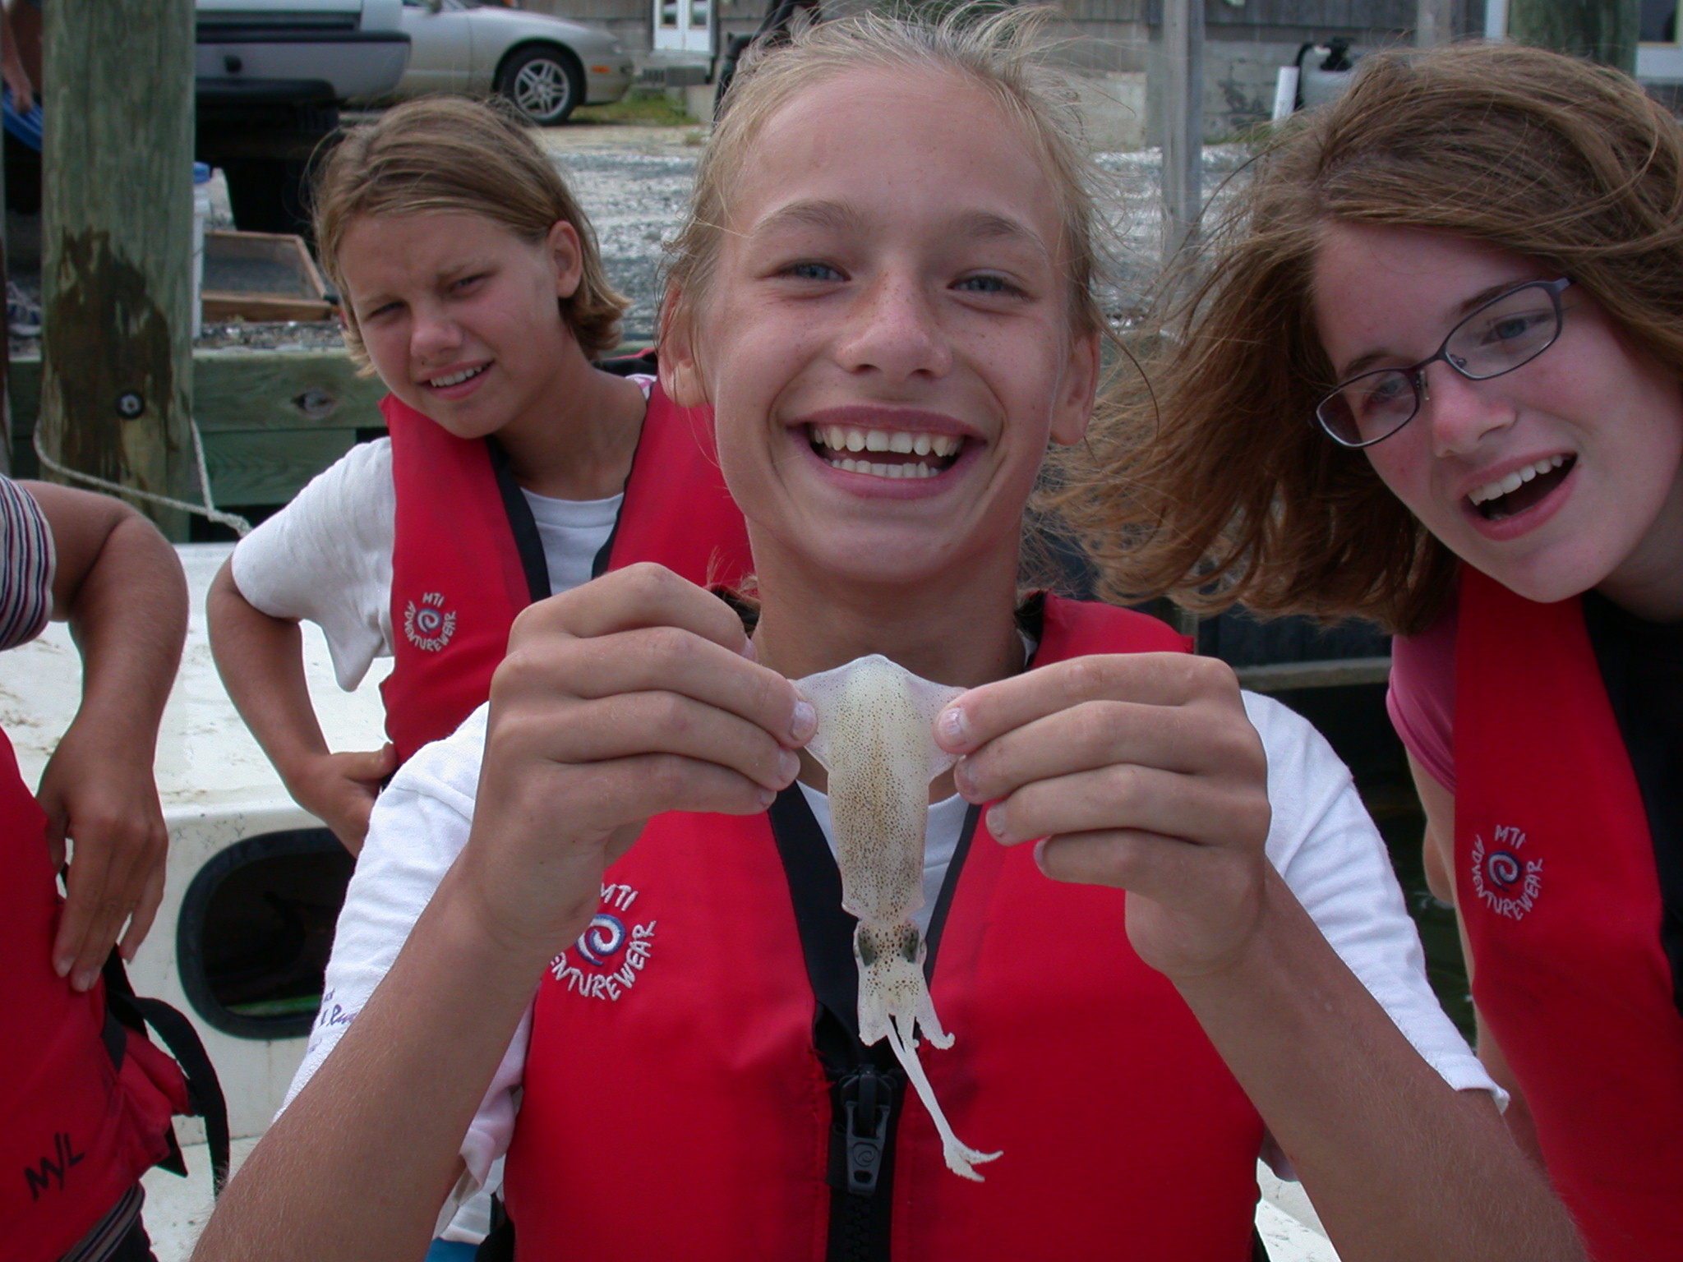
Notes:
MWEEs are so much more than a field trip! They are an integrated approach to learning both in the classroom and out in the field designed to create a deeper understanding of the environment and its stressors.
They are not add ons. MWEEs can help schools and teachers teach core subjects, including NGSS, in a thought provoking and engaging way. In fact, Stanford University is just finishing up a review of
research that looks at the evidence in support of environmental education and K-12 student
outcomes. In 81 studies that examined knowledge, 98% reported student knowledge gains. See the handout in your packets for more preliminary findings from their study.
Teachers are essential to MWEE implementation, guiding their students through the entire process and ensuring that it remains grounded in core subjects. Therefore, professional development that includes both content and outdoor education pedagogy is important.
The MWEE is revisited by teachers over time as the students engage in four essential elements:
Issue Definition
Outdoor Field Experiences
Action Projects
Synthesis and Conclusions
The definition of a MWEE can be found in your packets. The Workgroup is also working with partners to put together a Handbook for Practitioners, which will be available later this year.
You are going to see several examples of MWEEs as we move forward with today’s agenda.

Slide 9
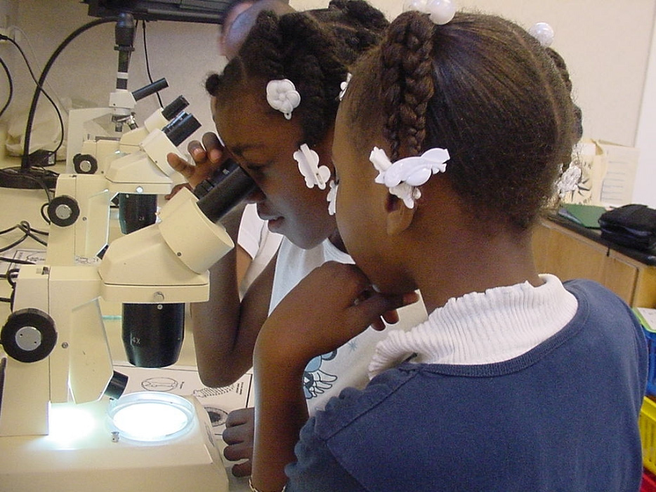
Notes:
MWEEs are so much more than a field trip! They are an integrated approach to learning both in the classroom and out in the field designed to create a deeper understanding of the environment and its stressors.
They are not add ons. MWEEs can help schools and teachers teach core subjects, including NGSS, in a thought provoking and engaging way. In fact, Stanford University is just finishing up a review of
research that looks at the evidence in support of environmental education and K-12 student
outcomes. In 81 studies that examined knowledge, 98% reported student knowledge gains. See the handout in your packets for more preliminary findings from their study.
Teachers are essential to MWEE implementation, guiding their students through the entire process and ensuring that it remains grounded in core subjects. Therefore, professional development that includes both content and outdoor education pedagogy is important.
The MWEE is revisited by teachers over time as the students engage in four essential elements:
Issue Definition
Outdoor Field Experiences
Action Projects
Synthesis and Conclusions
The definition of a MWEE can be found in your packets. The Workgroup is also working with partners to put together a Handbook for Practitioners, which will be available later this year.
You are going to see several examples of MWEEs as we move forward with today’s agenda.

Slide 10
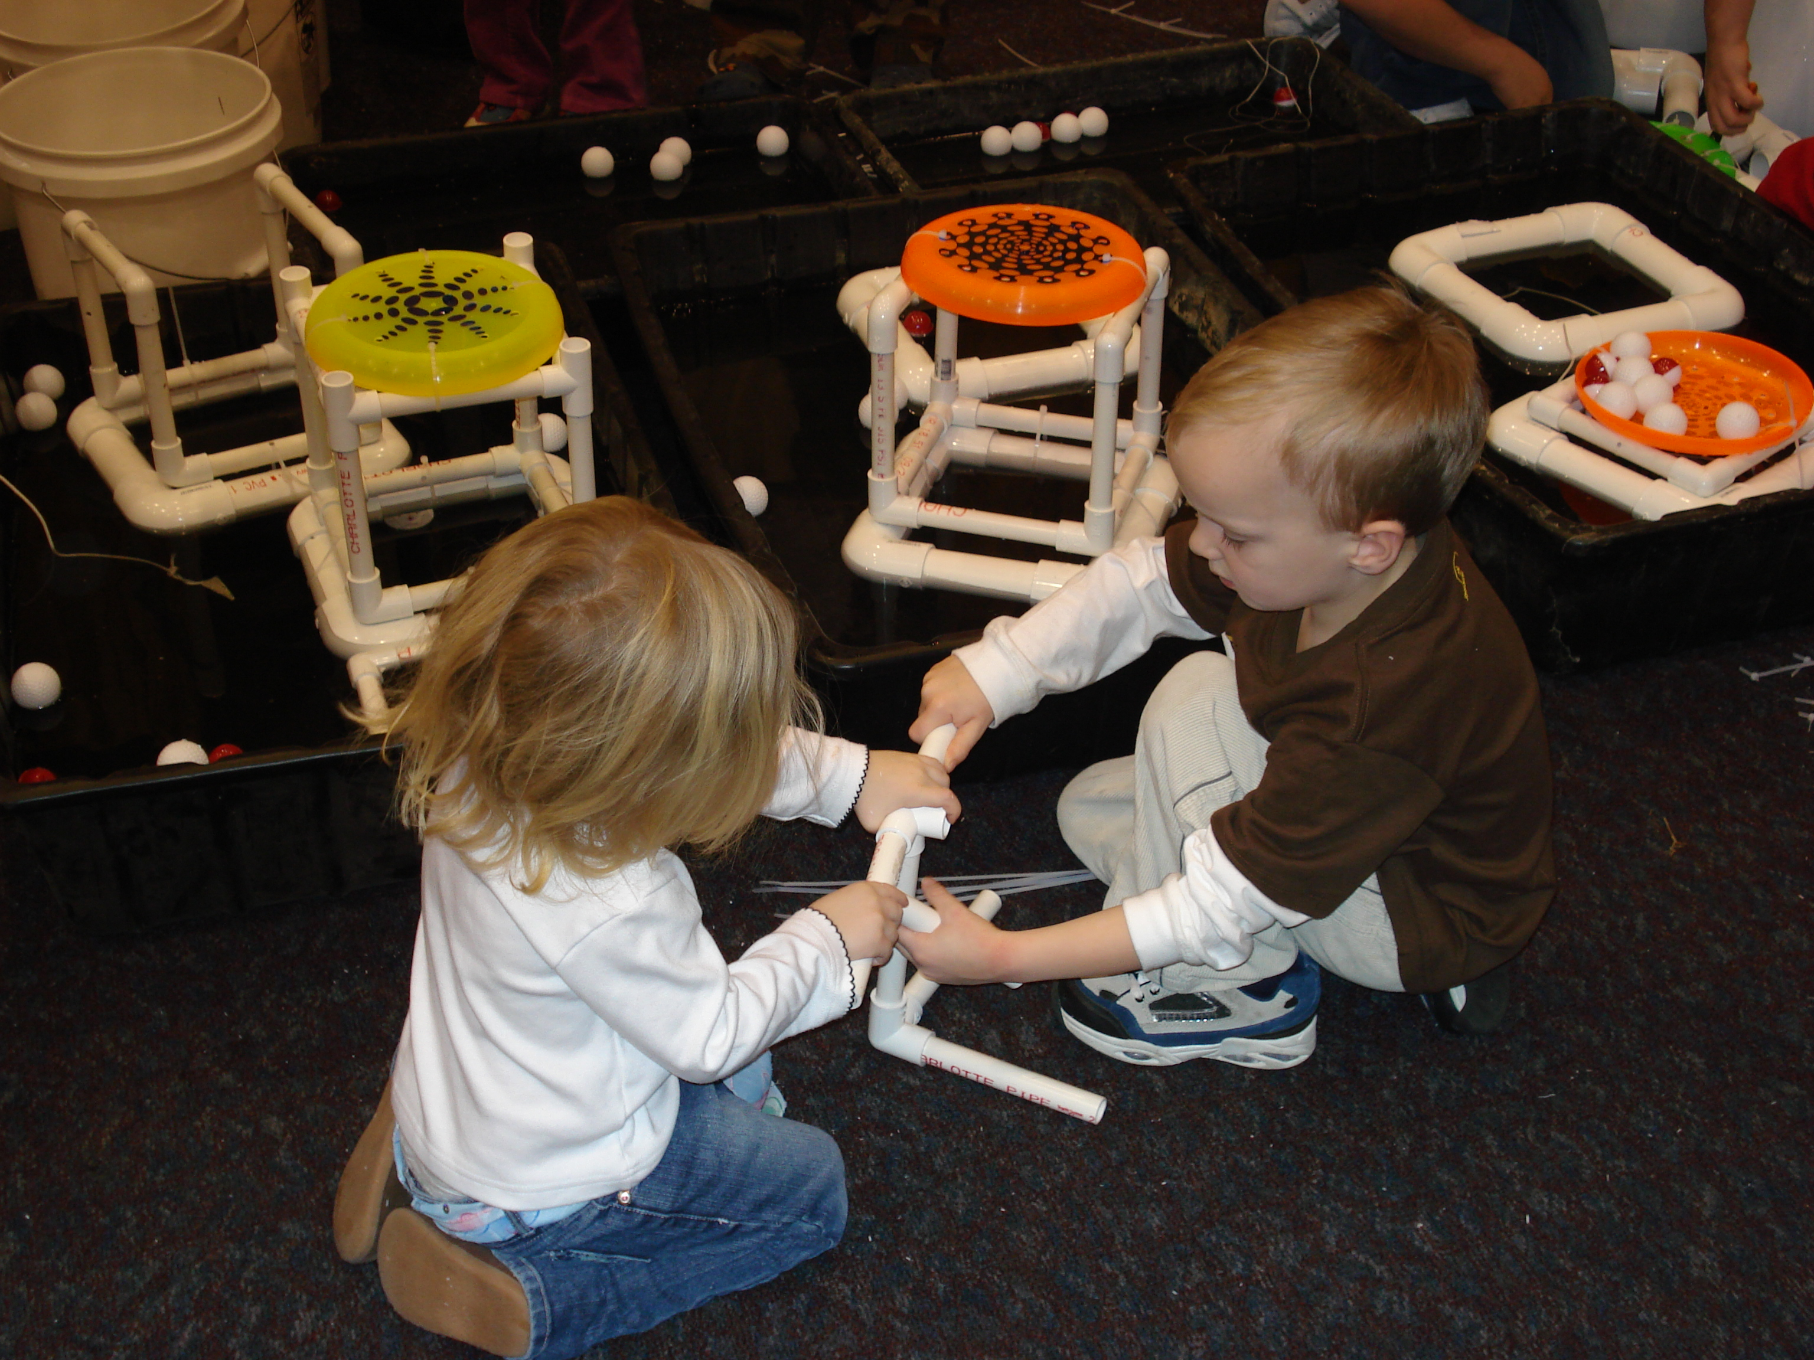
Notes:
MWEEs are so much more than a field trip! They are an integrated approach to learning both in the classroom and out in the field designed to create a deeper understanding of the environment and its stressors.
They are not add ons. MWEEs can help schools and teachers teach core subjects, including NGSS, in a thought provoking and engaging way. In fact, Stanford University is just finishing up a review of
research that looks at the evidence in support of environmental education and K-12 student
outcomes. In 81 studies that examined knowledge, 98% reported student knowledge gains. See the handout in your packets for more preliminary findings from their study.
Teachers are essential to MWEE implementation, guiding their students through the entire process and ensuring that it remains grounded in core subjects. Therefore, professional development that includes both content and outdoor education pedagogy is important.
The MWEE is revisited by teachers over time as the students engage in four essential elements:
Issue Definition
Outdoor Field Experiences
Action Projects
Synthesis and Conclusions
The definition of a MWEE can be found in your packets. The Workgroup is also working with partners to put together a Handbook for Practitioners, which will be available later this year.
You are going to see several examples of MWEEs as we move forward with today’s agenda.

Slide 11
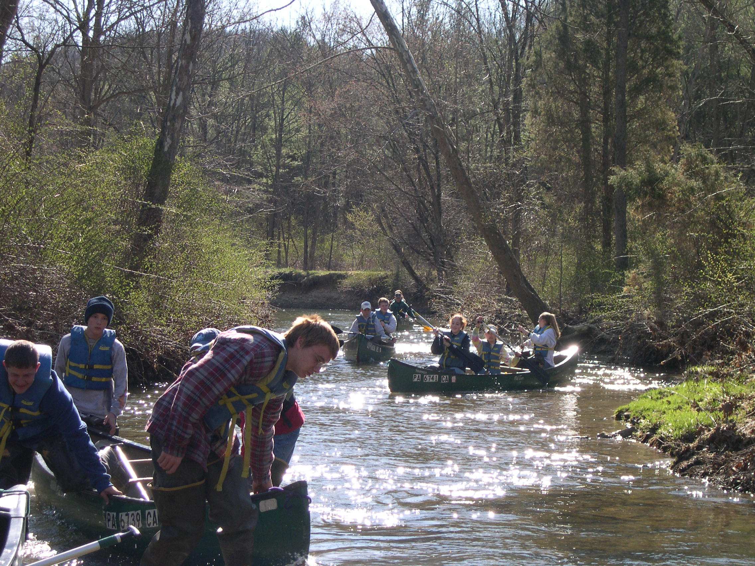
Notes:
MWEEs are so much more than a field trip! They are an integrated approach to learning both in the classroom and out in the field designed to create a deeper understanding of the environment and its stressors.
They are not add ons. MWEEs can help schools and teachers teach core subjects, including NGSS, in a thought provoking and engaging way. In fact, Stanford University is just finishing up a review of
research that looks at the evidence in support of environmental education and K-12 student
outcomes. In 81 studies that examined knowledge, 98% reported student knowledge gains. See the handout in your packets for more preliminary findings from their study.
Teachers are essential to MWEE implementation, guiding their students through the entire process and ensuring that it remains grounded in core subjects. Therefore, professional development that includes both content and outdoor education pedagogy is important.
The MWEE is revisited by teachers over time as the students engage in four essential elements:
Issue Definition
Outdoor Field Experiences
Action Projects
Synthesis and Conclusions
The definition of a MWEE can be found in your packets. The Workgroup is also working with partners to put together a Handbook for Practitioners, which will be available later this year.
You are going to see several examples of MWEEs as we move forward with today’s agenda.

Slide 12
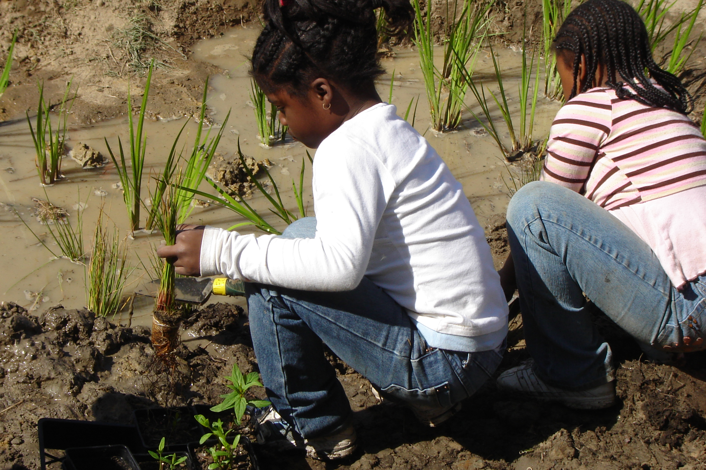
Notes:
MWEEs are so much more than a field trip! They are an integrated approach to learning both in the classroom and out in the field designed to create a deeper understanding of the environment and its stressors.
They are not add ons. MWEEs can help schools and teachers teach core subjects, including NGSS, in a thought provoking and engaging way. In fact, Stanford University is just finishing up a review of
research that looks at the evidence in support of environmental education and K-12 student
outcomes. In 81 studies that examined knowledge, 98% reported student knowledge gains. See the handout in your packets for more preliminary findings from their study.
Teachers are essential to MWEE implementation, guiding their students through the entire process and ensuring that it remains grounded in core subjects. Therefore, professional development that includes both content and outdoor education pedagogy is important.
The MWEE is revisited by teachers over time as the students engage in four essential elements:
Issue Definition
Outdoor Field Experiences
Action Projects
Synthesis and Conclusions
The definition of a MWEE can be found in your packets. The Workgroup is also working with partners to put together a Handbook for Practitioners, which will be available later this year.
You are going to see several examples of MWEEs as we move forward with today’s agenda.

Slide 13
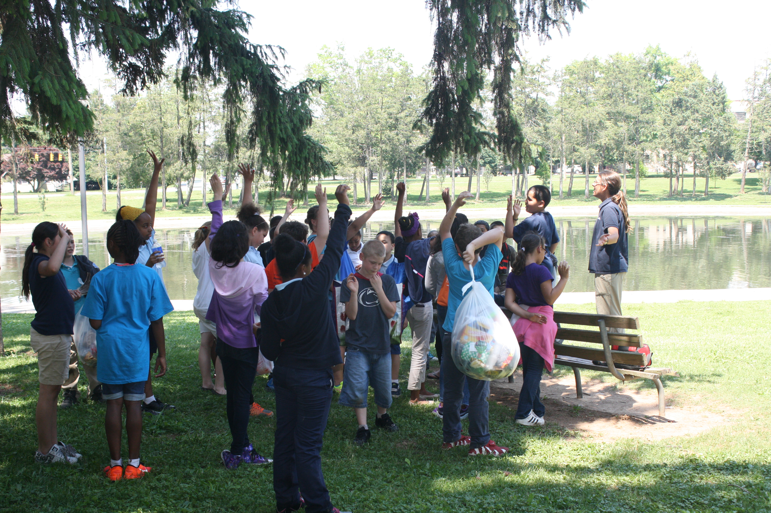
Notes:
MWEEs are so much more than a field trip! They are an integrated approach to learning both in the classroom and out in the field designed to create a deeper understanding of the environment and its stressors.
They are not add ons. MWEEs can help schools and teachers teach core subjects, including NGSS, in a thought provoking and engaging way. In fact, Stanford University is just finishing up a review of
research that looks at the evidence in support of environmental education and K-12 student
outcomes. In 81 studies that examined knowledge, 98% reported student knowledge gains. See the handout in your packets for more preliminary findings from their study.
Teachers are essential to MWEE implementation, guiding their students through the entire process and ensuring that it remains grounded in core subjects. Therefore, professional development that includes both content and outdoor education pedagogy is important.
The MWEE is revisited by teachers over time as the students engage in four essential elements:
Issue Definition
Outdoor Field Experiences
Action Projects
Synthesis and Conclusions
The definition of a MWEE can be found in your packets. The Workgroup is also working with partners to put together a Handbook for Practitioners, which will be available later this year.
You are going to see several examples of MWEEs as we move forward with today’s agenda.

Slide 14
Notes:
MWEEs are so much more than a field trip! They are an integrated approach to learning both in the classroom and out in the field designed to create a deeper understanding of the environment and its stressors.
They are not add ons. MWEEs can help schools and teachers teach core subjects, including NGSS, in a thought provoking and engaging way. In fact, Stanford University is just finishing up a review of
research that looks at the evidence in support of environmental education and K-12 student
outcomes. In 81 studies that examined knowledge, 98% reported student knowledge gains. See the handout in your packets for more preliminary findings from their study.
Teachers are essential to MWEE implementation, guiding their students through the entire process and ensuring that it remains grounded in core subjects. Therefore, professional development that includes both content and outdoor education pedagogy is important.
The MWEE is revisited by teachers over time as the students engage in four essential elements:
Issue Definition
Outdoor Field Experiences
Action Projects
Synthesis and Conclusions
The definition of a MWEE can be found in your packets. The Workgroup is also working with partners to put together a Handbook for Practitioners, which will be available later this year.
You are going to see several examples of MWEEs as we move forward with today’s agenda.

Slide 15
Sustainable Schools
Notes:
The second outcome focuses on Sustainable Schools, which are important for their environmental impact, but also because they can be used to teach students valuable life skills that encourage students to walk the walk. By the way, by increasing efficiency they also tend to save school systems considerable amounts of money which can be reinvested into student programs.
US Dept of Education has incentivized the development of sustainable schools through the creation of US Green Ribbon Schools. We have adopted the Green Ribbon Schools pillars here in the Mid Atlantic. In many instances, there are state specific criteria that respond to local considerations – but most build off of the Green Ribbon pillars.
These pillars are (1) Environmental Impact and Costs, (2) Health and Wellness, and (3) environmental and sustainability education, which focuses on student learning with an emphasis on STEM and civic engagement.
There are several key partners helping advance this work here in the region, including National Wildlife Federation through their EcoSchools Program and US EPA Region 3 with an emphasis on healthy schools. There are also state partners working day in and day out with schools and students to plan and implement projects.

Slide 16
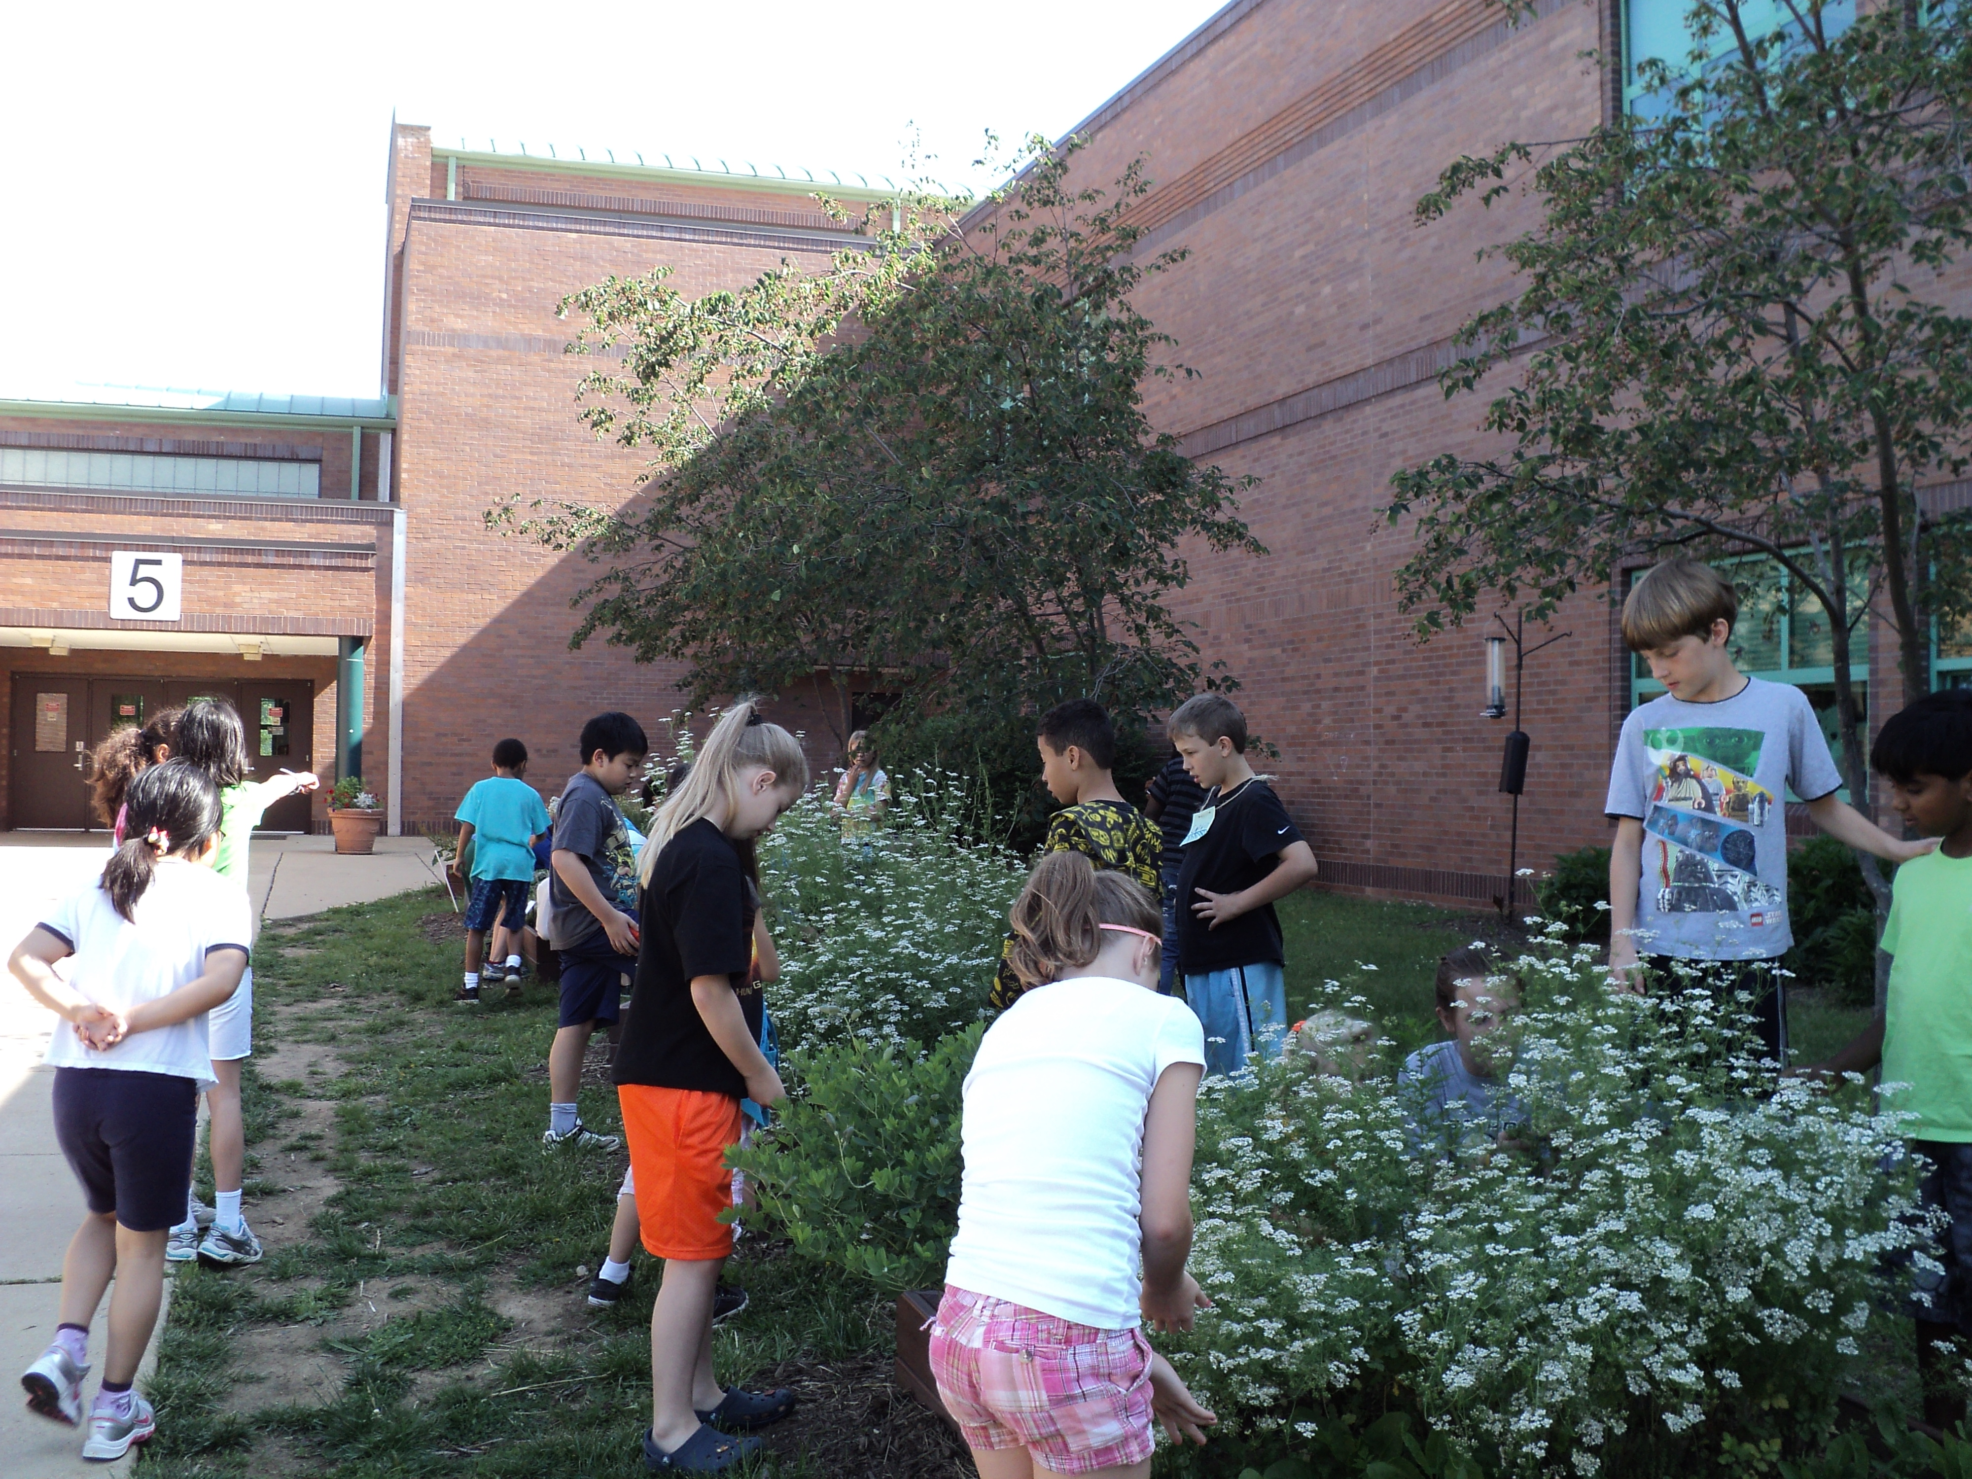
Notes:
The second outcome focuses on Sustainable Schools, which are important for their environmental impact, but also because they can be used to teach students valuable life skills that encourage students to walk the walk. By the way, by increasing efficiency they also tend to save school systems considerable amounts of money which can be reinvested into student programs.
US Dept of Education has incentivized the development of sustainable schools through the creation of US Green Ribbon Schools. We have adopted the Green Ribbon Schools pillars here in the Mid Atlantic. In many instances, there are state specific criteria that respond to local considerations – but most build off of the Green Ribbon pillars.
These pillars are (1) Environmental Impact and Costs, (2) Health and Wellness, and (3) environmental and sustainability education, which focuses on student learning with an emphasis on STEM and civic engagement.
There are several key partners helping advance this work here in the region, including National Wildlife Federation through their EcoSchools Program and US EPA Region 3 with an emphasis on healthy schools. There are also state partners working day in and day out with schools and students to plan and implement projects.

Slide 17
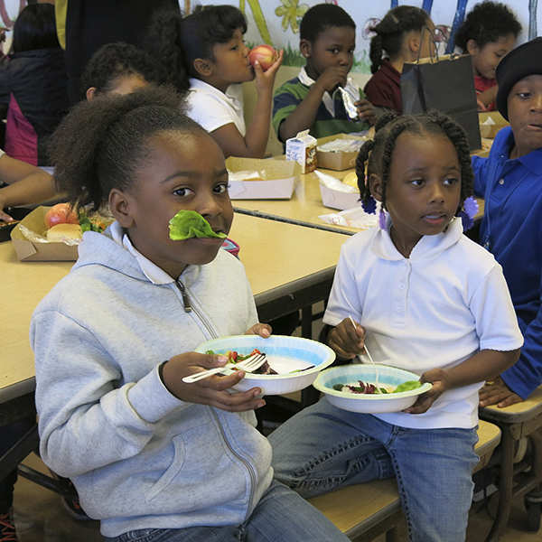
Notes:
The second outcome focuses on Sustainable Schools, which are important for their environmental impact, but also because they can be used to teach students valuable life skills that encourage students to walk the walk. By the way, by increasing efficiency they also tend to save school systems considerable amounts of money which can be reinvested into student programs.
US Dept of Education has incentivized the development of sustainable schools through the creation of US Green Ribbon Schools. We have adopted the Green Ribbon Schools pillars here in the Mid Atlantic. In many instances, there are state specific criteria that respond to local considerations – but most build off of the Green Ribbon pillars.
These pillars are (1) Environmental Impact and Costs, (2) Health and Wellness, and (3) environmental and sustainability education, which focuses on student learning with an emphasis on STEM and civic engagement.
There are several key partners helping advance this work here in the region, including National Wildlife Federation through their EcoSchools Program and US EPA Region 3 with an emphasis on healthy schools. There are also state partners working day in and day out with schools and students to plan and implement projects.

Slide 18
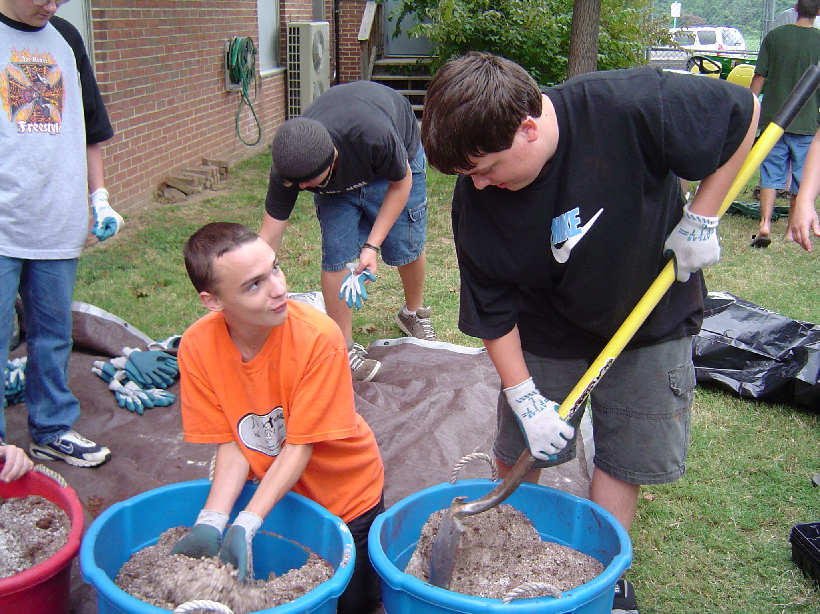
Notes:
The second outcome focuses on Sustainable Schools, which are important for their environmental impact, but also because they can be used to teach students valuable life skills that encourage students to walk the walk. By the way, by increasing efficiency they also tend to save school systems considerable amounts of money which can be reinvested into student programs.
US Dept of Education has incentivized the development of sustainable schools through the creation of US Green Ribbon Schools. We have adopted the Green Ribbon Schools pillars here in the Mid Atlantic. In many instances, there are state specific criteria that respond to local considerations – but most build off of the Green Ribbon pillars.
These pillars are (1) Environmental Impact and Costs, (2) Health and Wellness, and (3) environmental and sustainability education, which focuses on student learning with an emphasis on STEM and civic engagement.
There are several key partners helping advance this work here in the region, including National Wildlife Federation through their EcoSchools Program and US EPA Region 3 with an emphasis on healthy schools. There are also state partners working day in and day out with schools and students to plan and implement projects.

Slide 19
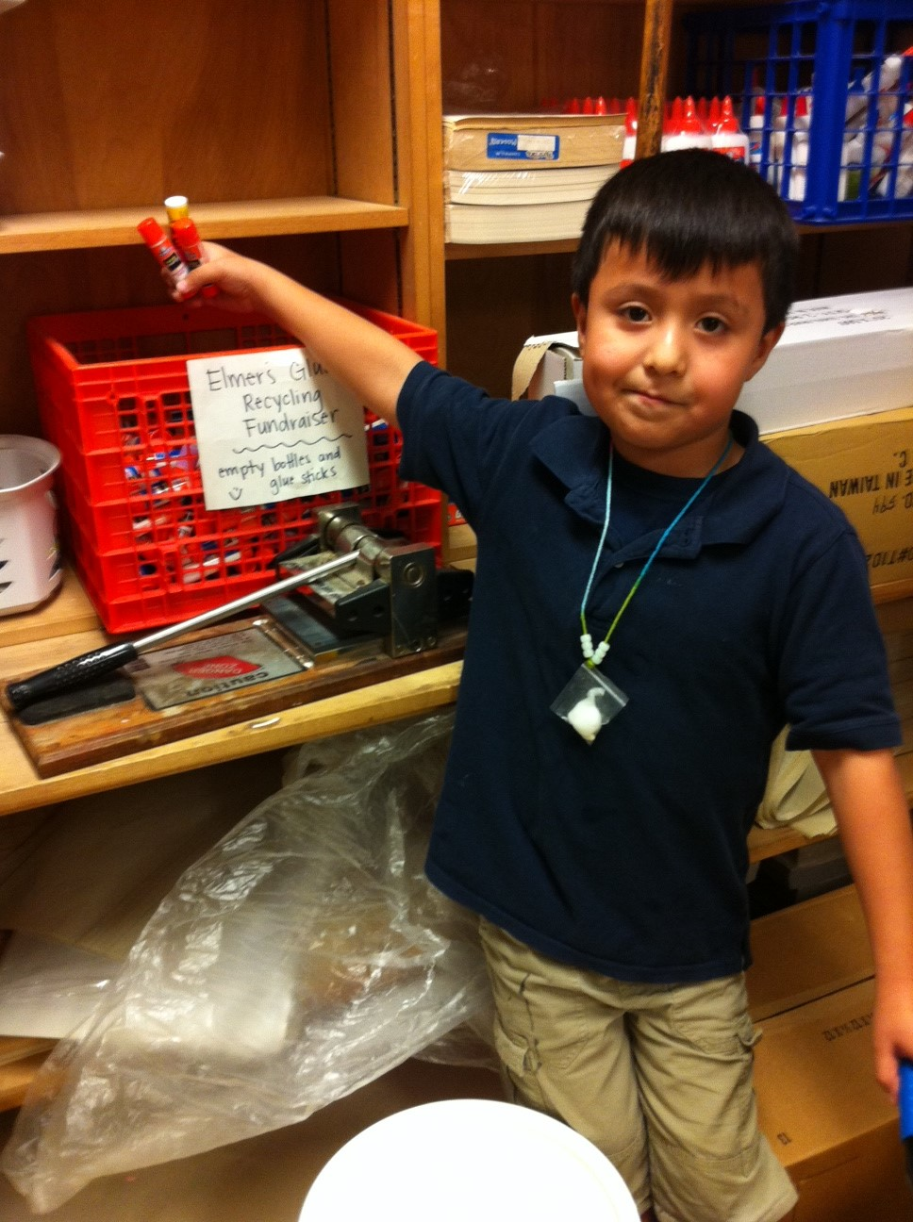
Notes:
The second outcome focuses on Sustainable Schools, which are important for their environmental impact, but also because they can be used to teach students valuable life skills that encourage students to walk the walk. By the way, by increasing efficiency they also tend to save school systems considerable amounts of money which can be reinvested into student programs.
US Dept of Education has incentivized the development of sustainable schools through the creation of US Green Ribbon Schools. We have adopted the Green Ribbon Schools pillars here in the Mid Atlantic. In many instances, there are state specific criteria that respond to local considerations – but most build off of the Green Ribbon pillars.
These pillars are (1) Environmental Impact and Costs, (2) Health and Wellness, and (3) environmental and sustainability education, which focuses on student learning with an emphasis on STEM and civic engagement.
There are several key partners helping advance this work here in the region, including National Wildlife Federation through their EcoSchools Program and US EPA Region 3 with an emphasis on healthy schools. There are also state partners working day in and day out with schools and students to plan and implement projects.

Slide 20
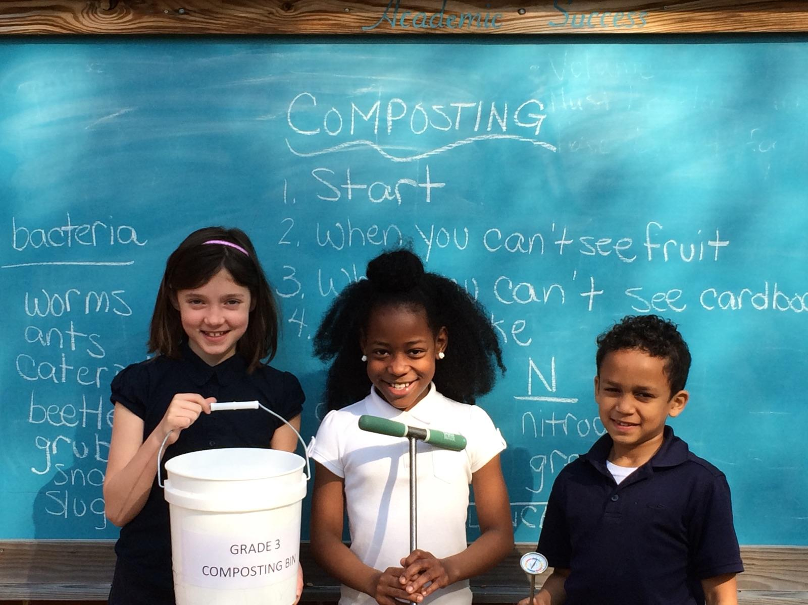
Notes:
The second outcome focuses on Sustainable Schools, which are important for their environmental impact, but also because they can be used to teach students valuable life skills that encourage students to walk the walk. By the way, by increasing efficiency they also tend to save school systems considerable amounts of money which can be reinvested into student programs.
US Dept of Education has incentivized the development of sustainable schools through the creation of US Green Ribbon Schools. We have adopted the Green Ribbon Schools pillars here in the Mid Atlantic. In many instances, there are state specific criteria that respond to local considerations – but most build off of the Green Ribbon pillars.
These pillars are (1) Environmental Impact and Costs, (2) Health and Wellness, and (3) environmental and sustainability education, which focuses on student learning with an emphasis on STEM and civic engagement.
There are several key partners helping advance this work here in the region, including National Wildlife Federation through their EcoSchools Program and US EPA Region 3 with an emphasis on healthy schools. There are also state partners working day in and day out with schools and students to plan and implement projects.

Slide 21
Policy & Metrics
School system level implementation is extremely important
Environmental Literacy Indicator Tool (ELIT) collected baseline data for 2014-2015 school year
ELIT measured:
Degree of preparedness to provide Environmental Literacy programming
Extent to which MWEEs are being provided to students
Number of sustainable schools
Notes:
The goal of this effort is to create high quality, SUSTAINABLE programs so working with school systems to generate buy-in and incentivize change is absolutely essential.
To understand where we are starting, the Chesapeake Bay Program conducted a baseline assessment of environmental literacy in school systems called “ELIT”. The survey measured:
Degree of preparedness to provide Env. Ed.
Extent to which MWEE’s are provided to students
Number of sustainable schools
NOTE: Results based only on survey respondents and the # of responses to each question

Slide 22
ELIT results
51% of school systems are well prepared or somewhat prepared to implement environmental education
68% of school divisions offer MWEEs for at least some elementary students (29% reach all)
74% of school divisions offer MWEEs for at least some middle school students (33% reach all)
69% offer of school systems offer MWEEs for at least some high school students (26% reach all)
709 schools have a sustainable schools certification

Slide 23
Increasing Capacity
School districts are embracing environmental literacy & sustainability to engage learners and save $$
Funding is available to develop programs:
NOAA B-WET
Chesapeake Bay Trust
EPA EE grants
NSF grants
State grants
Notes:
Taking this to scale and sustaining it is not only possible, but it is happening in school districts throughout the watershed in small and large districts, in affluent and underserved communities, in urban, suburban, and rural areas…and we are working with state and local representatives to describe and share the lessons learned from these success stories. You will hear some of these stories today.
There is also funding for the development of these program NOAA and the Chesapeake Bay Trust have been intentionally supporting this work for more than a decade. School districts and partners have also successfully applied EPA EE Grants, NSF funding, and a variety of state education funding programs to build sustainable programs.

Slide 24
Questions?

Slide 25
Housekeeping
Personal commitments
We will not be taking formal breaks
I will be serving as timekeeper throughout the day
Questions are encouraged
Most of all… We hope that you enjoy yourself
Notes:
As we move through today we would like for you to consider actions that you can take to advance environmental literacy in your role. We have provided you with a sheet of paper to document this for us. At the end of the day we will ask that you turn these in to us.
We will not be taking scheduled breaks today. Please take breaks as needed. There is a water cooler at the back of the room and the restrooms are by the doors.
We have a very full day planned. I will be serving as the timekeeper throughout the day. I will give you a 2 minute warning and if I stand up I ask that you close out your remarks.
This is an opportunity to learn more and dig in on environmental literacy. Questions are highly encouraged.
We hope that you have a wonderful time today. If you need anything, you can ask me or Kevin Schabow who is…

