Slide 1
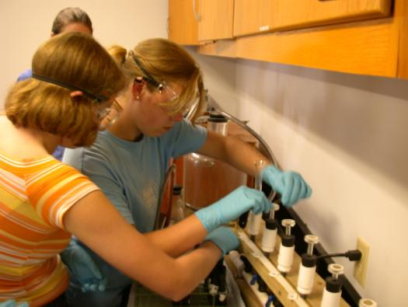
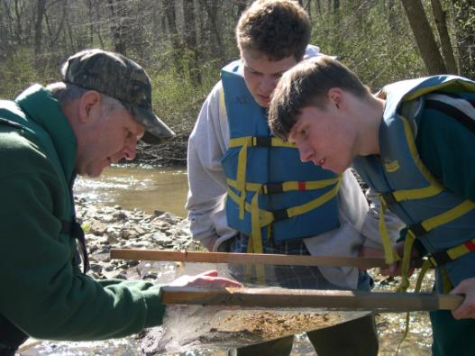
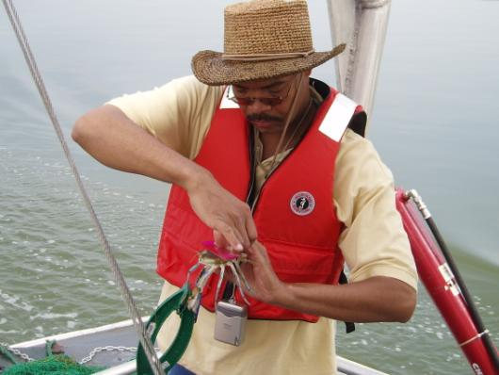
Chesapeake Bay Program Environmental Literacy Goal
April 11, 2017

Slide 2
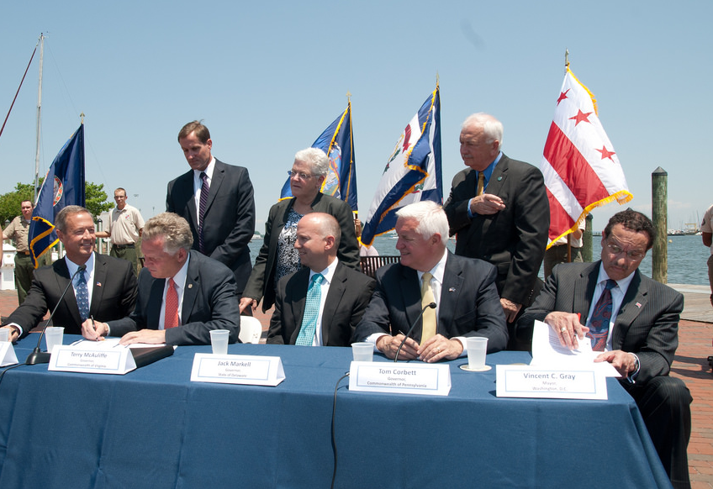
Environmental Literacy Goal
GOAL: Enable students in the region to graduate with the knowledge and skills to act responsibly to protect and restore their local watershed
OUTCOMES:
Student MWEEs
Sustainable Schools
Policy & Metrics
Notes:
As Nick mentioned, the Bay Program signed the new Chesapeake Bay Watershed Agreement in June of 2014. The Agreement included an Environmental Literacy Goal that committed us to enabling students to graduate with the knowledge and skills to protect and restore their local watershed.
There were three associated outcomes for
Providing student Meaningful Watershed Educational Experiences – affectionately called MWEEs – in each elementary, middle, and high school
Increasing the number of Sustainable Schools and ensuring that students are actively engaged in those efforts
Establishing supportive policies, programs, and metrics at all levels to advance this work

Slide 3
Student MWEEs
Continually increase students’ age-appropriate understanding of the watershed through participation in teacher-supported, meaningful watershed educational experiences and rigorous, inquiry-based instruction, with a target of at least one meaningful watershed educational experience in elementary, middle and high school depending on available resources.
Notes:
So what are student MWEEs? They are an integrated approach to learning both in the classroom and out in the field designed to create a deeper understanding of the environment and its stressors. NOT a field trip!
A MWEE is revisited by teachers over time as the students engage in four essential elements:
Issue Definition
Outdoor Field Experiences
Action Projects
Synthesis and Conclusions
Teachers are essential to MWEE implementation, guiding their students through the entire process and ensuring that it remains grounded in core subjects and for that reason professional development that includes both content and outdoor education pedagogy is important.
This video from Nature Bridge will show you how engaging student MWEEs can be.

Slide 4
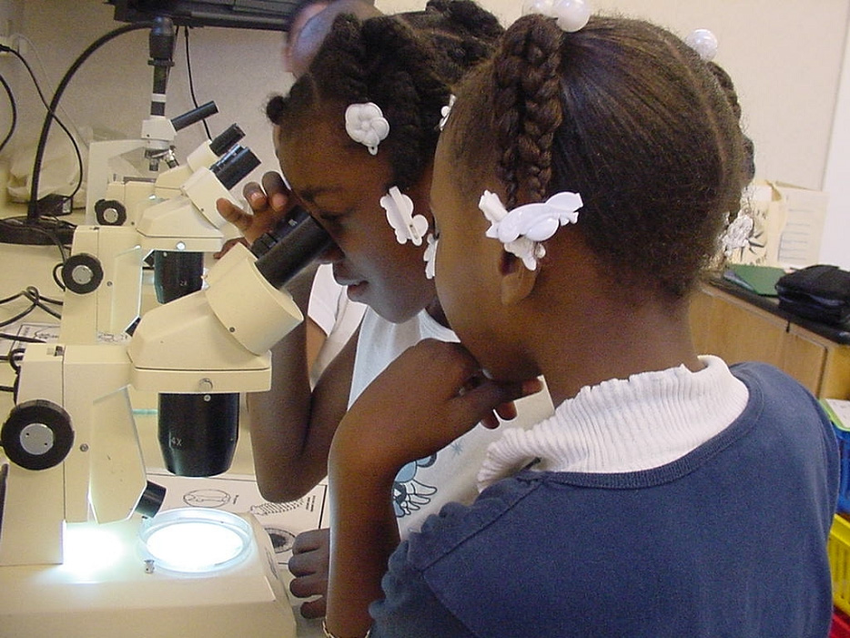

Slide 5
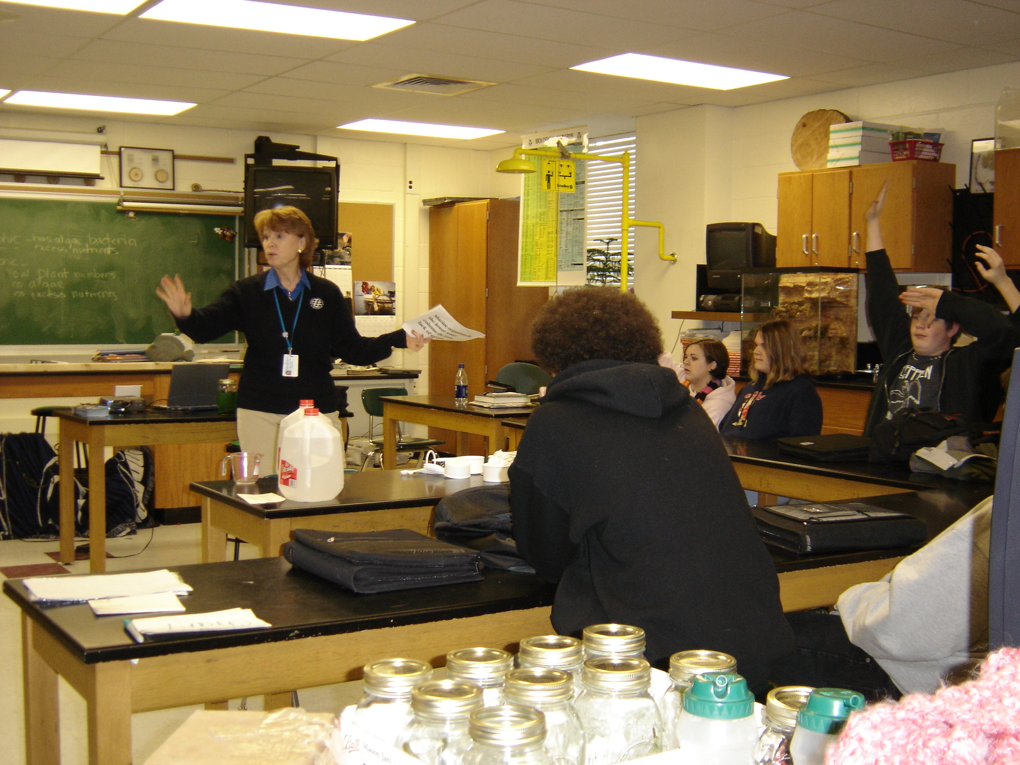

Slide 7
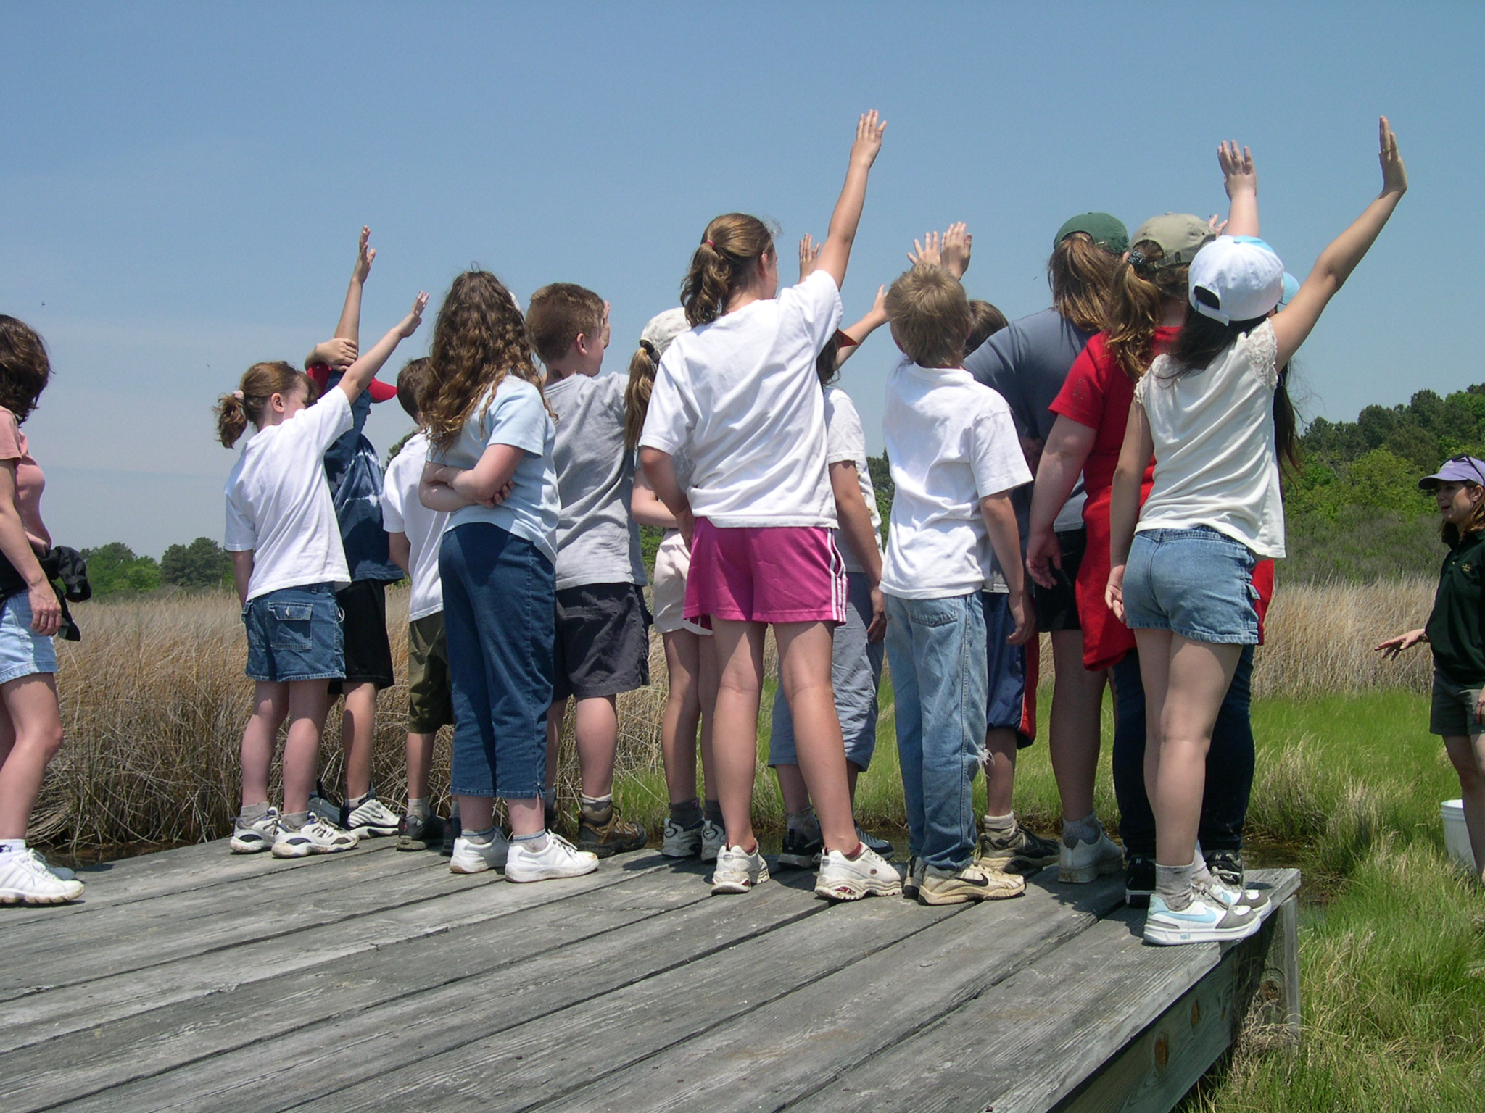

Slide 8
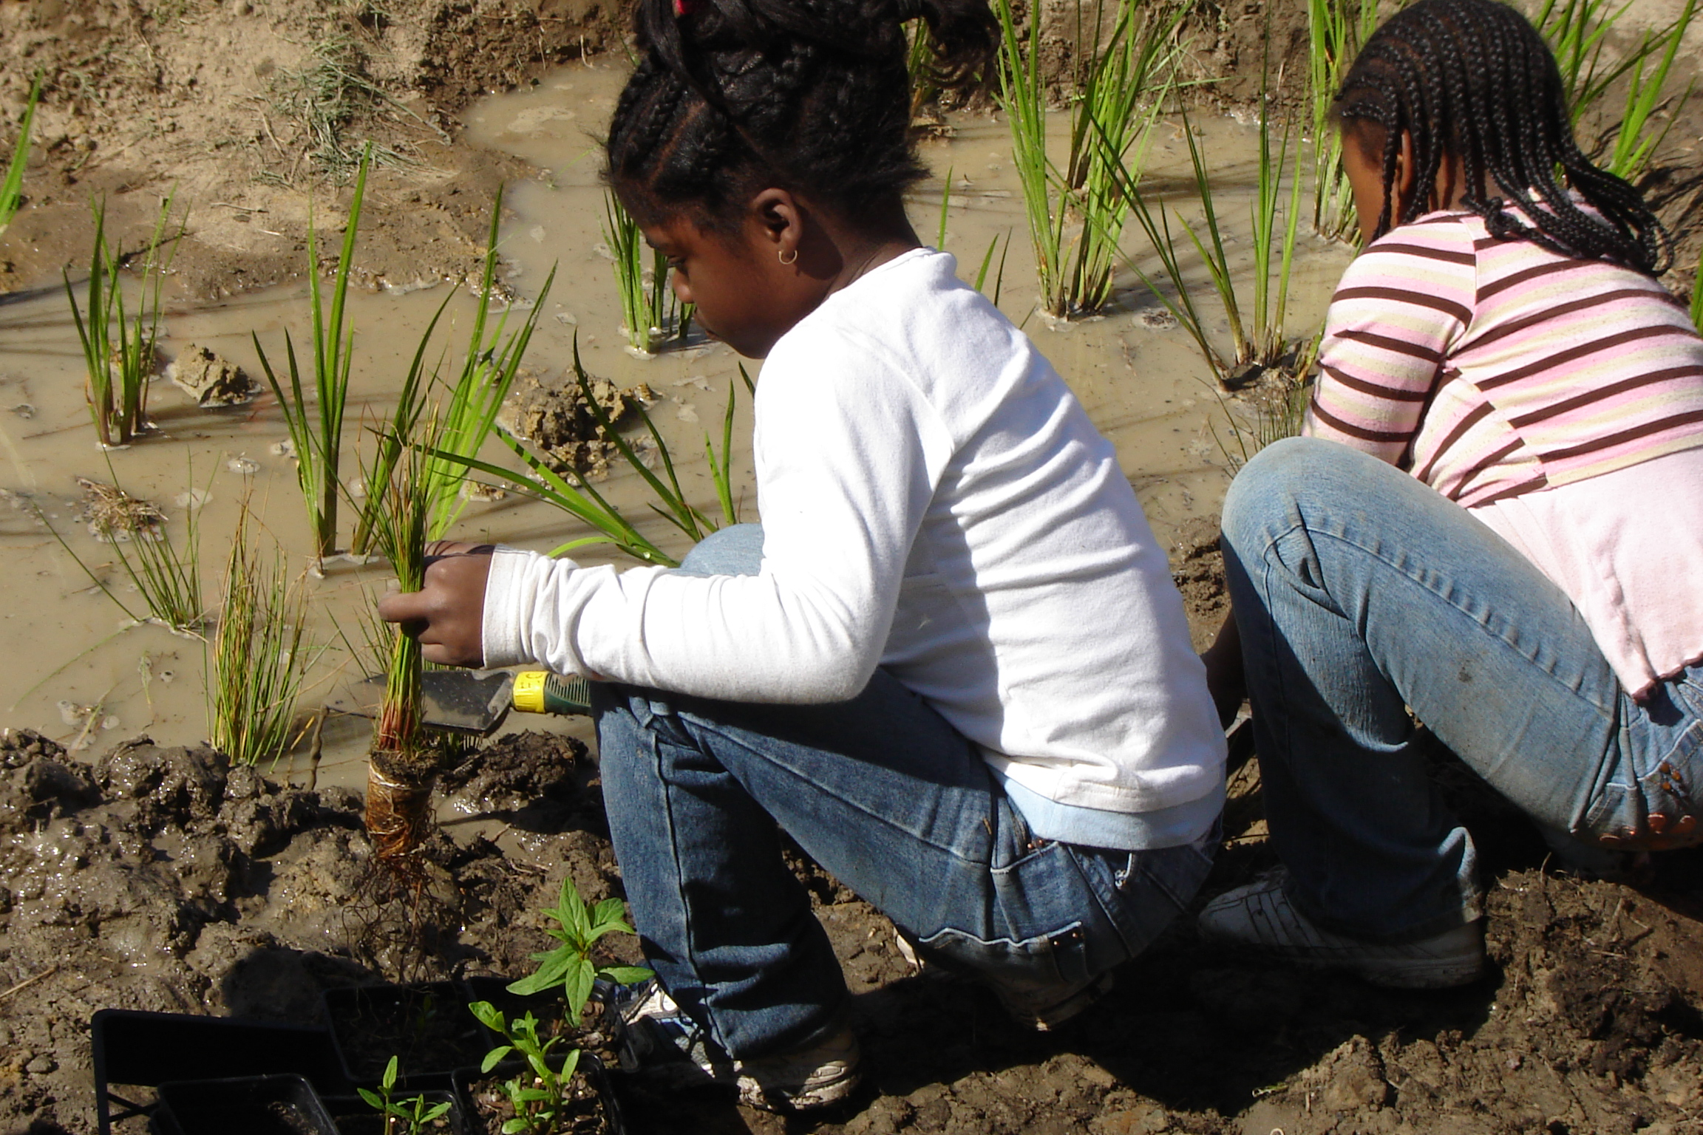

Slide 9
MWEE Video

Slide 10
MWEE Implementation (2015)
68% of school divisions offer MWEEs for at least some elementary students (29% reach all)
74% of school divisions offer MWEEs for at least some middle school students (33% reach all)
69% offer of school systems offer MWEEs for at least some high school students (26% reach all)
Notes:
NOTE: Results based only on survey respondents and the # of responses to each question

Slide 11
CBP Activities to support MWEEs
Awarded $2.5 million to approximately 30 MWEE projects through NOAA B-WET
Published new Educators Guide to the MWEE and planning a companion online version
Host Bay Backpack website for teachers

Slide 12
Sustainable Schools
Continually increase the number of schools in the region that reduce the impact of their buildings and grounds on their local watershed, environment and human health through best practices, including student-led protection and restoration projects.
Notes:
Our second outcome focuses on Sustainable Schools, which are important for their environmental impact, but also because they can be used to teach students valuable life skills that encourage students to walk the walk. Increasing efficiency has the added benefit of saving school systems considerable amounts of money which can be reinvested into student programs.
Work with states to encourage the adoption of practices the support the pillars of the US Department of Education Green Ribbons Schools:
Environmental Impact and Cost
Health and Wellness
Environmental and Sustainability education, which focuses on student learning with an emphasis on STEM and civic engagement
US Dept of Education has incentivized the development of sustainable schools through the creation of US Green Ribbon Schools. We have adopted the Green Ribbon Schools pillars here in the Mid Atlantic. In many instances, there are state specific criteria that respond to local considerations – but most build off of the Green Ribbon pillars.
These pillars are (1) Environmental Impact and Costs, (2) Health and Wellness, and (3) environmental and sustainability education, which focuses on student learning with an emphasis on STEM and civic engagement.

Slide 13
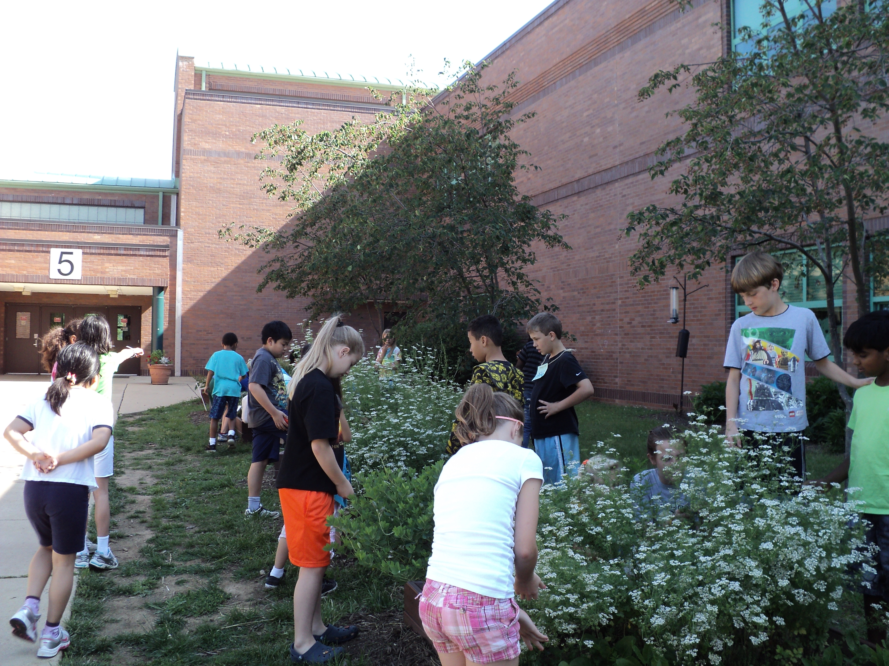

Slide 14
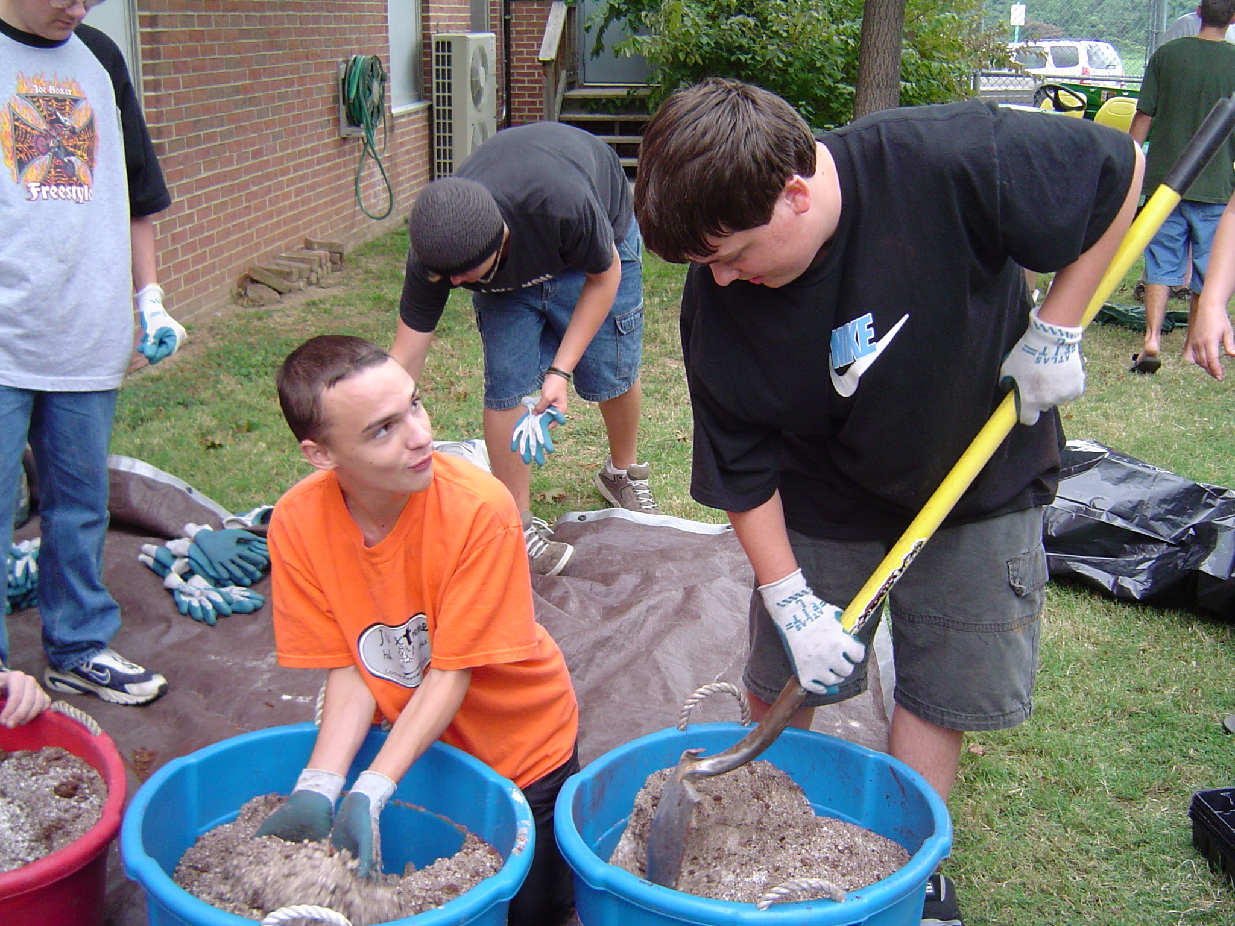

Slide 15
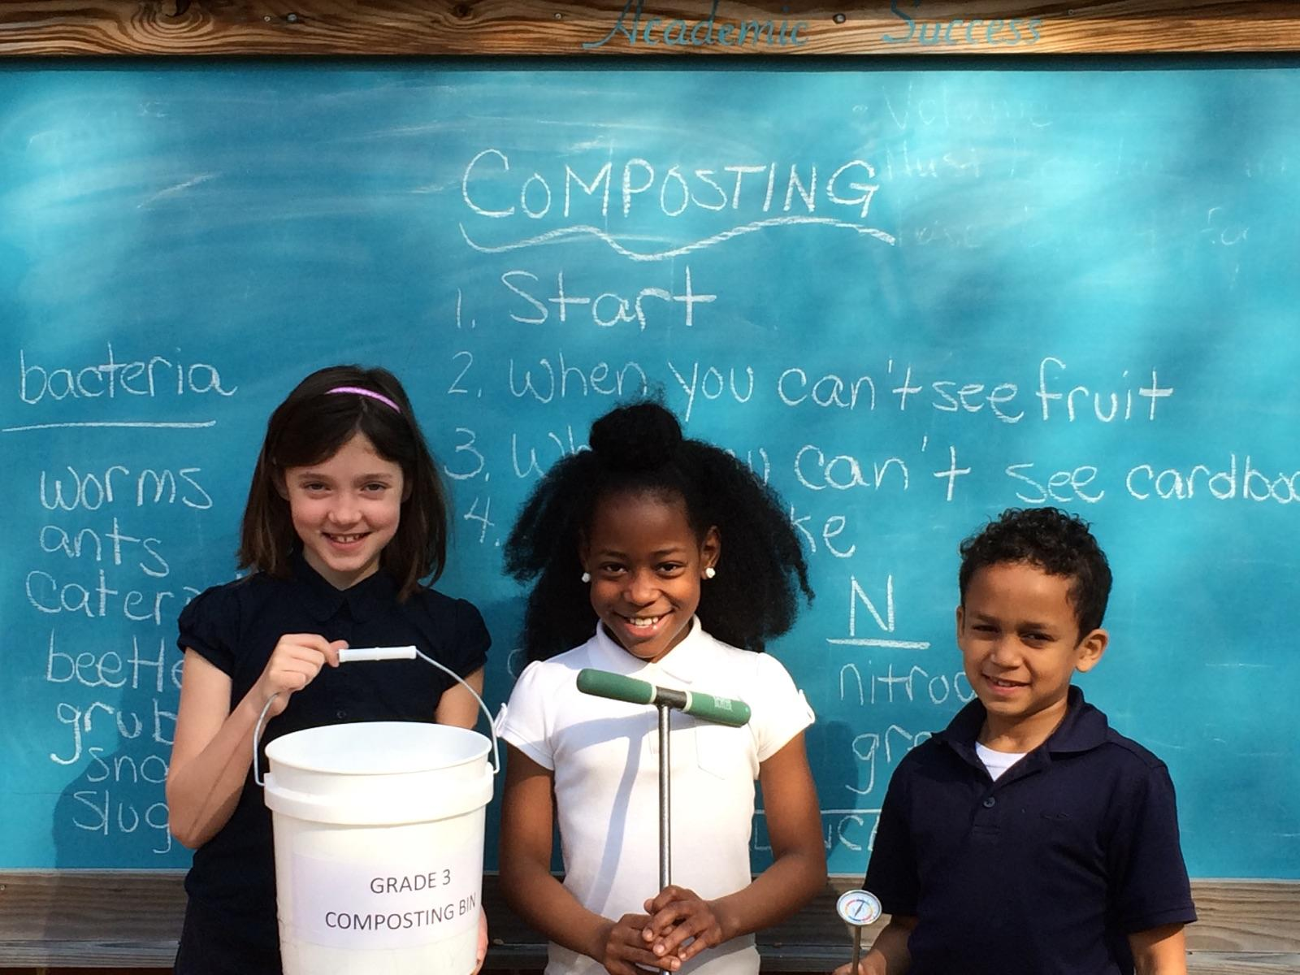

Slide 16
Sustainable Schools (2015)
Notes:
We have 5XX sustainable schools in the region.

Slide 17
CBP Activities to support Sustainable Schools
Awarded grants to 6 jurisdictions to support capacity building efforts related to sustainable schools
Partnering with National Wildlife Federation and MAEOE to create online videos and trainings about stormwater
Launching a new “School Grounds” section on Bay Backpack

Slide 18
Environmental Literacy Policy
Each participating Bay jurisdiction should develop a comprehensive and systemic approach to environmental literacy for all students in the region that includes policies, practices, and voluntary metrics that support the environmental literacy Goals and Outcomes of this Agreement.
Notes:
Our last outcome focuses on environmental literacy policy and metrics.
School system level implementation is important for SYSTEMIC and SUSTAINABLE programs
Environmental Literacy Indicator Tool (ELIT) collected baseline data for 2014-2015 school year
Degree of preparedness to provide Environmental Literacy programming
Extent to which MWEEs are being provided to students
Number of sustainable schools

Slide 19
Policy & Metrics
Goal is to create high quality SYSTEMIC and SUSTAINABLE programs so working with school systems to generate buy-in and incentivize change is absolutely essential.
Environmental Literacy Indicator Tool (ELIT) collected baseline data for 2014-2015 school year
Degree of preparedness to provide Environmental Literacy programming
Extent to which MWEEs are being provided to students
Number of sustainable schools
Notes:
The goal of this effort is to create high quality, SYSTEMIC and SUSTAINABLE programs so working with school systems to generate buy-in and incentivize change is absolutely essential.
To understand where we are starting, the Chesapeake Bay Program conducted a baseline assessment of environmental literacy in school systems called “ELIT”. The survey measured:
Degree of preparedness to provide Env. Ed.
Extent to which MWEE’s are provided to students
Number of sustainable schools

Slide 20
Increasing Capacity
School districts are developing sustainability plans and EL strategies that include MWEEs and teacher training
Funding is available to help develop programs:
NOAA B-WET
Chesapeake Bay Trust
EPA CBP and EE grants
NSF grants
State grants
Notes:
Taking this to scale and sustaining it is not only possible, but it is happening in school districts of all sizes and at all economic levels. Environmental literacy plans and sustainability plans for school districts are becoming more common.
There is also funding for the development of environmental literacy and sustainability programs. NOAA and the Chesapeake Bay Trust have been intentionally supporting this work for more than a decade. School districts and partners have also successfully applied EPA EE Grants, NSF funding, and a variety of state education funding programs to build sustainable programs. They are also using their own funding.

Slide 21
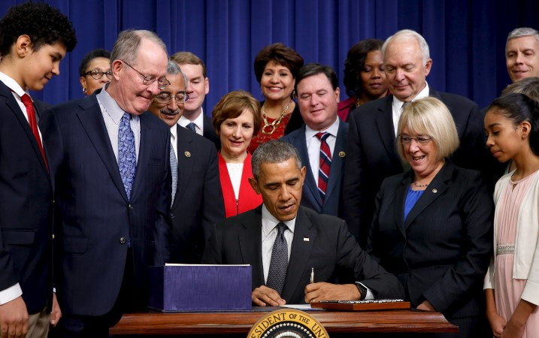
Every Student Succeeds Act
Signed December 2015
Includes key language for environmental education in Title IV for first time
Other Titles have also been leveraged (i.e. Title 2 professional development)
While there is new scrutiny, bill passed both Chambers with overwhelming bipartisan support
Notes:
On December 10, 2015 the President signed the Every Student Succeeds Act, which replaces No Child Left Behind and includes key language for environmental education. The bill passed through both Chambers with overwhelming bipartisan support.

Slide 22
Responding LEAs (whole region)
Notes:
Of all respondents in the watershed: 16% were well prepared and 41% were somewhat prepared to implement EE.

Slide 23
All LEAs in Region (whole region)
Notes:
The tricky part is that we did not have very strong response rates in some states. So all that we can say for certain about the region as a whole is that 5% of school districts in the states represented here are well prepared and 13% are somewhat prepared to implement environmental education. We just don’t know what is going on in the school districts that did not respond.

Slide 24
CBP Activities to Support Policy Work
Convene monthly calls and annual in-person meetings to advance regional and state work
Finalized indicators for Sustainable Schools and LEA Preparedness
Drafted new ELIT survey for release Spring 2017

Slide 25
NAAEE Video
Notes:
Stanford University recently completed a review of research that looks at the evidence in support of environmental education and K-12 student
outcomes. In 81 studies that examined knowledge, 98% reported student knowledge gains. See the handout in your packets for more preliminary findings from their study.

Slide 26
Questions?

Slide 27
Housekeeping
Review of packet materials
We will not be taking formal breaks
I will be serving as timekeeper throughout the day
Questions are encouraged
Most of all… We hope that you enjoy yourself
Notes:
As we move through today we would like for you to consider actions that you can take to advance environmental literacy in your role. We have provided you with a sheet of paper to document this for us. At the end of the day we will ask that you turn these in to us.
We will not be taking scheduled breaks today. Please take breaks as needed. There is a water cooler at the back of the room and the restrooms are by the doors.
We have a very full day planned. I will be serving as the timekeeper throughout the day. I will give you a 2 minute warning and if I stand up I ask that you close out your remarks.
This is an opportunity to learn more and dig in on environmental literacy. Questions are highly encouraged.
We hope that you have a wonderful time today. If you need anything, you can ask me or Kevin Schabow who is…

