Slide 1

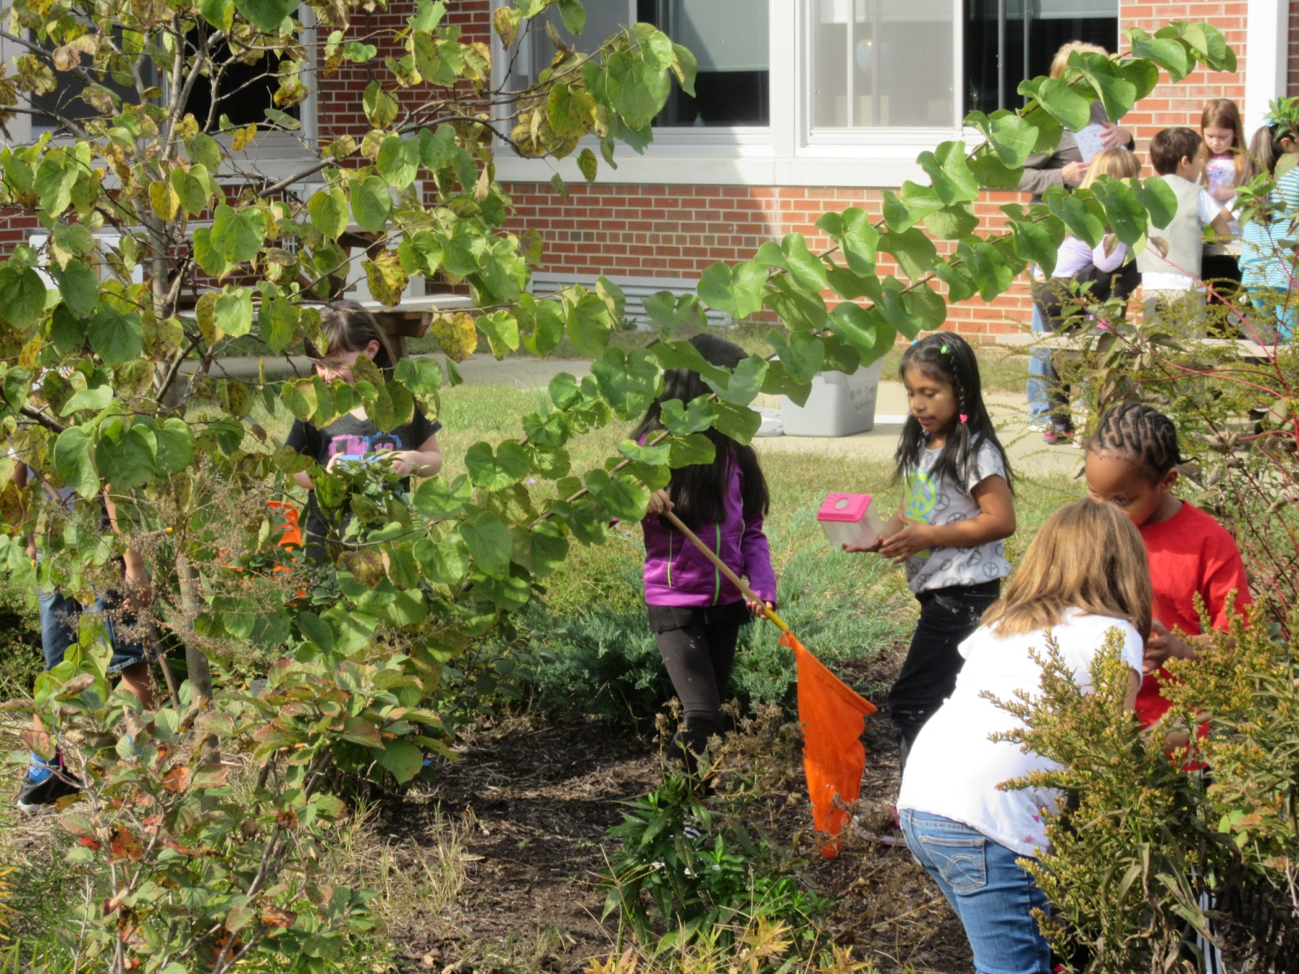




Seaford School District, Seaford, Delaware
Schoolyard Habitats and Rain Gardens:
Connecting the Watershed to Science Content
Sussex County Conservation District

Slide 2
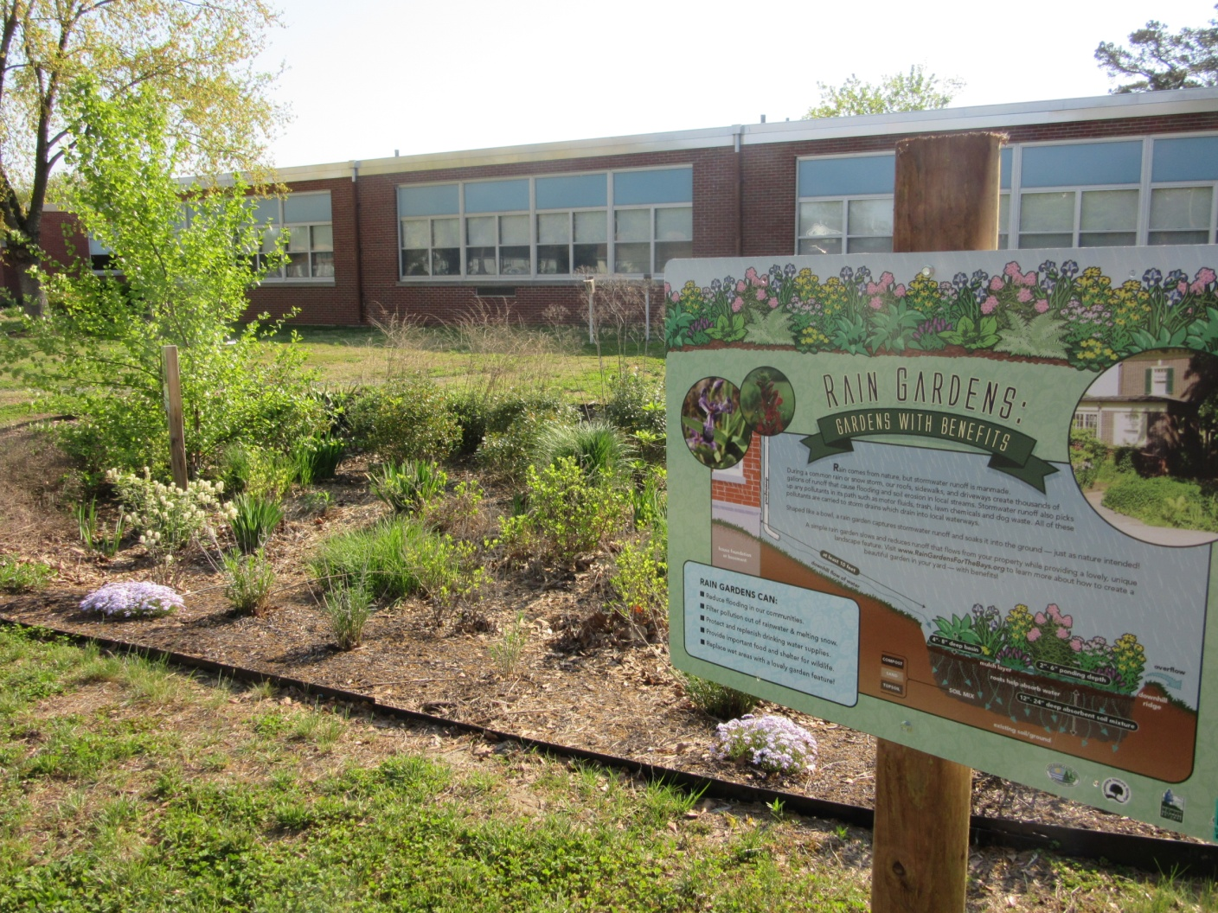
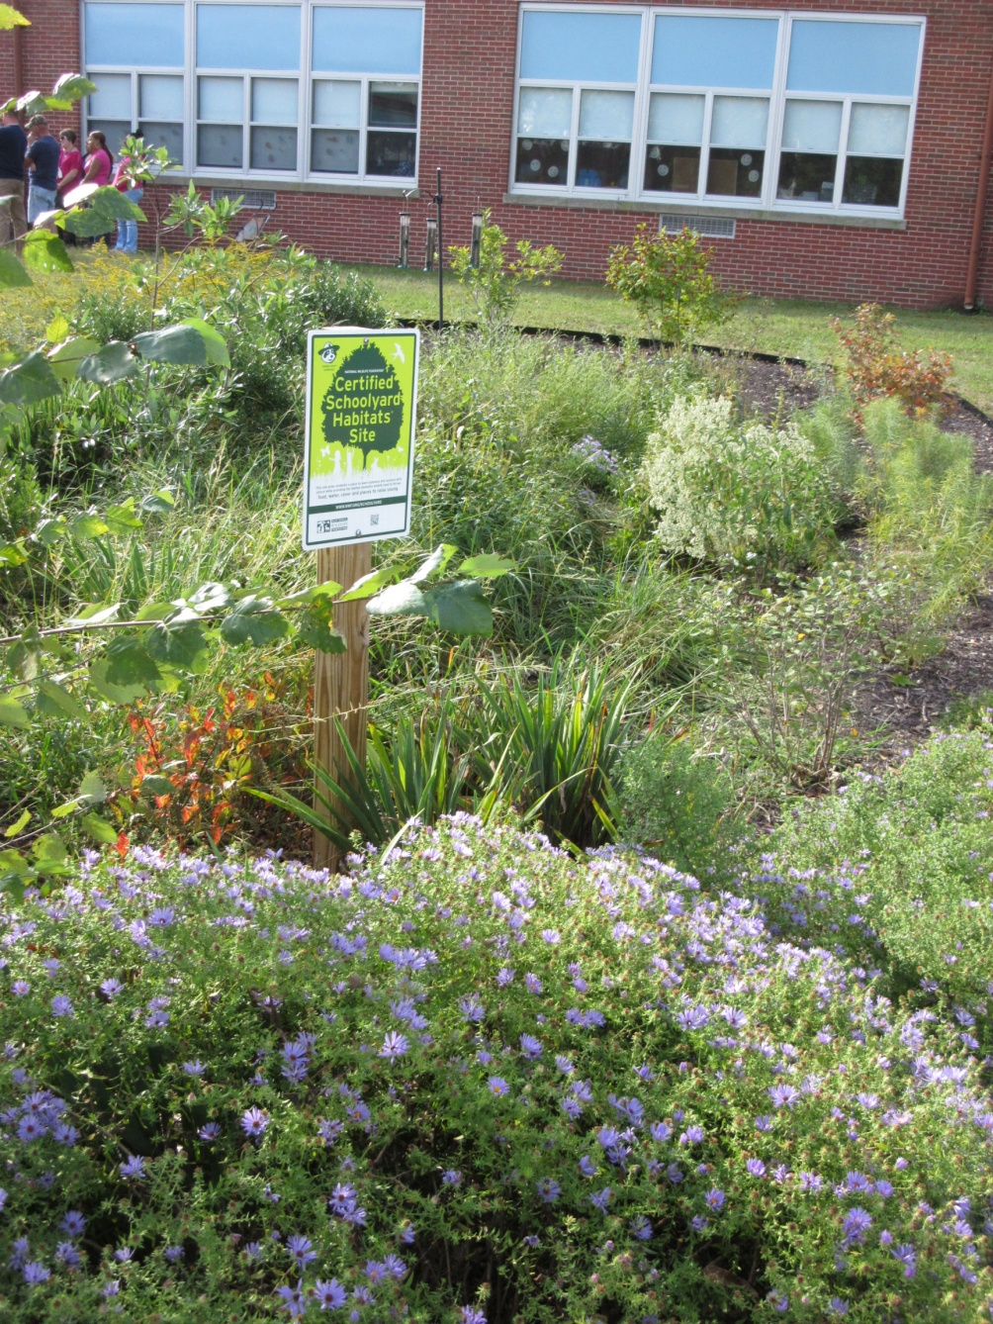
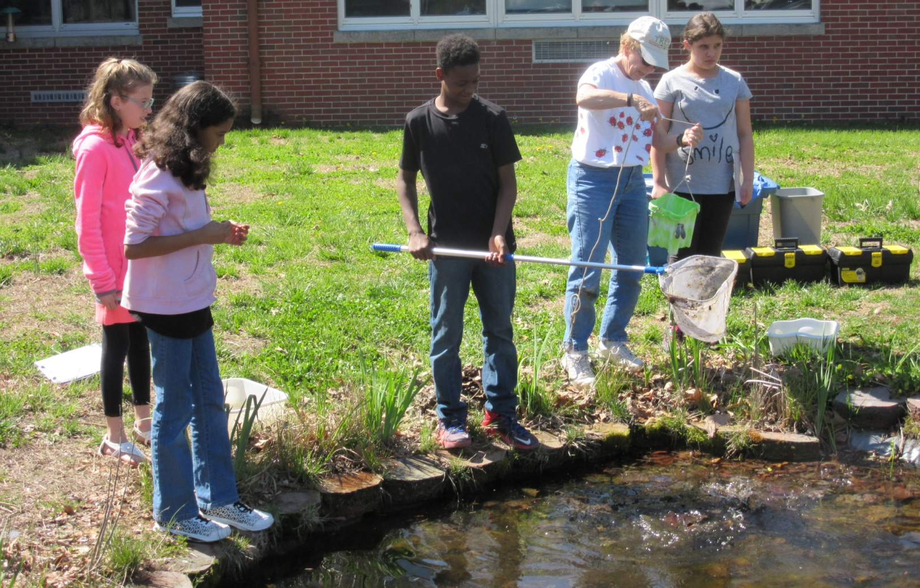
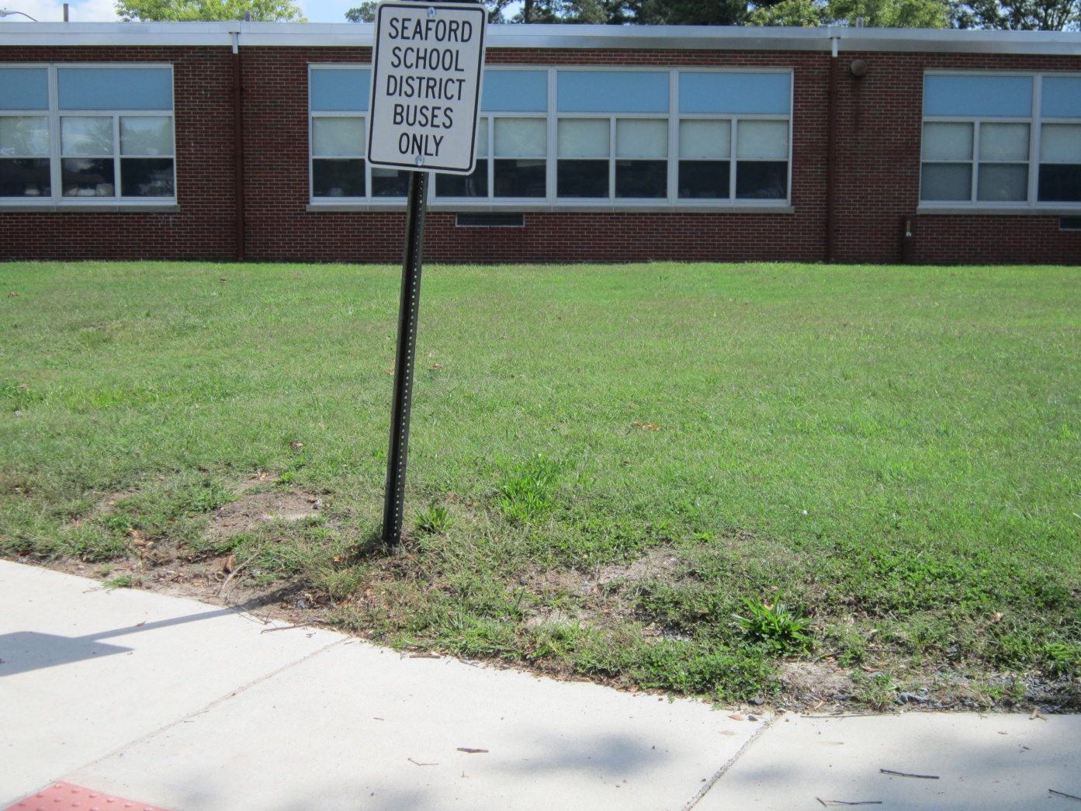
Frederick Douglass Elementary School, Seaford, DE

Slide 3
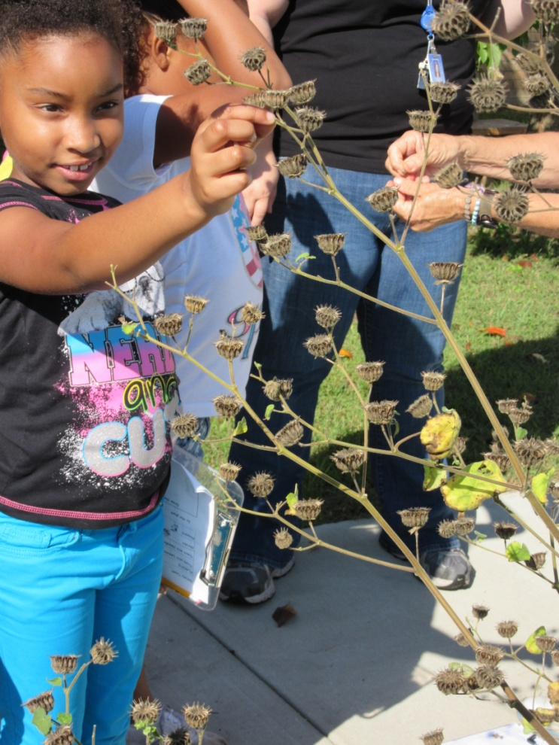
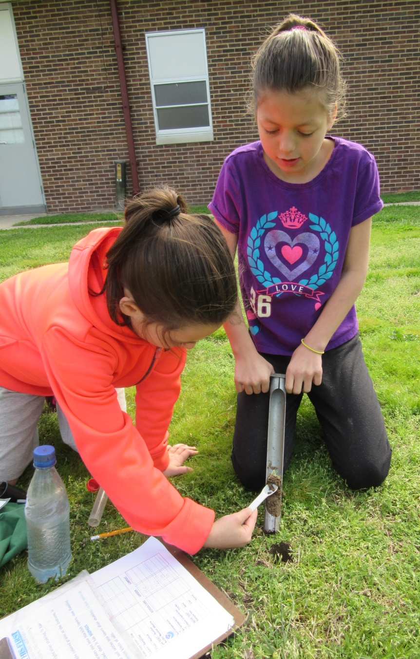
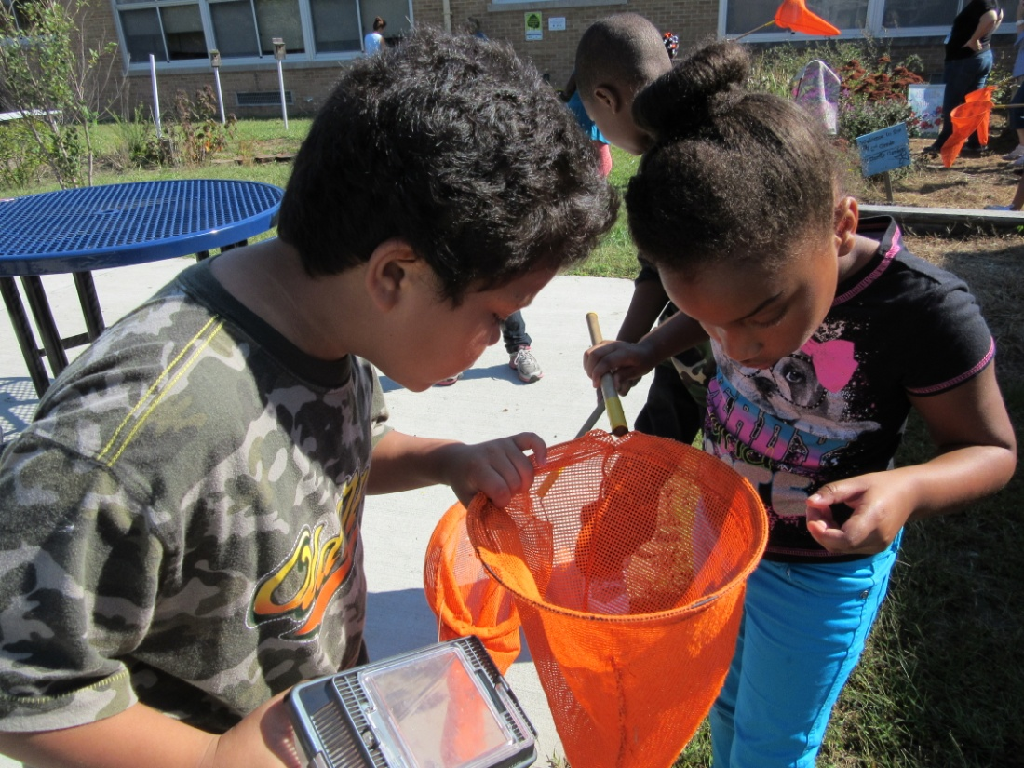
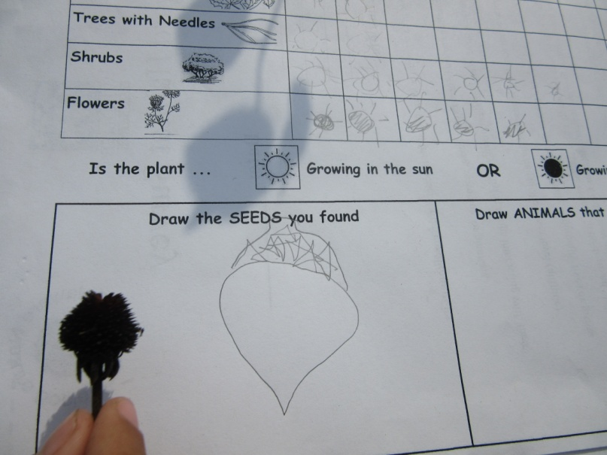
Curriculum Connections: Outdoor Learning Lab
DE Department of Education Science Content Standards and Next Generation Science Standards

Slide 4
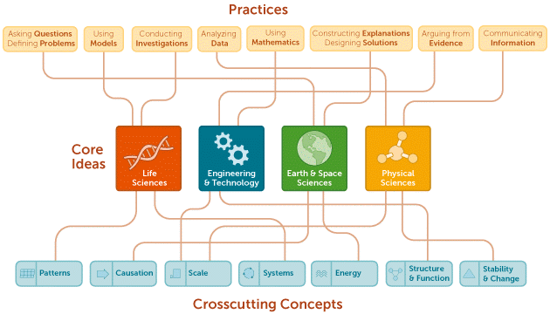
Next Generation Science Standards

Slide 5
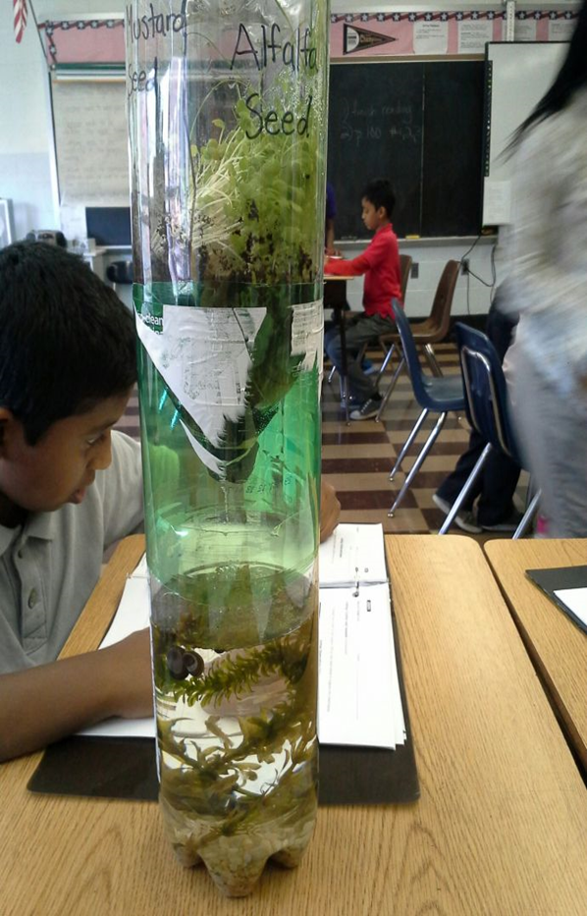
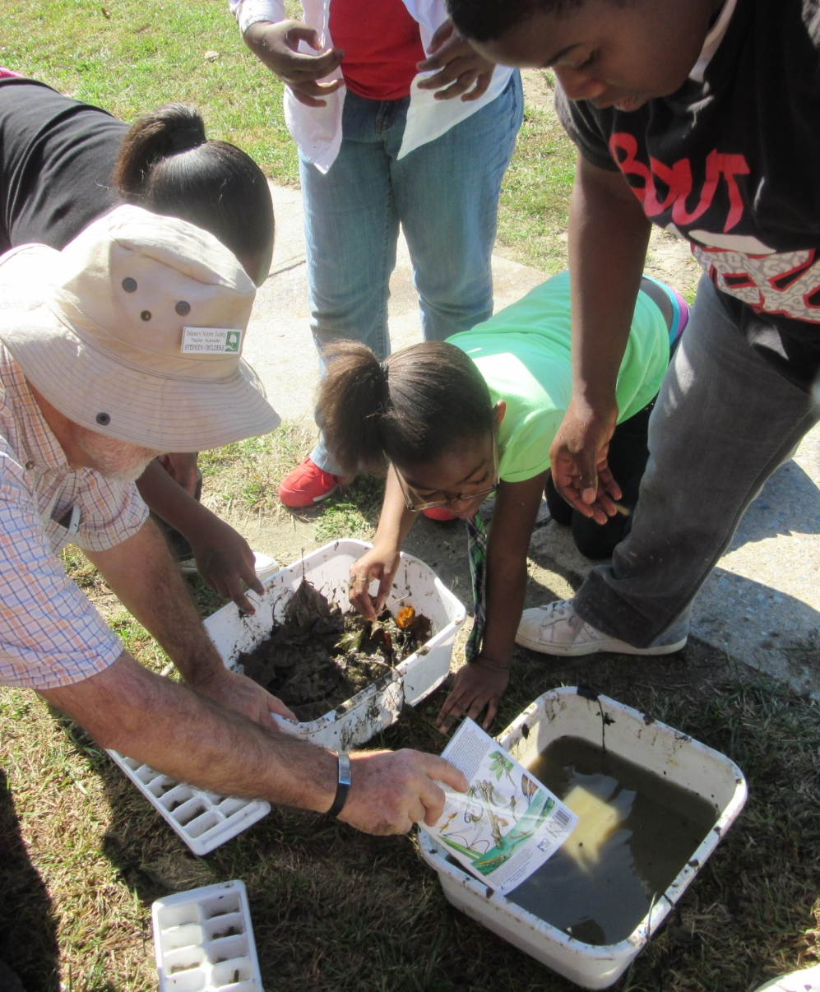
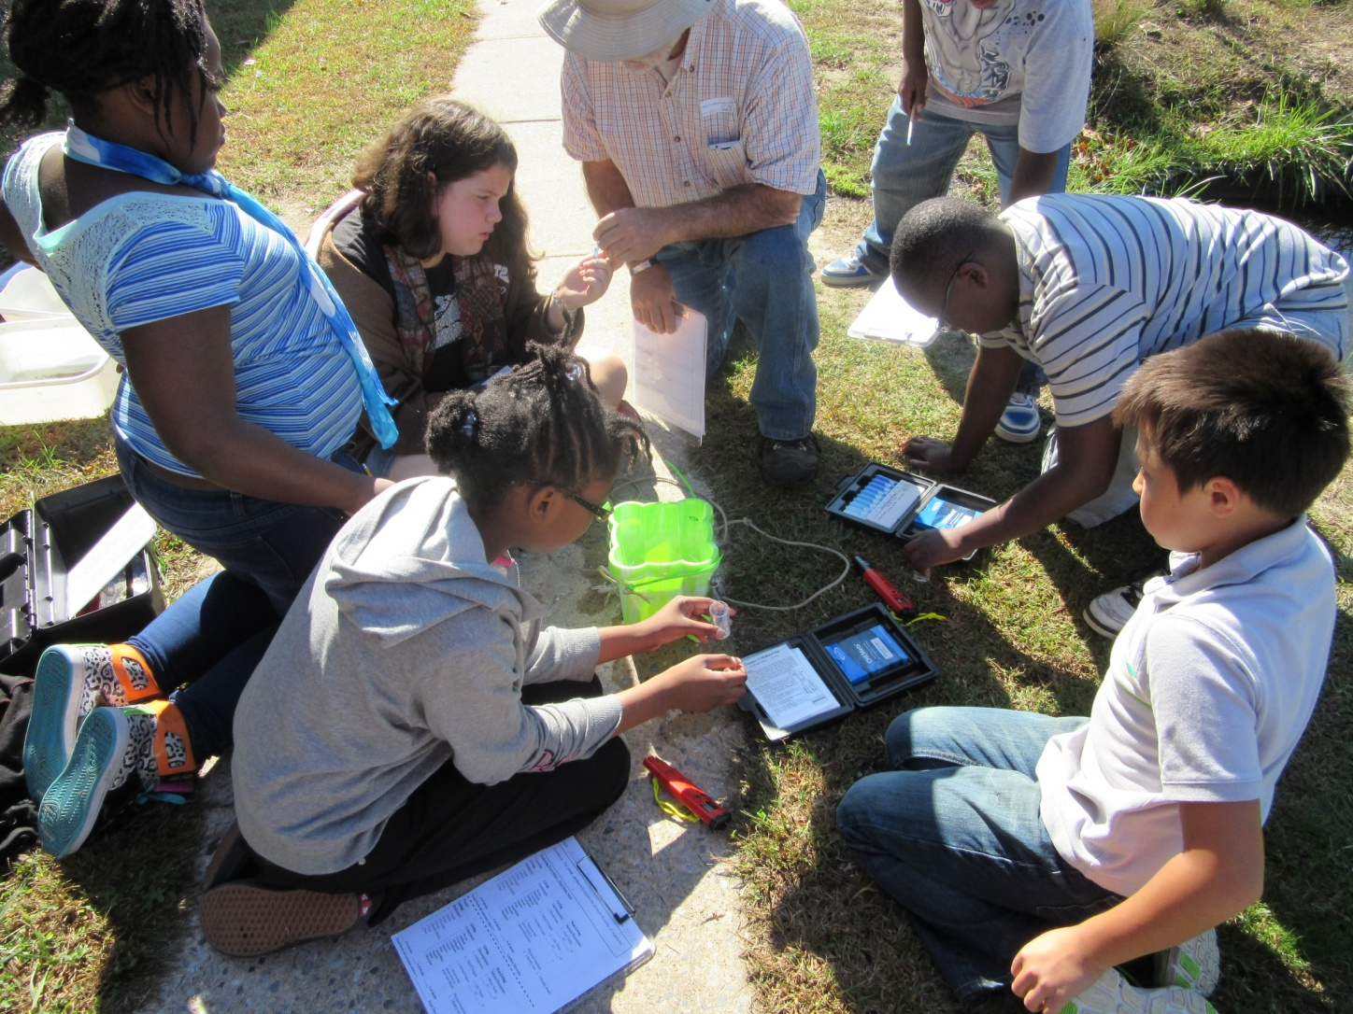
Curriculum Connections: Outdoor Learning Lab
Meaningful Watershed Educational Experiences

Slide 6
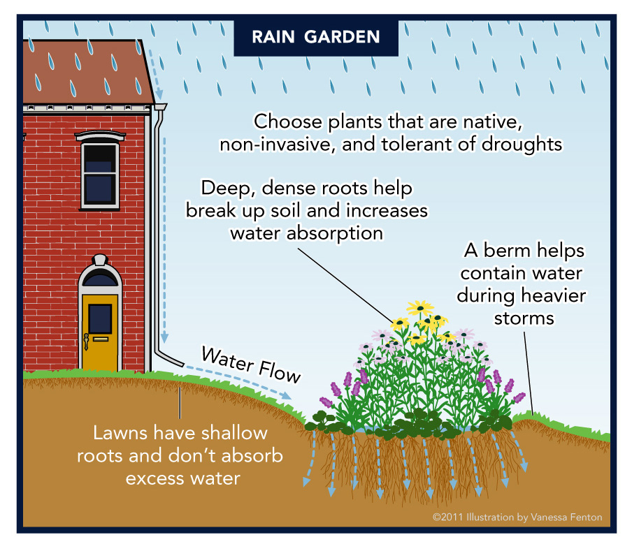
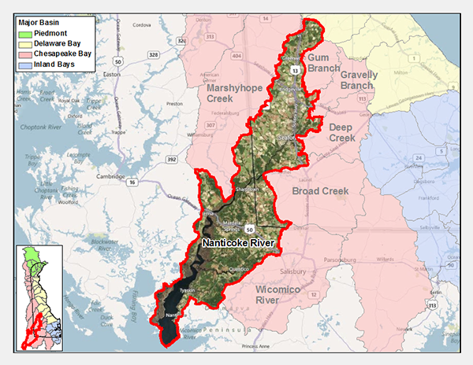
Teacher Supported MWEEs:
Nanticoke River Watershed

Slide 7


Meaningful Watershed Educational Experiences
MWEE’s | What does it look like in the Schoolyard Habitat? Aligned with academic standards, Common Core and NGSS | Practices in Science: Student centered/Teacher is facilitator
• Experiences are an Integral part of the instructional program. | How does rain shape the earth? (List ideas) (Landforms, Soils) NGSS | • Activity is seamlessly connected to what is occurring in the classroom.
• Experiences are investigative or project oriented. | Were does the soil go? (List ideas) Erosion Activity: Students generate hypothesis. | • Activity is centered on questions and investigated through data, observation and hands-on activities.
• Experiences include an authentic, local context for the investigations. | Erosion activity in schoolyard: grassy area, sandy/ area and garden area | • Activity is connected to hands-on experience in the schoolyard, neighborhood and community.
• Experiences are part of a sustained activity. | ENGAGE, EXPLORE, EXPLAIN, ELABORATE AND EVALUATE | • Teaching science through inquiry: 5E Model.
Preparation phase | Demonstrate water movement after a rain storm. Engage Students to share prior knowledge based on their observations. | • Background research
Action phase | Participate in hand-on activity to collect data. | • Field experience
Reflection phase | Students analyze the data and draw conclusions. | • Results of project are analyzed and evaluated.
• Experiences consider the watershed as a system. | Plants need soil and water to grow. Plants help keep soil in place and prevent it from reaching waterways. How can people help to prevent erosion? | • Activity connects to local waters and the Chesapeake Bay watershed.

Slide 8
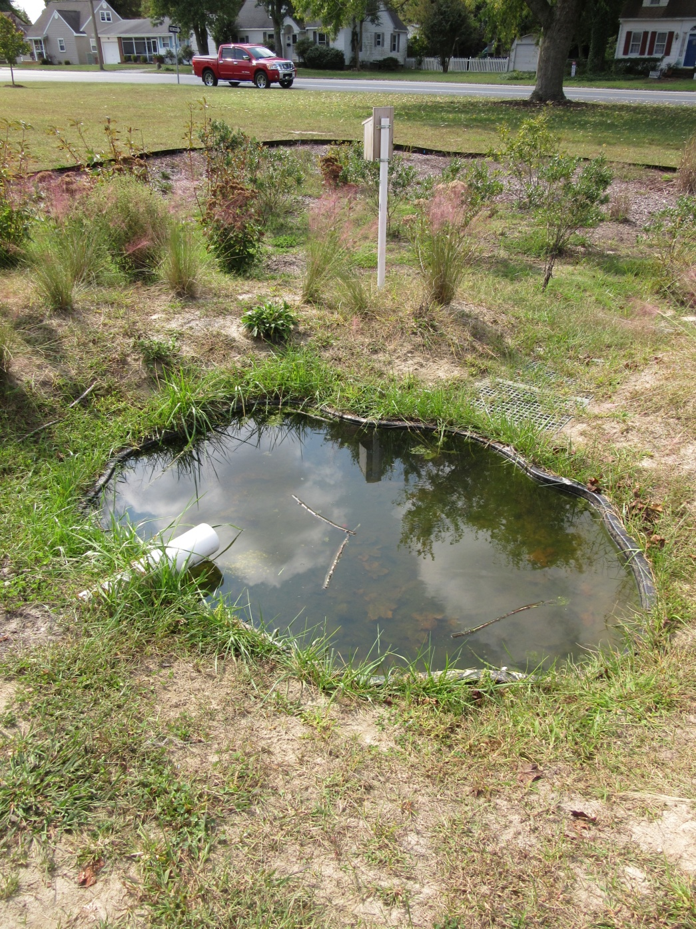
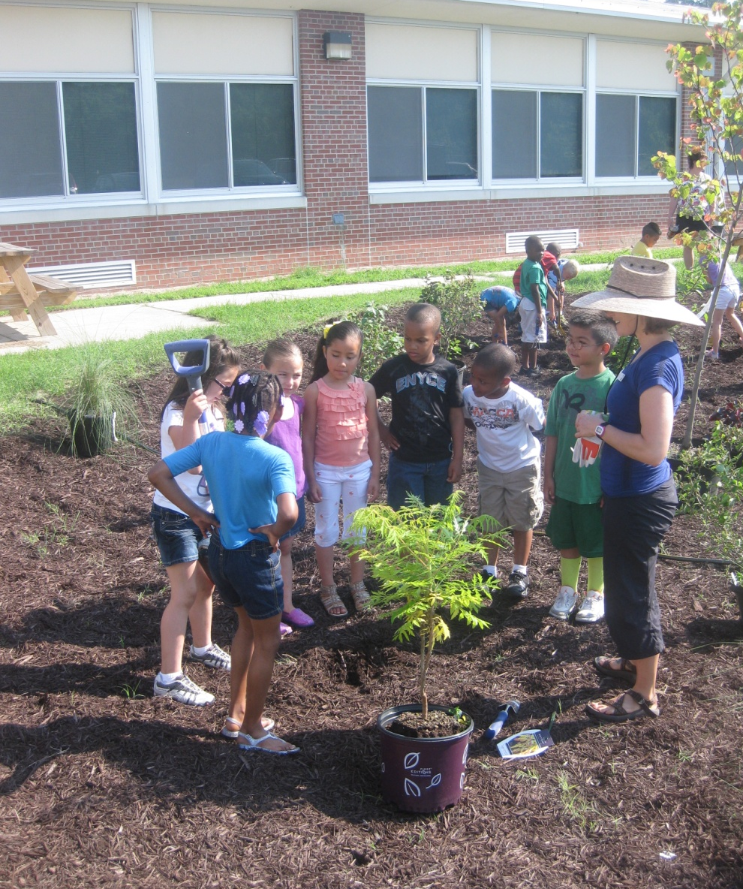
Sustainable Future

Slide 9
