Slide 1
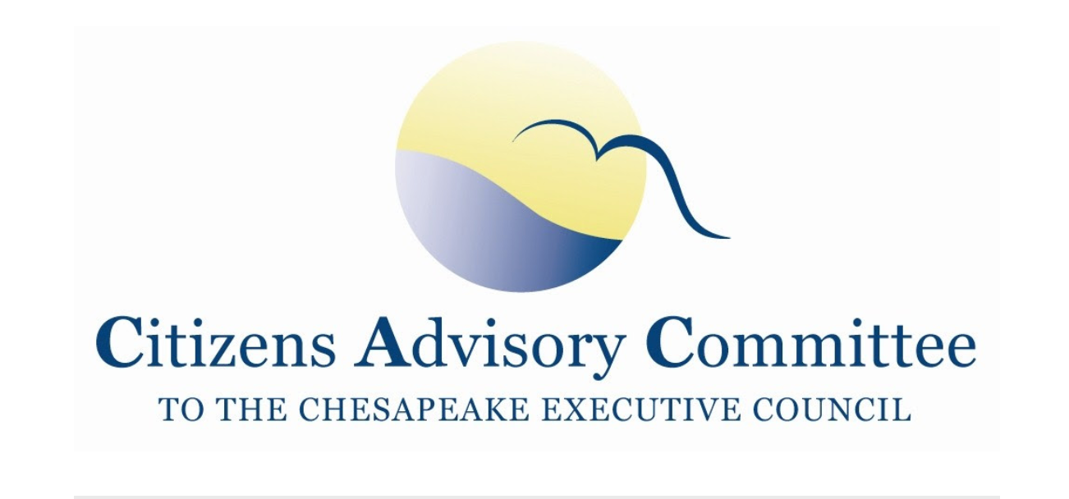
~Day One~ May 18, 2022
Photo Credit: Will Parson/Chesapeake Bay Program

Slide 2
Why are we learning about solar development?
Renewable energy is a positive move toward reducing greenhouse gasses from fossil fuels to address climate change impacts and reduce our dependence on foreign oil

Slide 3
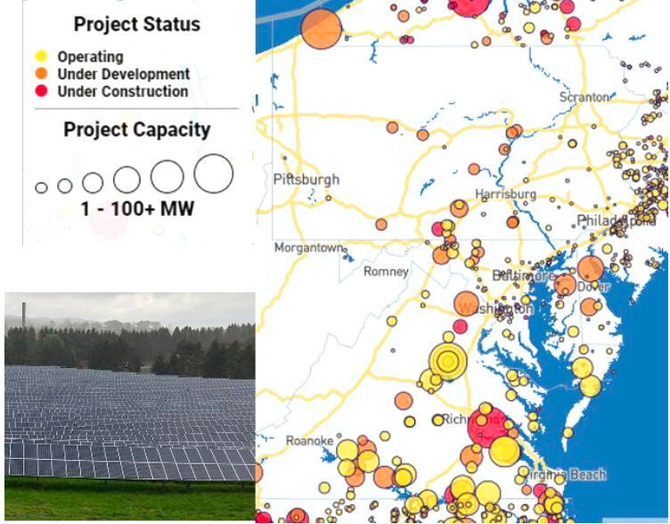
Why are we learning about solar development?
According to the Solar Energy Industries Association, the solar industry is set to quadruple over the next decade
Map of existing and proposed major solar projects with example photo
(Map/data source: SEIA 2022)

Slide 4
Why are we learning about solar development?
The Chesapeake Bay Program recognized the need to utilize their scientific, modeling, monitoring and planning capabilities to prioritize the communities, working lands and habitats that are most vulnerable to the risks of a changing climate
The 2021 Chesapeake Executive Council: Directive No. 21-1 Collective Action for Climate Change
2022 Bay 101 Climate Change video

Slide 5
What challenges make large-scale solar development controversial?
Land use changes for forests and agricultural lands
Erosion from site affecting nearby streams and properties
Change in viewscape, nuisance glare from panels
Perceived or feared decline in nearby property values

Slide 6
What is the connection between solar development and local water quality?
Siting on agricultural lands that could be used for sustainable farming that provides food and healthy soils that capture carbon
Siting on forested lands that clean air, capture carbon, filter water, control erosion, and sustain biodiversity, habitat and recreation
Erosion and sediment control during construction
Post - construction stormwater runoff from impervious surface of solar arrays and surrounding land

Slide 7
What is the connection between solar development and local water quality?
Some Chesapeake Bay Watershed Agreement goals and outcomes that could be impacted by large scale solar development without careful siting and stormwater management considerations:
Forest Buffers Outcome
Protected Lands Outcome for wetlands and forest lands
Stream Health Outcome
Water Quality and 2025 Watershed Implementation Plan (WIP) Outcome

Slide 8
What is the connection between solar development and local water quality?
According to an April 2022 Bay Journal article entitled, More than 800 solar projects in Bay states stuck waiting for review
Bay states have adopted aggressive climate-change mitigation policies that rely on renewable energy
Solar made up more than half of all new electricity generated in the United States during the first three quarters of 2021, according to the Solar Energy Industries Association
There will be a proposed fast-tracked process to relieve the log jam of reviews

Slide 9
What is the connection between solar development and local water quality?
Solar projects waiting for review
Maryland: 48 projects, potential power capacity of 2,502 megawatts (enough to power 410,000 homes)
Pennsylvania: 443 projects, potential power capacity of 8,854 megawatts (enough to power 1.4 million homes)
Virginia: 416 projects, potential power capacity of 22,679 megawatts (enough to power 3.7 million homes)

Slide 10
What is the connection between solar development and local water quality?
The Issue:
While renewable energy is a positive move toward reducing greenhouse gasses from fossil fuels to address climate change impacts on the Chesapeake Watershed, is the recent boom in solar farms increasing the challenge to meet water quality goals in unintended but avoidable ways?

Slide 11
What the panel aims to uncover
Objective: Understand the trends and drivers of large-scale solar development, the associated water quality impacts and some best practices to protect local water quality.

Slide 12
What the panel aims to uncover
Section One: Research & Science
Land Consumption
Local Opposition
Co-location
State and local tensions
Competing Policies
Examples of Ordinances & Recommended Practices to protect water quality
Section Two: Perspectives
Snapshot of issues in VA/MD/PA from a state agency level
Industry insights
Section Three: Tours

